Slide 1
OP-AMP APPLICATIONS
The summing amplifier, Differential and instrumentation amplifiers, Voltage to current and current to voltage conversion, The Op-amp with complex impedances, Differentiators and integrators.

Slide 2
Summing amplifier (Adder)
One of the important application of an Operational Amplifier is the Summing Amplifier or otherwise known as Adder.
As the name suggests, a Summing Amplifier is an Op-amp based circuit where multiple input signals of different voltages are added.
Summing amplifiers are of 2 types.
1.Inverting summing amplifier
2. non-inverting summing amplifier

Slide 3
Inverting summing amplifier
Many applications in electronic circuits requires two or more signals to be added or combined into a single output.
Summing amplifier is also called as Voltage adder since its output is the addition of voltages present at its input terminal.
Summing amplifier uses an inverting amplifier configuration, i.e. the input is applied to the inverting input terminal of the op-amp, while the non-inverting input terminal is connected to ground.
Due to this configuration, the output voltage is out of phase with respect to the input by 180º.

Slide 4
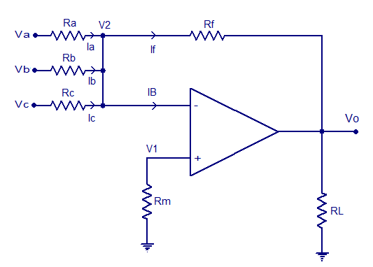
Circuit of inverting summing amplifier

Slide 5
Analysis of inverting summing amplifier
I
In the circuit, the input signals V_{a} , V_{b} , V_{c} are applied to the inverting input of the op-amp through input resistors R_{a} , R_{b} , R_{c} .Any number of input signals can be applied to the inverting input in the above manner. R_{f} is the feedback resistor , R_{L} is the load resistor.Non inverting input of the op-amp is grounded using R_{m} resistor. By applying kirchhoff’s current law at node V₂ we get,
I_{a} + I_{b} + I_{c} = I_{f} + I_{b}
Since the input resistance of an ideal op-amp is close to infinity and has infinite gain. We can neglect I_{b} , no current flows into the op-amp.
Therefore I_{a} + I_{b} + I_{c} = I_{f} ……….(1)
Now V₁ is grounded , hence V₂ is at virtual ground.
Hence V₂ = 0

Slide 6
Equation (1) can be rewritten as
(V_{a} - 0) /R_{a} + (V_{b}- 0)/R_{b} + (V_{c}- 0)/R_{c} = (0 - V₀)/R_{f} we get (V_{a}/R_{a}) + (V_{b}/R_{b})+ (V_{c}/R_{c}) = -V₀/R_{f}
Vo = -R_{f} ((V_{a}/R_{a}) + (V_{b}/R_{b})+ (V_{c}/R_{c}))
Vo = - {(R_{f}/R_{a} )V_{a} + (R_{f}/R_{b}) V_{b} + (R_{f}/R_{c}) V_{c} }……..(2)
If resistor R_{a}, R_{b}, R_{c} has same value i.e. R_{a}=R_{b}=R_{c}=R, then equation (2) can be written as
V₀ = - (R_{f}/R) x (V_{a} + V_{b} +V_{c})…………….(3)
If the values of R_{f} = R , then the o/p voltage becomes,
V₀ = - (V_{a} + V_{b} + V_{c})-----------------(4)
This indicates that the output voltage is the sum of the input voltages and is inverted i.e. out of phase with the input signal.

Slide 7
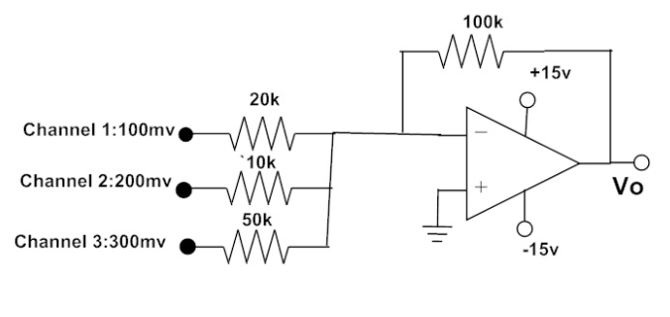
Voltage Adder Example

Slide 8
The closed loop voltage gains of each channel can be calculated as shown below
A_{CL1} = – (R_{f} / R₁) = – (100kΩ / 20kΩ) => A_{CL1} = -5
A_{CL2} = – (R_{f} / R₂) = – (100kΩ / 10kΩ) => A_{CL2} = -10
A_{CL3} = – (R_{f} / R₃) = – (100kΩ / 50kΩ) => A_{CL3} = -2
The output voltage of the inverting summing amplifier is given as,
V_{OUT} = – (A_{CL1} V₁ + A_{CL2} V₂ + A_{CL3} V₃)
= – [(5x 100mV) + (10x200mV) + (2x300mV)]
= – (0.5 V + 2 V + 0.6 V)
V_{OUT} = – 3.1 V

Slide 9
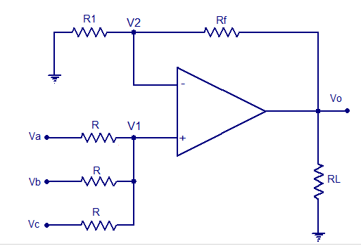
Non-inverting summing amplifier

Slide 10
Analysis of Non-inverting summing amplifier
Using super position theorem we can find the total output voltage, V₀ = V_{0a} + V_{0b} + V_{0c}
V₀ = (1+ R_{f} /R₁ ). {V_{a}R/2 + V_{b}R/2 + V_{c}R/2 } / (R + R/2)
V₀ = (1+ R_{f} /R₁ ). (V_{a}/3 + V_{b}/3 + V_{c}/3)
By selecting R_{f} =2R₁
Then V₀ = ( V_{a} + V_{b} + V_{c} )
We can conclude that the output voltage is sum of the three input voltages without any polarity change or in phase with the input voltages.

Slide 11
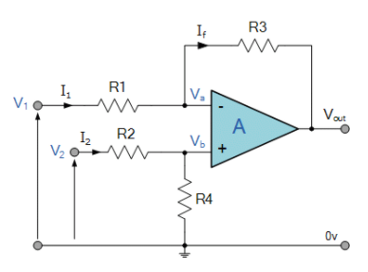
Differential amplifier (difference amplifier- subtractor) with one op-amp

Slide 12
Analysis of differential amplifier
Using super position theorem we can find the total output voltage, V₀ = V₀₁ + V₀₂
V₀ = - (R₃/ R₁) x V₁ + (1+ R₃ /R₁ ). V₂ (R₄ / R₂ +R₄ )
By selecting R₁ =R₂ = R₃ =R₄
Then V₀ = V₂ – V₁
We can conclude that the output voltage is the difference of the input voltages.

Slide 13
Instrumentation amplifier
1.In many industrial , biomedical and consumer applications the measurement and control of physical conditions are very important like temperature , humidity , light intensity , water flow , pressure , bio electric potentials ,etc.
2. All these are measured by transducers , sensors and be amplified to drive indicators , display devices or processors , etc.
3. So we require high gain , high input impedance , low output impedance , high CMRR ,high slew rate and low power consumption amplifiers.
4. Hence an instrumentation amplifier is designed to amplify weak signals , added with noise with low thermal and time drifts .
5. Basically, the Instrumentation Amplifiers like µA 725 , ICL 7605 ,
LH 0036 ,INA 101 , PGA 201 are used.

Slide 14
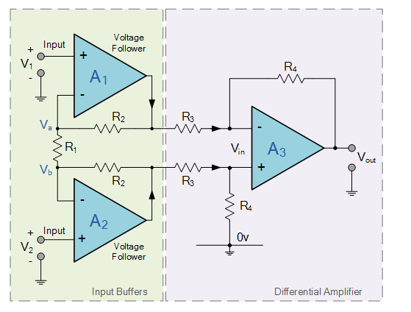
Design of Instrumentation amplifier

Slide 15
Analysis of Instrumentation amplifier
In the instrumentation amplifier circuit we can have two stages with three op-amps.
First two op-amps (A₁ , A₂ ) acts as buffer amplifiers to provide high input impedance.
The last op-amp(A₃ ) acts as differential amplifier with some gain (R₄ / R₃ )
Let a current of “ I “ flows from V_{b} to V_{a}

Slide 16
In this circuit V_{b} = V₂ and V_{a} = V₁ ,
(because of virtual short concept )
Then the current I = ( V_{b} - V_{a} ) / R₁ = ( V₂ - V₁ ) / R₁
Let the output voltages of A₂ as V₀₂ and A₁ as V₀₁
Then V₀₂ = V₂ + IR₂ = V₂ + (( V₂ - V₁ ) / R₁) x R₂
V₀₁ = V₁ – IR₂ = V₁ - (( V₂ - V₁ ) / R₁) x R₂
Finally the o/p voltage V_{out} = (R₄ / R₃) (V₀₂ – V₀₁)
= (R₄ / R₃) { V₂ + (( V₂ - V₁ ) / R₁) x R₂ - [ V₁ - (( V₂ - V₁ ) / R₁) x R₂ ]}
V_{out} = ( V₂ - V₁ )x ( 1+ 2 R₂ / R₁ ) x(R₄ /R₃)

Slide 17
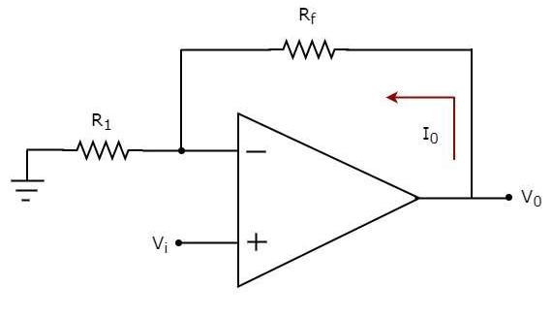
Voltage to current converter

Slide 18
V- I converter
It is also called transconductance amplifier.
An op-amp based voltage to current converter produces an output current when a voltage is applied to its non-inverting terminal.
an input voltage V_{i} is applied at the non-inverting input terminal of the op-amp. According to the virtual short concept, the voltage at the inverting input terminal of an op-amp will be equal to the voltage at its non-inverting input terminal . So, the voltage at the inverting input terminal V_{f} of the op-amp will be V_{i}

Slide 19
Analysis of V- I converter
Applying KCL at inverting i/p terminal ,
V_{in} / R₁ - I₀ = 0
V_{in} / R₁ = I₀
Hence I₀ α V_{in}
Applications :
1. Low voltage ac and dc voltmeters.
2.Diode match finders
3.LED’s and Zener diode testers.
Drawbacks :
If larger currents are required we can use a power op-amp or a low power op-amp with an output current booster.

Slide 20
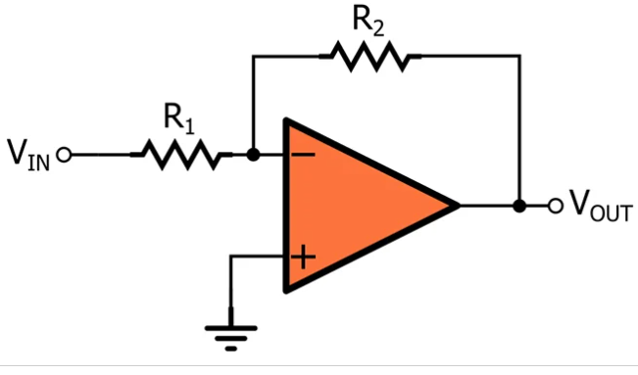
Current to voltage converter

Slide 21
Analysis of I- V Converter
Let us consider an inverting amplifier.
The o/p voltage is given by
V_{out} = ( - R_{F}/ R₁ ) V_{IN}
Then V_{out} = - R_{F} ( V_{IN} / R₁ )
We may write i_{in} = ( V_{IN} / R₁ )
Hence V_{out} = - R_{F} i_{in}
Therefore V_{out} α i_{in}
i.e. o/p voltage is proportional to i/p current
so we may redraw the ckt in the next slide.

Slide 22
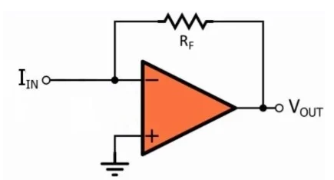
Current to Voltage converter using op-amp

Slide 23
Current to Voltage converter using op-amp
Applications :
1.To detect current from photodetectors ,
photomultipliers.
2. Digital to Analog converters.
Sensitivity = A_{f} = voltage gain
= change in o/p voltage/ change in i/p current
= ΔV₀ / ΔI_{in}
= - R_{f}
Drawback :
It has low sensitivity.

Slide 24
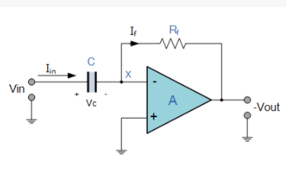
Ideal Differentiator

Slide 25
Analysis of differentiator
The basic op-amp differentiator circuit produces an output signal which is the first derivative of the input signal.
Applying KCL at node X ,
I_{in} = I_{B} + I_{f} , but I_{B} is very small ,
Hence I_{in} = I_{f}
But I_{in} = C { d/dt (V_{in} – 0 )} and I_{f} = (0 - V_{out} )/ R_{f}
Therefore C d/dt (V_{in} – 0 ) = (0 - V_{out} )/ R_{f}
C d (V_{in} ) /dt = - V_{out} / R_{f}
V_{out} = - CR_{f} d (V_{in}) /dt
i.e. the output voltage is the differentiation of the input voltage

Slide 26
The voltage gain of differentiator circuit is
A_{v} = - Z_{f} / Z₁ = - R_{f} / ( 1 / jωC₁)
= - jωR_{f}C₁ = I ωR_{f} C₁ I
Drawbacks :
1.When the voltage gain is unity, A_{v} = 1
I ωR_{f} C₁ I = 1
Then the differentiator becomes unstable and break into oscillations.
2.Even the input impedance (Z₁ = 1/jωC₁) decreases with the increase of input signal frequency.
3.This makes the the circuit sensitive to high frequency noise. So the ideal differentiator is not suitable to practical applications, hence we have to consider practical differentiator.

Slide 27
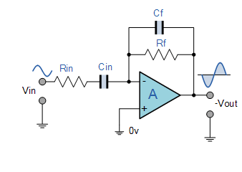
Practical differentiator

Slide 28
Analysis of Practical differentiator
Voltage gain = A_{v} = V₀ / V_{i} = - Z_{f} / Z₁
= - ( R_{f} II C_{F} ) / (R₁ + JωC₁ )
= - ( JωR_{F}C₁ )/ (1 + JωR_{F}C_{F} )(1 + jωR₁C₁ )
When R_{f}C_{f} = R₁C₁
A_{v} = - jωR_{f}C₁ / (1 + jωR₁C₁ )²
I A_{V} I = ω R_{f}C₁ /(1+ ω²R²C²)
For good differentiator the time period ( T ) of i/p signal ,
T ≥ R_{f}C₁
Advantage of practical Differentiator :
1. It is more stable.
2. it eliminates high frequency noise.

Slide 29
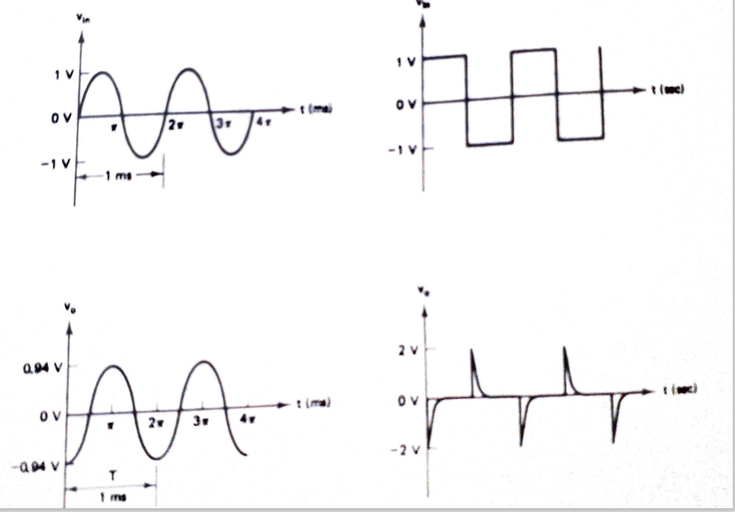
Waveforms of Differentiator Circuit

Slide 30
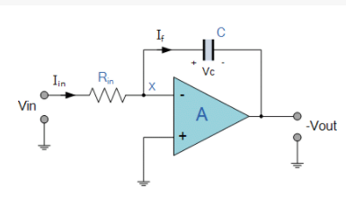
Ideal integrator

Slide 31
Analysis of Ideal integrator
The op-amp based integrator produces an output voltage that is both proportional to the amplitude and duration of the input signal.
Applying KCL at node X ,
I_{in} = I_{B} + I_{f} , but I_{B} is very small ,
Hence I_{in} = I_{f}
Therefore (v_{I} – 0 )/ R₁ = C d/dt (0 – V₀ )
dV₀ /dt = - V_{i} / CR_{in}
V₀ = - ( 1/ CR_{in} )ʃ V_{i} + k
Where k is integration constant
Finally V_{o}(s) = - (1/ sCR_{in}) x V_{i} (s)
Voltage gain A_{v} = V₀(s) / V_{i}(s) = - (1 / sCR_{in} ) = (1/ ωCR_{in} )

Slide 32
Drawback of Ideal integrator :
when frequency = 0 then , A_{v} is very high .
hence the circuit will go into open-loop op-amp, and the output goes to saturation.
Applications :
1. Signal wave shaping circuits.
2. Analog to Digital converters.
3. Analog computers.

Slide 33
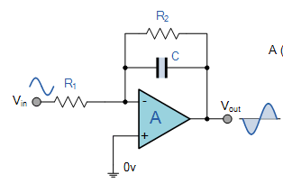
Lossy or Practical integrator

Slide 34
Analysis of practical integrator
Voltage gain (A_{v}) = V₀ / V_{i}
= - Z_{f} / Z_{i}
= - (R₂II C) / R₁
= - (R₂ / R₁) x { 1/ (1+ jωCR₂)}

Slide 35
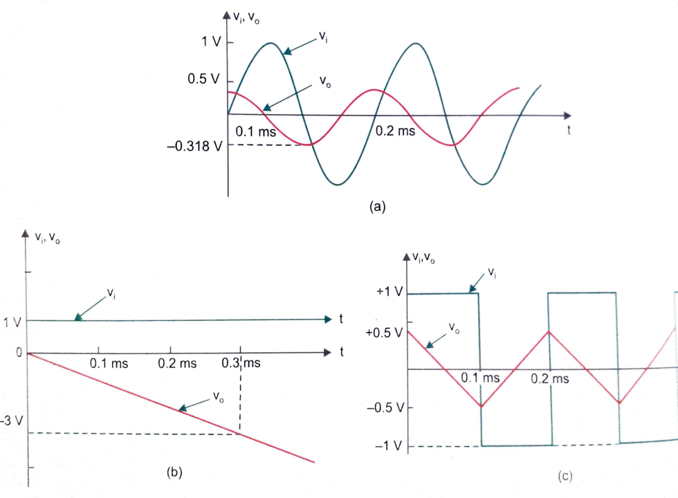
Waveforms of Integrator Circuit

