Slide 1
BAPATLA ENGINEERING COLLEGE :: BAPATLA
(Autonomous)
Deep Learning (20ECJ44)
By
Dr. Naga Raju Challa
Assistant Professor,
Department of ECE,
Bapatla Engineering College,
(Autonomous)
Bapatla.

Slide 2
Machine Learning Basics

Slide 3
Learning Algorithms
A machine learning algorithm is an algorithm that is able to learn from data.
Definition: A computer program is said to learn from experience E with respect to some class of tasks T and performance measure P, if its performance at tasks in T, as measured by P, improves with experience E.
Task: A task is a specific problem or objective that the algorithm is designed to solve or perform.
Performance Measure: A performance measure is a metric or evaluation criteria used to assess how well a learning algorithm is performing on a specific task or dataset.
Experience: An experience is the process of gaining knowledge and practical skills in the field of machine learning and artificial intelligence, particularly in the context of designing, implementing, and optimizing algorithms that enable computers to learn from data and make predictions or decisions.

Slide 4
Machine Learning Tasks
The most common machine learning tasks are as follows:
Classification: Classification involves categorizing data inputs into predefined classes or categories. Let us consider an example whose input vector
Where is the features of a vector.
To solve this task, the learning algorithm is usually asked to produce a function
When
Examples: Logistic Regression, Decision Trees, Support Vector Machines, and Neural Networks. Applications include spam email detection, image classification, and sentiment analysis.
Regression: It is a statistical technique used in data analysis and machine learning to model the relationship between a dependent variable and one or more independent variables (also known as predictors or features). The goal of regression analysis is to understand how changes in the independent variables are associated with changes in the dependent variable.
$$x∈ℝ^{n}$$
$$x_{i}$$
$$f:ℝ^{n}→\left\{1,2...,k\right\}$$
$$y=f\left(x\right)$$

Slide 5
Machine Learning Tasks
The most common machine learning tasks are as follows:
Transcription
Machine translation
Structured output
Anomaly detection
Synthesis and sampling
Imputation of missing values
Denoising
Density estimation or probability mass function estimation:

Slide 6
Learning Models
Supervised Learning Models: In supervised learning, models are trained on labeled data, where each input is associated with a corresponding target or output. Common algorithms include linear regression, decision trees, support vector machines, and deep neural networks. These models learn to map inputs to outputs and can be used for tasks like classification and regression.
Unsupervised Learning Models: Unsupervised learning models work with unlabeled data and aim to discover patterns, structures, or relationships within the data. Clustering algorithms like k-means and hierarchical clustering, as well as dimensionality reduction techniques like Principal Component Analysis (PCA), are examples of unsupervised learning models.
Reinforcement Learning Models: In reinforcement learning, agents learn to make sequential decisions in an environment to maximize a reward signal. These models are used in applications such as game playing, robotics, and autonomous systems. Popular reinforcement learning algorithms include Q-learning and deep reinforcement learning algorithms like DQN and A3C.

Slide 7
Learning Models
Semi-Supervised Learning Models: Semi-supervised learning combines elements of both supervised and unsupervised learning. These models use a small amount of labeled data and a larger amount of unlabeled data to improve learning performance.
Self-Supervised Learning Models: Self-supervised learning is a type of unsupervised learning where models generate their own labels from the data itself. For example, in natural language processing, models might learn to predict missing words in a sentence or generate contextually relevant representations of words or phrases.
Transfer Learning Models: Transfer learning involves pre-training a model on one task or dataset and then fine-tuning it for another related task. This approach can save time and resources when training models and is commonly used in deep learning, such as with pre-trained convolutional neural networks (CNNs) for image classification.

Slide 8
Learning Models
Neural Network Architectures: Deep learning models, which are a subset of neural networks, have gained prominence in recent years. These models consist of multiple layers of interconnected artificial neurons and are particularly well-suited for tasks involving large amounts of data, such as image and speech recognition. Popular architectures include convolutional neural networks (CNNs) for computer vision and recurrent neural networks (RNNs) for sequence data.

Slide 9
Maximum Likelihood Estimation
To obtain a more convenient but equivalent optimization problem, we observe that taking the logarithm of the likelihood does not change its arg max but does conveniently transform a product into a sum

Slide 10
Maximum Likelihood Estimation
However, the arg max does not change when we rescale the cost function, we can divide by m to obtain a version of the criterion that is expressed as an expectation with respect to the empirical distribution defined by the training data
One way to interpret maximum likelihood estimation is to view it as minimizing the dissimilarity between the empirical distribution defined by the training set and the model distribution, with the degree of dissimilarity between the two measured by the KL divergence. The KL divergence is given by

Slide 11
Properties of Maximum Likelihood Estimation
The true distribution pdata must lie within the model family pmodel(·; θ). Otherwise, no estimator can recover pdata .
The true distribution pdata must correspond to exactly one value of θ. Otherwise, maximum likelihood can recover the correct pdata , but will not be able to determine which value of θ was used by the data generating processing.

Slide 12
Building a Machine Learning Algorithm
Building a machine learning algorithm involves several steps and considerations.
Define the Problem
Data Collection
Data Preprocessing
Feature Engineering
Model Selection
Model Training
Model Evaluation
Monitoring and Maintenance
Documentation and Reporting
Security

Slide 13
Feedforward Neural Network
Source: NPTEL IIT KGP

Slide 14
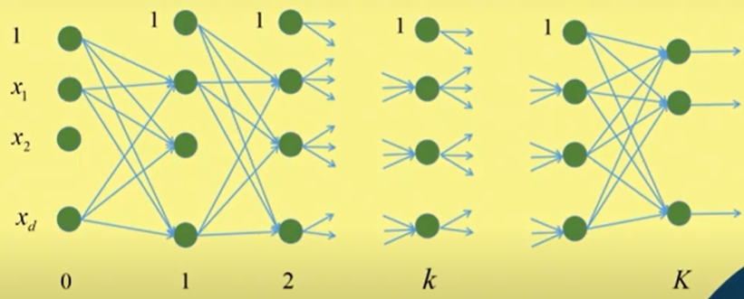
Multilayer Feedforward Network
Source: NPTEL IIT KGP

Slide 15
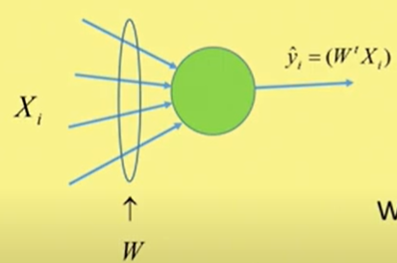
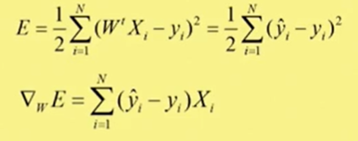
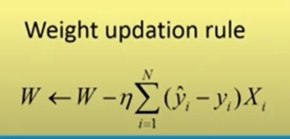
Back Propagation Algorithm
$$η=rate of convergence factor$$
Source: NPTEL IIT KGP

Slide 16
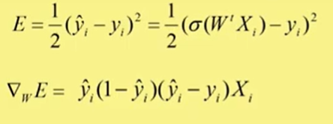
Back Propagation Algorithm

Slide 17
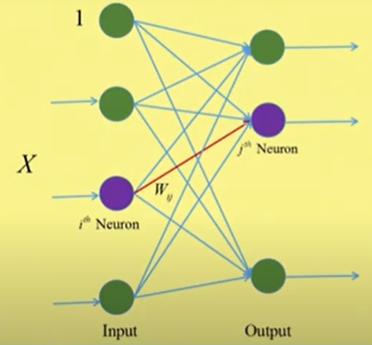
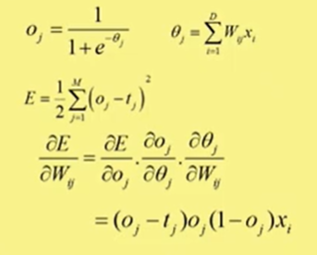
Back Propagation Algorithm & Stochastic gradient decent
Source: NPTEL IIT KGP

Slide 18
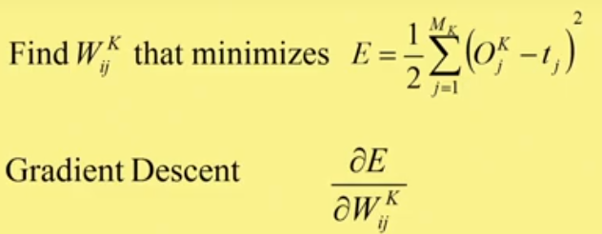
Back Propagation Algorithm: Output Layer
Source: NPTEL IIT KGP

Slide 19
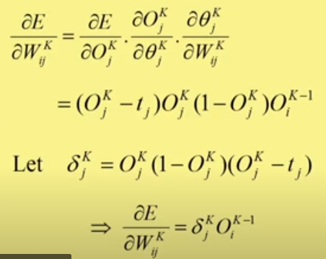
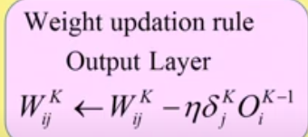
Back Propagation Algorithm: Output Layer
Source: NPTEL IIT KGP

Slide 20
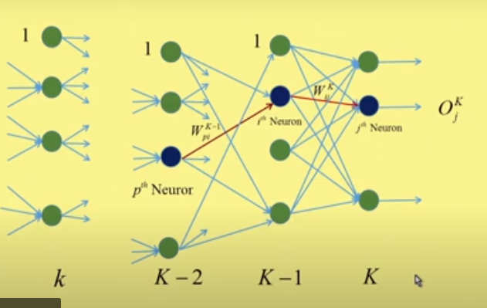
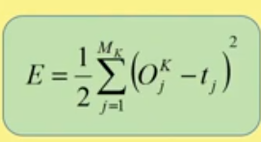
Back Propagation Algorithm: Hidden Layer
Source: NPTEL IIT KGP

Slide 21
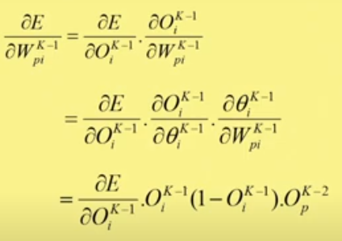
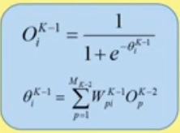
Back Propagation Algorithm: Hidden Layer
Source: NPTEL IIT KGP

Slide 22
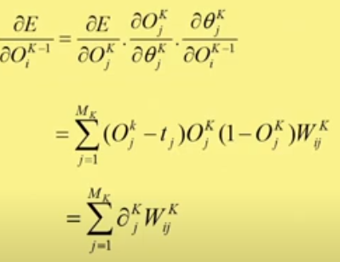
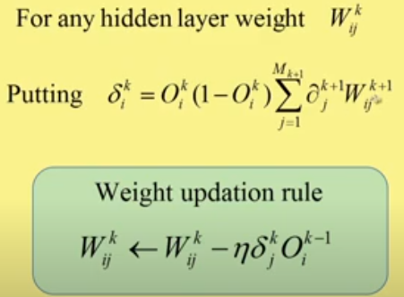
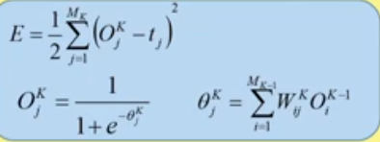
Back Propagation Algorithm: Hidden Layer
Source: NPTEL IIT KGP

Slide 23
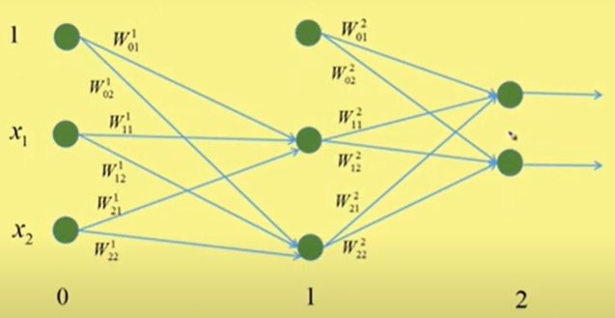
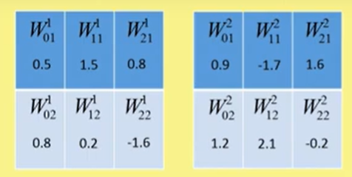
Multilayer Perceptron: Example
Source: NPTEL IIT KGP

Slide 24
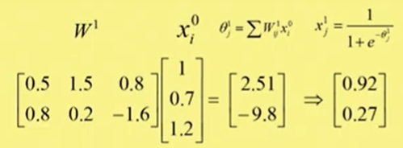
Multilayer Perceptron: Example
Source: NPTEL IIT KGP

Slide 25
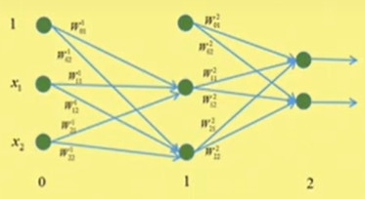
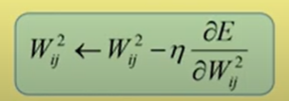
Back Propagation: Example
Source: NPTEL IIT KGP

Slide 26
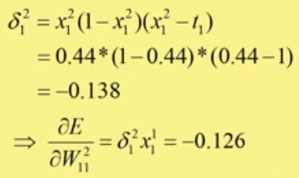
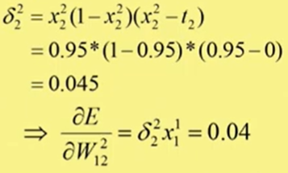
Back Propagation: Example
Source: NPTEL IIT KGP

Slide 27
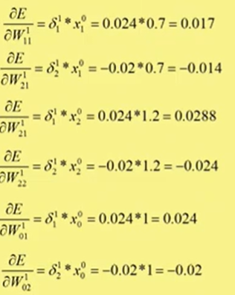
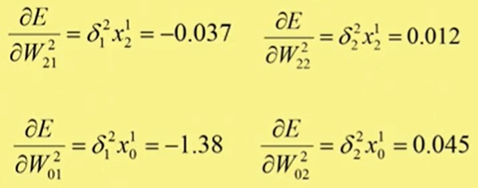
Back Propagation: Example
Source: NPTEL IIT KGP

Slide 28
The Curse of Dimensionality
Many machine learning problems become exceedingly difficult when the number of dimensions in the data is high. This phenomenon is known as the curse of dimensionality.
Various key points that understand the curse of dimensionality is as follows:
Increasing Dimensionality
Data Sparsity
Computational Complexity
Overfitting
Data Collection and Storage
Curse Mitigation

