Slide 1
BAPATLA ENGINEERING COLLEGE :: BAPATLA
(Autonomous)
Deep Learning (20ECJ44)
By
Dr. Naga Raju Challa
Assistant Professor,
Department of ECE,
Bapatla Engineering College,
(Autonomous)
Bapatla.

Slide 2
UNIT- III
Convolutional Neural Networks

Slide 3
Motivation
The motivation behind designing CNNs is rooted in the need to effectively process and extract features from structured grid data, with a particular emphasis on images, leading to improvements in various computer vision tasks.
Here some of the key motivations for the development of CNNs.
Local Connectivity
Parameter Sharing
Translation Invariance
Feature Hierarchy
Reduction of Spatial Dimensions
Effective Parameterization
Success in Image Recognition
Transfer Learning

Slide 4
Motivation towards CNN
Parameter | Description
Local Connectivity | Images exhibit a hierarchical structure with local patterns and features. Traditional fully connected neural networks do not consider the spatial relationships between pixels, resulting in a large number of parameters and inefficient learning of local patterns. CNNs, with their convolutional layers, take advantage of the local connectivity, allowing the network to learn features using shared weights.
Parameter Sharing | CNNs use parameter sharing through the convolutional operation. A single set of weights (filter) is applied to different parts of the input image. This reduces the number of parameters in the network, making it more efficient and easier to train. Parameter sharing also helps in learning translation-invariant features.
Translation Invariance | CNNs are designed to be translation-invariant, meaning they can recognize patterns regardless of their position in the input. This is achieved through the use of convolutional and pooling layers, enabling the network to capture and recognize features regardless of their spatial location.

Slide 5
Motivation towards CNN
Parameter | Description
Feature Hierarchy | CNNs automatically learn hierarchical representations of features. The early layers capture basic features like edges and textures, while deeper layers learn more complex and abstract features. This hierarchical feature extraction is crucial for tasks such as image recognition and object detection.
Reduction of Spatial Dimensions | Pooling layers in CNNs help in reducing the spatial dimensions of the feature maps, making the computation more tractable and decreasing the risk of overfitting. Pooling layers also help in maintaining the invariance to small translations.
Effective Parameterization | CNNs are designed to be effective in parameterization, meaning they can learn complex representations with a relatively small number of parameters compared to fully connected networks. This is especially important for tasks involving large input data like high-resolution images.

Slide 6
Motivation towards CNN
Parameter | Description
Success in Image Recognition | CNNs have demonstrated remarkable success in image recognition tasks, such as the ImageNet Large Scale Visual Recognition Challenge. Their ability to automatically learn and extract hierarchical features from images has contributed to their widespread adoption in computer vision applications.
Transfer Learning | CNNs are well-suited for transfer learning, where a pre-trained model on a large dataset (e.g., ImageNet) can be fine-tuned for a specific task with a smaller dataset. This is particularly valuable when labeled data for a specific task is limited.

Slide 7
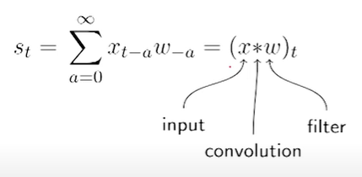
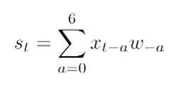
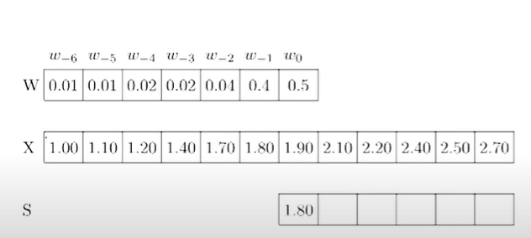
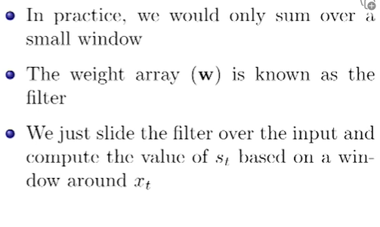
Convolutional Neural Network Layers (CNN Layers)

Slide 8
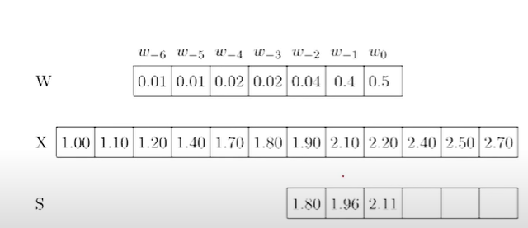
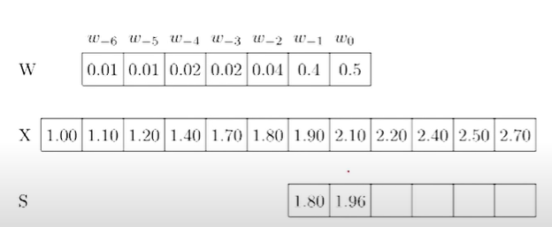
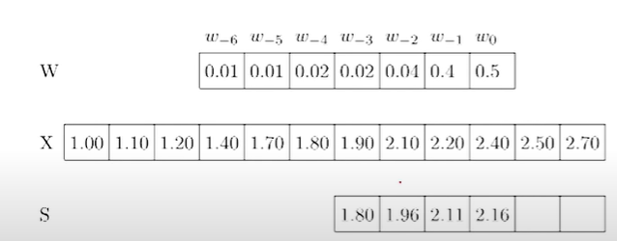
Convolutional Neural Network Layers (CNN Layers)
For 3 entry:
For 1 entry:
For 2 entry:
For 4 entry:

Slide 9
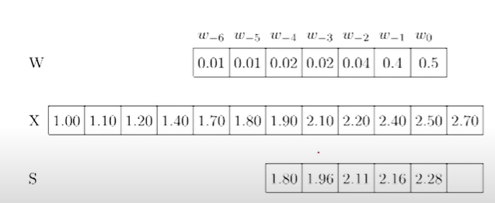
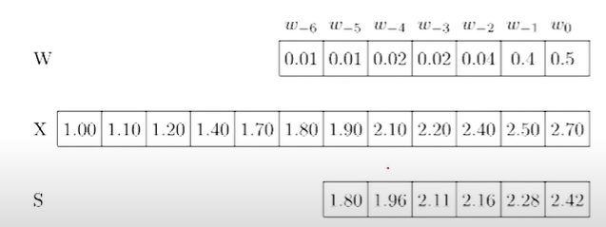
Convolutional Neural Network Layers (CNN Layers)
This convolution is for 1-D vectors.
The mathematical expression for convolution is defined as
For 5 entry:
For 6 entry:

Slide 10
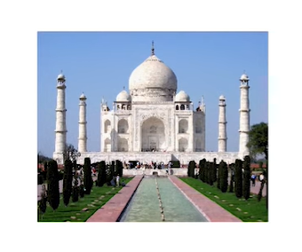
Convolutional Neural Network Layers (CNN Layers)
Let us consider for 2-D vector i.e., image

Slide 11
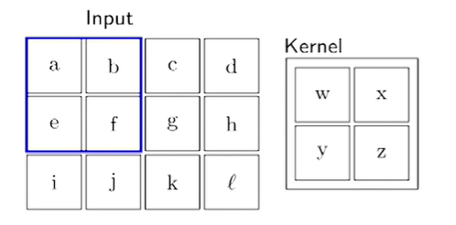
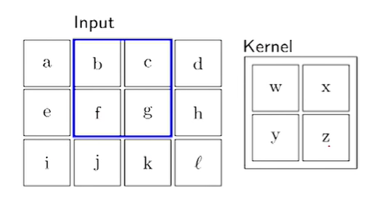
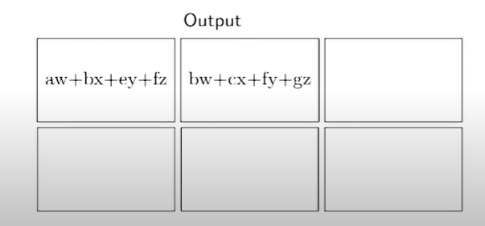
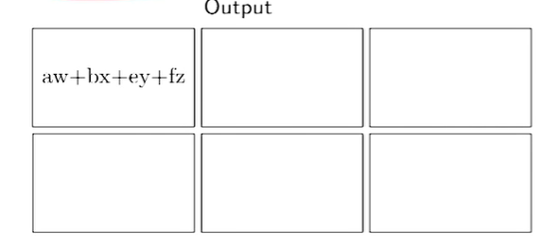
Convolutional Neural Network Layers (CNN Layers)

Slide 12
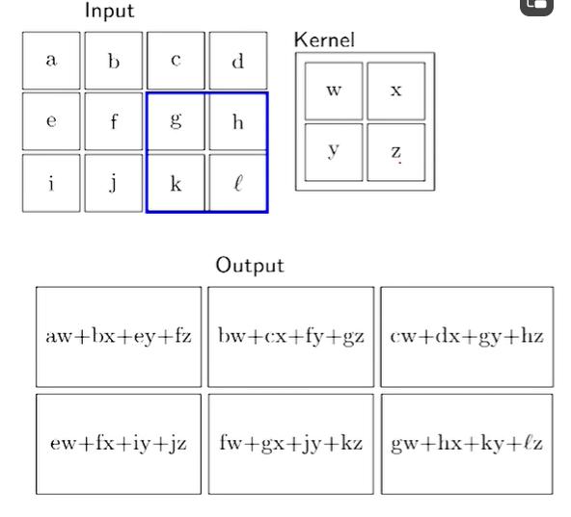
Convolutional Neural Network Layers (CNN Layers)

Slide 13
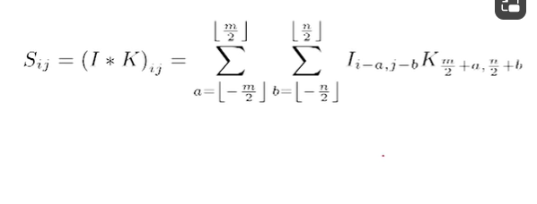
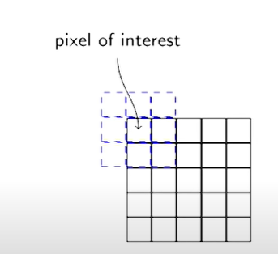
Convolutional Neural Network Layers (CNN Layers)
For the rest of the discussion we use the following formula for the convolution.
In other words the kernel is center on the pixel of interest.
So we will be looking at both preceding and succeeding neighbors.

Slide 14
Convolutional Neural Network Layers (CNN Layers)
The resulting image should be blurred, because we are taking the average
?

Slide 15
Convolutional Neural Network Layers (CNN Layers)
?
The resulting image should be sharpen.

Slide 16
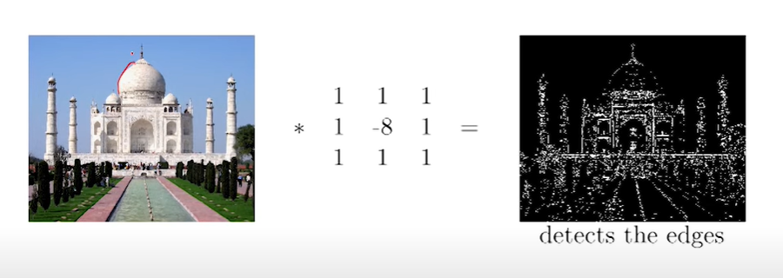
Convolutional Neural Network Layers (CNN Layers)
?
The resulting image should be detects the edges.

Slide 17
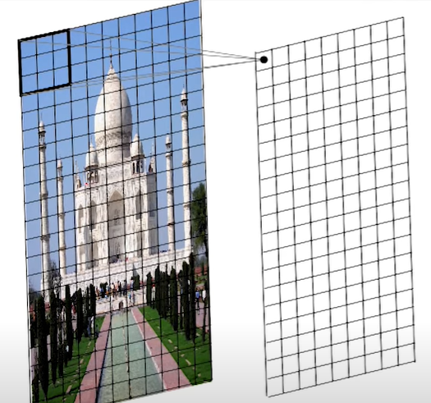
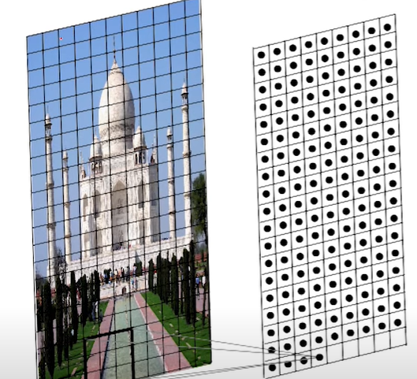
Convolutional Neural Network Layers (CNN Layers)
The size of the image is , because RGB
The resulting output is known as feature map
If we use multiple filters, multiple feature maps can be extracted
$$n×n×3$$

Slide 18
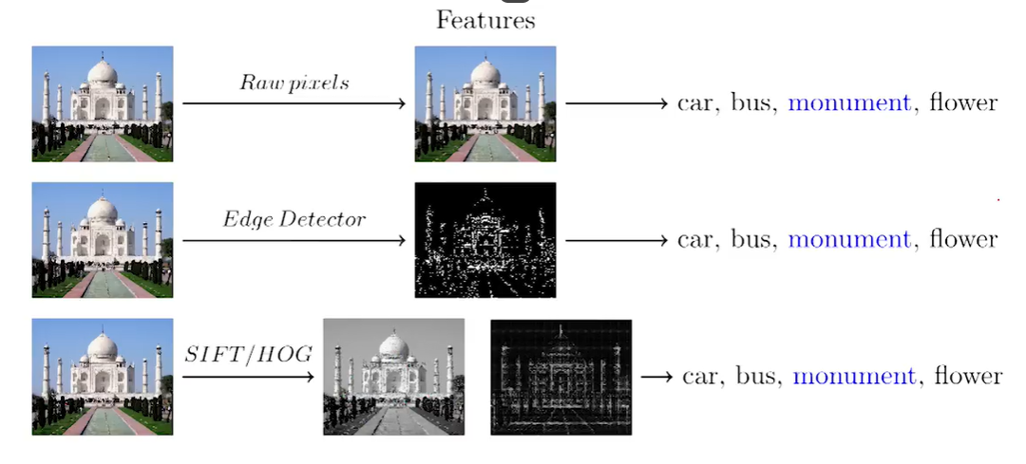
Convolutional Neural Network Layers (CNN Layers)
What is the connection between convolution and neural networks?
We will try to understand this by assuming the “Image classification”
(Machine Learning Algorithm)

Slide 19
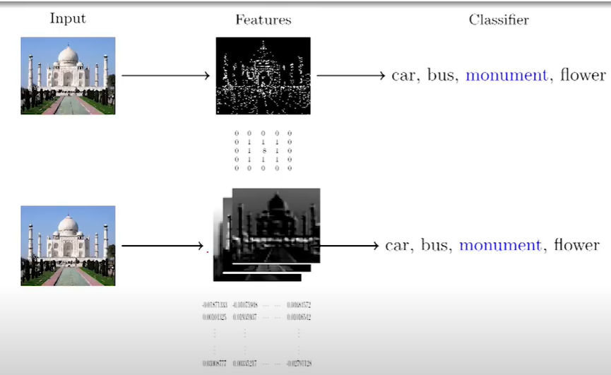
Convolutional Neural Network Layers (CNN Layers)
Instead of using hand crafted kernels such as edge detector can we learn for meaningful kernel/filter in addition to learn the weights of the classifier?

Slide 20
Convolutional Neural Network Layers (CNN Layers)

Slide 21
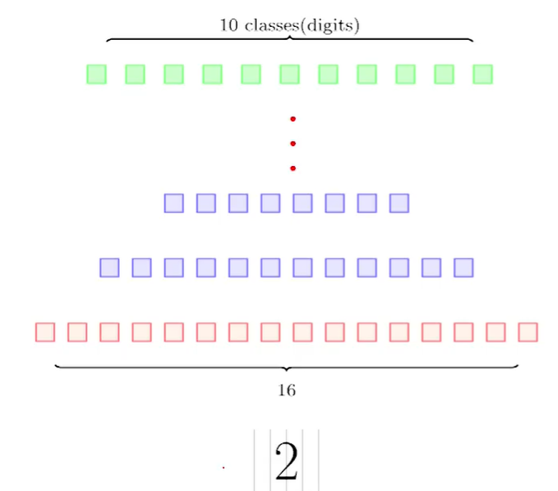
Convolutional Neural Network Layers (CNN Layers)

Slide 22
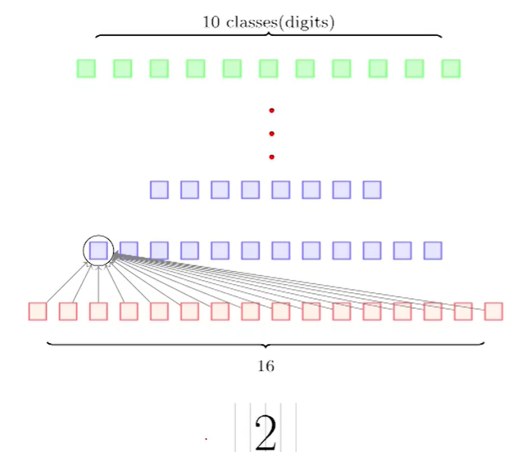
Convolutional Neural Network Layers (CNN Layers)
General Feedforward Neural Network

Slide 23
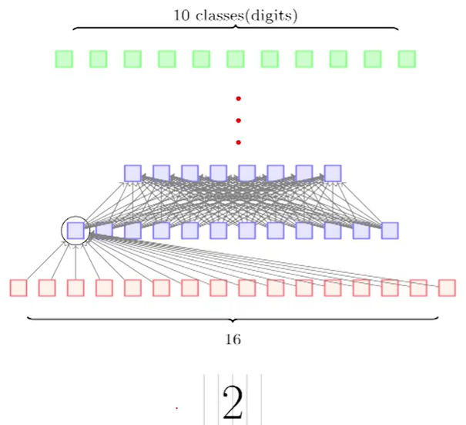
Convolutional Neural Network Layers (CNN Layers)
General Feedforward Neural Network

Slide 24
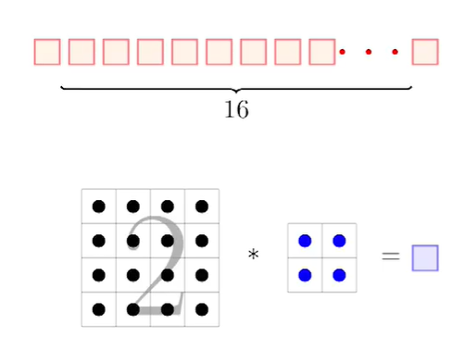
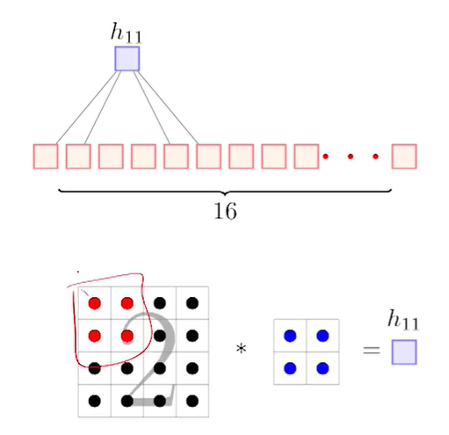
Convolutional Neural Network Layers (CNN Layers)
Convolutional Neural Network

Slide 25
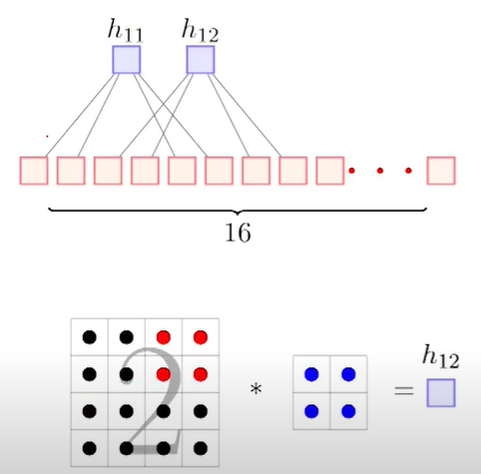
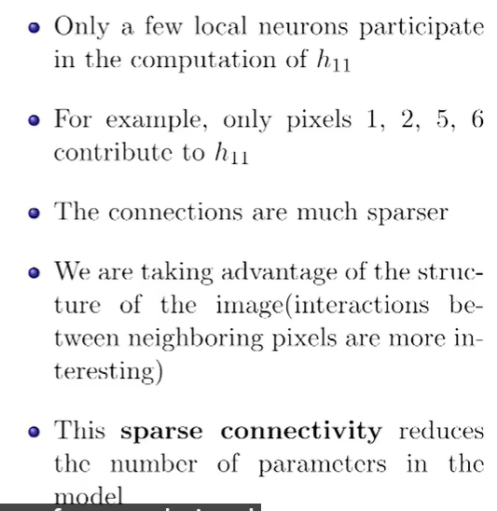
Convolutional Neural Network Layers (CNN Layers)
Convolutional Neural Network

Slide 26
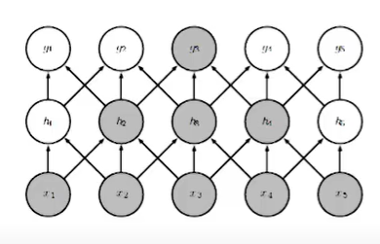
Sparse Connectivity

Slide 27
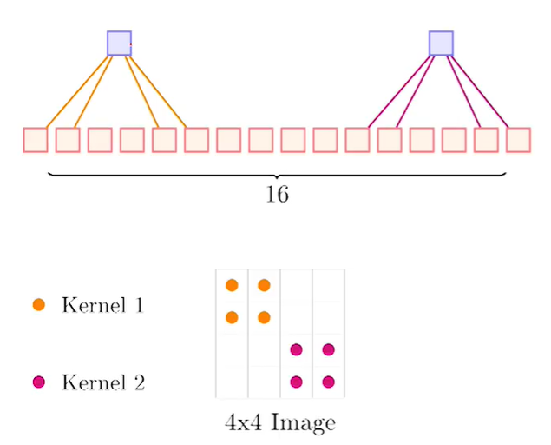
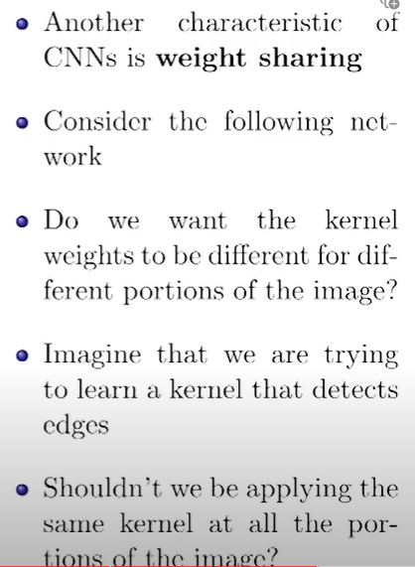
Weight Sharing

Slide 28
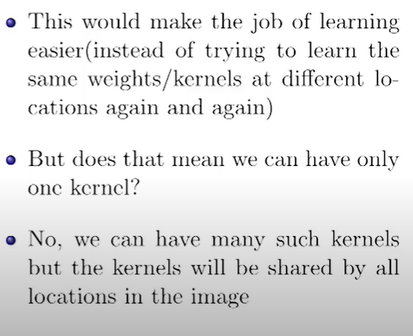
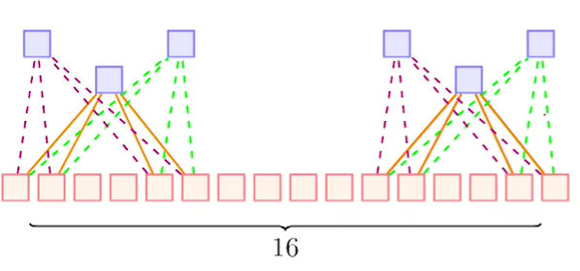
Weight Sharing

Slide 29
Fully Connected CNN

Slide 30
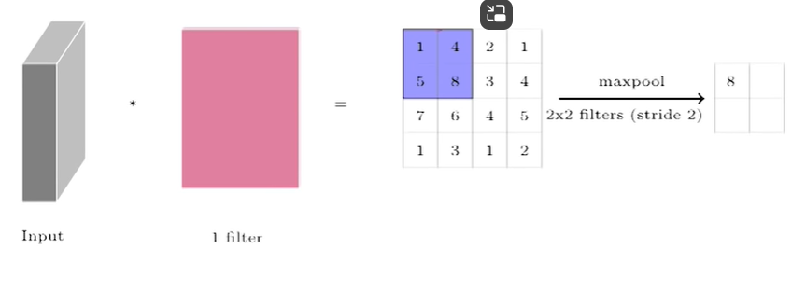
MaxPooling

Slide 31
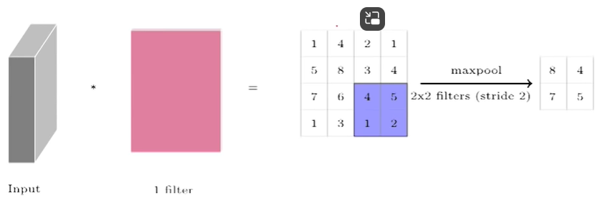
MaxPooling

Slide 32
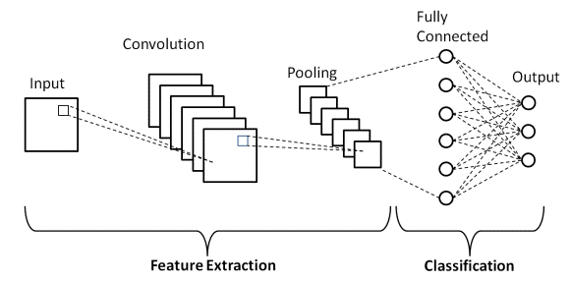
Convolutional Neural Network Layers (CNN Layers)
Fig 3.1: Basic Architecture of CNN

Slide 33
CNN Layers
Convolutional Neural Networks (CNNs) are a class of deep neural networks that are particularly effective in computer vision tasks, such as image recognition and classification. CNNs are composed of layers with specific functions. The common layers that are found in a typical convolutional neural network as follows.
Input Layer:
The input layer represents the raw input data, such as an image. Each neuron in this layer corresponds to a pixel in the input image.
Convolutional Layer:
This layer applies convolutional operations to the input data. Convolutional operations involve sliding a filter (also called a kernel) over the input to perform local feature extraction. The result is a feature map that highlights important patterns in the input.

Slide 34
CNN Layers
Activation Layer (ReLU - Rectified Linear Unit)
After the convolutional operation, an activation function is applied element-wise to introduce non-linearity. The Rectified Linear Unit (ReLU) is a common activation function used in CNNs.
Pooling (Subsampling or Down-sampling) Layer
Pooling layers are used to reduce the spatial dimensions of the feature maps. Max pooling, for example, takes the maximum value from a group of neighboring pixels, effectively down sampling the data.
Fully Connected (Dense) Layer
Fully connected layers connect every neuron in one layer to every neuron in the next layer. In CNNs, these layers are often used at the end of the network for classification tasks.
Flatten Layer
Before connecting to fully connected layers, the feature maps are often flattened into a one-dimensional vector. This is necessary because fully connected layers require one-dimensional input.

Slide 35
CNN Layers
Dropout Layer
Dropout is a regularization technique where a random set of neurons are ignored during training. This helps prevent overfitting by promoting redundancy in the network.
Batch Normalization Layer
Batch normalization normalizes the input of a layer by adjusting and scaling the activations. This can speed up training and improve the overall stability of the neural network.
These layers are typically stacked together to form the architecture of a CNN.
The convolutional and pooling layers are responsible for extracting features from the input data, and the fully connected layers are responsible for making predictions or classifications based on these features.
The arrangement and number of these layers can vary depending on the specific architecture of the CNN. Popular CNN architectures include AlexNet, VGGNet, GoogLeNet, and ResNet.
Source: NPTEL IIT KGP

Slide 36
Filters in CNN
Filters also known as kernels in CNN and it plays a crucial role in the convolutional layers.
Filters are small, learnable matrices that slide over the input data to perform the convolution operation.
The purpose of filters is to detect patterns and features in the input data, such as edges, textures, or more complex structures.
Each filter learns to recognize different features through the training process.
Working of Filters in CNN
Convolution Operation
The filter is slid over the input data, and at each position, it computes the dot product between its weights and the values in the input volume. This process results in a feature map that highlights the presence of certain features in the input.
Stacking Filters
CNNs typically use multiple filters in each convolutional layer. Each filter specializes in detecting different patterns. For example, one filter might be designed to detect edges in a certain orientation, while another might focus on texture patterns.

Slide 37
Working of Filters in CNN
Depth of Filters
The number of filters in a convolutional layer determines the depth of the layer. Each filter produces a separate feature map, and the depth of the layer is equal to the number of filters used. The depth increases the network's ability to capture and learn diverse features.
Learnable Parameters
The weights of the filters are learnable parameters, meaning they are adjusted during the training process through backpropagation and gradient descent. The network learns to optimize these weights to improve its ability to recognize important features for the given task.
Size of Filters
The size of the filters (usually a small square, like 3x3 or 5x5) determines the size of the local region they analyze. Smaller filter sizes are common because they allow the network to capture more local features and reduce the number of parameters, making the model computationally more efficient.
Stride
The stride defines how much the filter moves across the input data in each step. A larger stride reduces the size of the output feature map, while a smaller stride increases its size. Stride is a hyperparameter that influences the spatial dimensions of the feature maps.

Slide 38
Working of Filters in CNN
Stride
The stride defines how much the filter moves across the input data in each step. A larger stride reduces the size of the output feature map, while a smaller stride increases its size. Stride is a hyper parameter that influences the spatial dimensions of the feature maps.
Filters can combine with activation functions (such as ReLU) and pooling layers, enable CNNs to learn hierarchical representations of features in the input data.
As the network goes deeper, it learns more abstract and complex features, making it capable of understanding and recognizing intricate patterns in the data.
The weights of the filters are adjusted during training to minimize the error in the network's predictions.

Slide 39
Parameter Sharing in CNN
Parameter sharing is a key concept in Convolutional Neural Networks (CNNs) that contributes to the efficiency and effectiveness of these networks, particularly in image recognition tasks. The idea behind parameter sharing is to use the same set of parameters (weights and biases) for multiple units in a layer.
In the context of CNNs, parameter sharing is primarily applied to the filters (kernels) used in convolutional layers. However, It works on
Shared Weights
In a convolutional layer, a filter is used to perform convolutional operations on the input data. Instead of having separate weights for each position in the input, the same set of filter weights is shared across the entire input. This means that the filter slides over the input, and the same weights are used at every position.
Local Receptive Fields
Each unit in the feature map (output of the convolutional layer) is responsible for a small local region in the input known as the receptive field. The weights of the filter are applied to this local region, and by sliding the filter, the same weights are applied to different local regions across the entire input.

Slide 40
Parameter Sharing in CNN
Pooling Layers and Subsampling
In addition to parameter sharing in convolutional layers, pooling layers are often used to reduce the spatial dimensions of the feature maps. Pooling involves downsampling the feature maps by taking the maximum or average value within local regions. This further reduces the computational load and helps create a spatial hierarchy of features.
Benefits
Reduced Memory Usage: Since the same set of parameters is used across the entire input, parameter sharing reduces the number of parameters compared to fully connected layers. This leads to a significant reduction in memory requirements and helps manage computational complexity.
Translation Invariance: Parameter sharing allows the network to be invariant to translation. In other words, the network can recognize the same pattern regardless of where it appears in the input. This is particularly useful for tasks like image recognition where the location of a feature in an image shouldn't affect its recognition.
Feature Detection: Shared weights enable the filters to learn generic feature detectors that can recognize patterns in different spatial locations. This is crucial for capturing hierarchical representations of features in the input data.

Slide 41
Regularization in CNN
Regularization is an important concept in machine learning, including Convolutional Neural Networks (CNNs).
Regularization techniques are employed to prevent overfitting, which occurs when a model learns to perform well on the training data but fails to generalize to new, unseen data. Overfitting is a common concern, especially when dealing with complex models and limited datasets.
Regularization techniques used in CNNs
Dropout: Dropout is a widely used regularization technique. During training, random units (neurons) are "dropped out" or set to zero with a certain probability. This helps prevent co-adaptation of neurons, making the network more robust and reducing overfitting.
Weight Regularization (L1 and L2 regularization): L1 and L2 regularization involve adding a penalty term to the loss function based on the magnitude of the weights. L1 regularization adds the sum of the absolute values of the weights, while L2 regularization adds the sum of the squared values. This discourages the model from learning overly complex patterns and helps prevent overfitting.
Batch Normalization: While primarily used to normalize inputs, batch normalization also has a regularization effect. It introduces a small amount of noise during training, which can act as a form of regularization and help prevent overfitting.

Slide 42
Regularization in CNN
Data Augmentation: Data augmentation involves applying random transformations to the training data, such as rotations, flips, and shifts. This artificially increases the size of the training dataset, helping the model generalize better to unseen data.
Early Stopping: Monitoring the model's performance on a validation set during training and stopping the training process when the performance starts to degrade is a form of regularization. This helps prevent the model from fitting the training data too closely and overfitting.
Drop Connect: Drop Connect is an extension of Dropout, where instead of dropping out individual neurons, entire connections between layers are dropped with a certain probability. This can be applied to the weights in convolutional layers.
Ensemble Methods: Training multiple models and combining their predictions can also act as a form of regularization. Each model may learn different aspects of the data, and combining them helps improve generalization.
The choice of regularization techniques depends on the specific characteristics of the dataset and the complexity of the model. Often, a combination of these techniques is used to achieve the best results in terms of preventing overfitting while still allowing the model to learn useful patterns from the data.

Slide 43
Regularization in CNN
Data Augmentation: Data augmentation involves applying random transformations to the training data, such as rotations, flips, and shifts. This artificially increases the size of the training dataset, helping the model generalize better to unseen data.
Early Stopping: Monitoring the model's performance on a validation set during training and stopping the training process when the performance starts to degrade is a form of regularization. This helps prevent the model from fitting the training data too closely and overfitting.
Drop Connect: Drop Connect is an extension of Dropout, where instead of dropping out individual neurons, entire connections between layers are dropped with a certain probability. This can be applied to the weights in convolutional layers.
Ensemble Methods: Training multiple models and combining their predictions can also act as a form of regularization. Each model may learn different aspects of the data, and combining them helps improve generalization.
The choice of regularization techniques depends on the specific characteristics of the dataset and the complexity of the model. Often, a combination of these techniques is used to achieve the best results in terms of preventing overfitting while still allowing the model to learn useful patterns from the data.

Slide 44
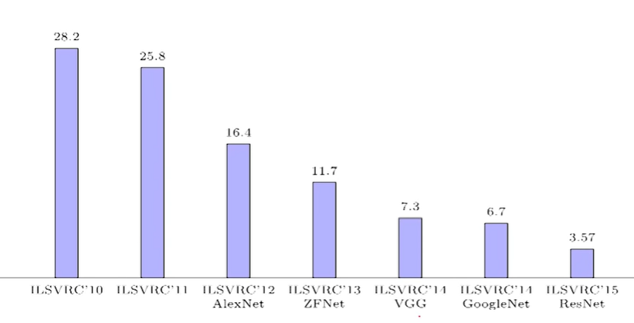
AlexNet

Slide 45
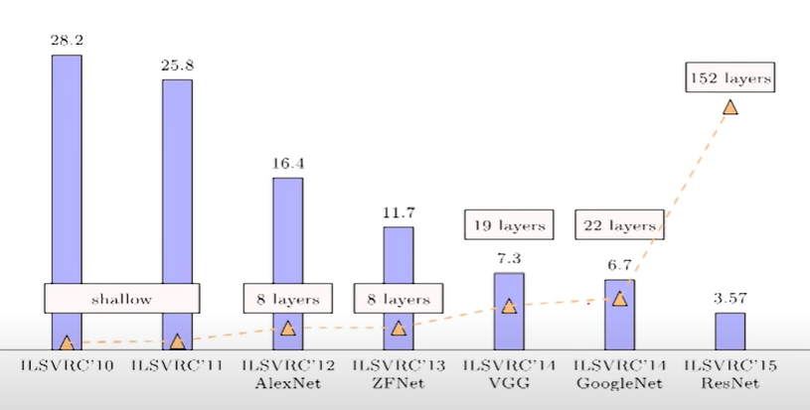
AlexNet

Slide 46
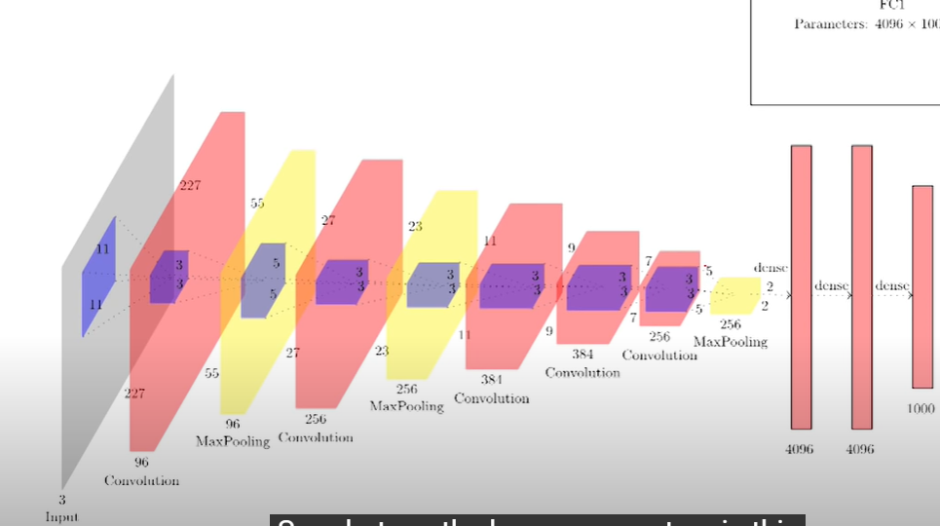
AlexNet

Slide 47
AlexNet
AlexNet is a convolutional neural network (CNN) architecture designed for image classification tasks. It was developed by Alex Krizhevsky, Ilya Sutskever, and Geoffrey Hinton, and it won the ImageNet Large Scale Visual Recognition Challenge (ILSVRC) in 2012, marking a breakthrough in the field of deep learning.
The key characteristics of AlexNet is as follows:
Architecture: AlexNet consists of eight layers of learnable parameters, including five convolutional layers, followed by three fully connected layers. The convolutional layers are designed to capture hierarchical features in the input images.
Rectified Linear Units (ReLU): AlexNet uses the rectified linear unit activation function (ReLU) throughout most of its layers. ReLU introduces non-linearity to the network, helping it learn complex patterns in the data.
Local Response Normalization (LRN): Local Response Normalization is applied after the first and second convolutional layers. It normalizes the responses across different feature maps, enhancing the network's generalization ability.

Slide 48
AlexNet
Overlapping Max-Pooling: Max-pooling is used for down-sampling in the spatial dimensions. Unlike traditional pooling methods, AlexNet uses overlapping pooling, meaning that the pooling regions have some overlap. This helps in capturing more spatial hierarchies.
Dropout: To prevent overfitting, AlexNet incorporates dropout regularization in the fully connected layers. Dropout randomly drops a certain percentage of neurons during training, forcing the network to learn more robust features.
Large-Scale Training: AlexNet was one of the first neural networks to be trained on a large-scale dataset, specifically the ImageNet dataset, which contains millions of labeled images. The massive scale of the dataset and the computational power required for training contributed to the success of AlexNet.
GPU Acceleration: AlexNet's successful implementation was made possible, in part, by the use of Graphics Processing Units (GPUs) for parallelizing the training process. This significantly reduced training time compared to using traditional Central Processing Units (CPUs).

Slide 49
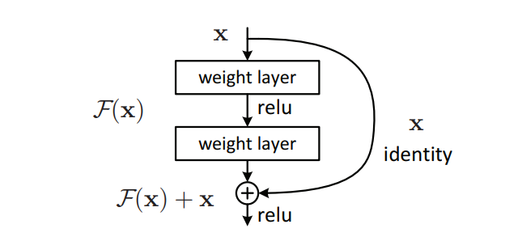
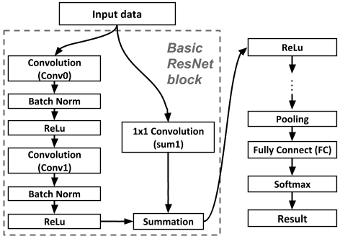
RESNET
Block Diagram of RESNET

Slide 50
RESNET
ResNet, short for Residual Networks, is a type of deep neural network architecture that was designed to address the challenges of training very deep networks.
It was introduced by Kaiming He, Xiangyu Zhang, Shaoqing Ren, and Jian Sun in their paper "Deep Residual Learning for Image Recognition" in 2015.
The main innovation of ResNet is the use of residual blocks, which allow the network to learn residual functions instead of directly learning the desired underlying mapping.
This is achieved by introducing shortcut connections that skip one or more layers.
These shortcut connections enable the gradient to be easily propagated back through the network during training, addressing the vanishing gradient problem commonly encountered in deep networks.
The key features of ResNet is as follows:
Residual Blocks: The basic building block of a ResNet is the residual block. Each block consists of two main paths: the identity path, which passes the input directly to the next layer, and the residual path, which learns the residual mapping. The output of the block is the sum of these two paths.

Slide 51
RESNET
ResNet, short for Residual Networks, is a type of deep neural network architecture that was designed to address the challenges of training very deep networks.
It was introduced by Kaiming He, Xiangyu Zhang, Shaoqing Ren, and Jian Sun in their paper "Deep Residual Learning for Image Recognition" in 2015.
The main innovation of ResNet is the use of residual blocks, which allow the network to learn residual functions instead of directly learning the desired underlying mapping.
This is achieved by introducing shortcut connections that skip one or more layers.
These shortcut connections enable the gradient to be easily propagated back through the network during training, addressing the vanishing gradient problem commonly encountered in deep networks.
The key features of ResNet is as follows:
Residual Blocks: The basic building block of a ResNet is the residual block. Each block consists of two main paths: the identity path, which passes the input directly to the next layer, and the residual path, which learns the residual mapping. The output of the block is the sum of these two paths.

Slide 52
RESNET
Shortcut Connections: The shortcut connections, or skip connections, enable the gradient to be directly propagated through the network without passing through multiple layers. This helps in mitigating the vanishing gradient problem, making it easier to train very deep networks.
Deep Architectures: ResNet architectures are capable of being very deep, with models ranging from dozens to hundreds of layers. This depth is facilitated by the residual connections, allowing for effective training and optimization of extremely deep networks.
Batch Normalization: ResNet typically incorporates batch normalization, which helps in stabilizing and accelerating the training process by normalizing the inputs of each layer.
Global Average Pooling: Instead of using fully connected layers at the end of the network, ResNet often uses global average pooling to reduce spatial dimensions. This helps in reducing the number of parameters and preventing overfitting.
ResNet architectures have been widely used in various computer vision tasks, such as image classification, object detection, and segmentation.

Slide 53
Transfer Learning Techniques
In the context of Convolutional Neural Networks (CNNs), transfer learning has been particularly successful due to the ability of CNNs to learn hierarchical features.
Here are some common transfer learning techniques in CNN:
Feature Extraction: In feature extraction, a pre-trained CNN is used as a fixed feature extractor. The idea is to remove the last few layers of the pre-trained model, which are typically responsible for task-specific classification, and retain the earlier layers that have learned generic features. These features can then be used as input for a new classifier trained on the target task.
Fine-Tuning: Fine-tuning involves taking a pre-trained CNN and further training it on the target task. Instead of keeping the entire architecture fixed, as in feature extraction, fine-tuning allows the weights of some layers to be updated during training on the new task. This is especially useful when the target task is related to the original task, but there are some task-specific nuances.

Slide 54
Transfer Learning Techniques
Pre-trained Models: Many pre-trained CNN models are available and have been trained on large-scale datasets like ImageNet. Models like VGG, ResNet, Inception, and MobileNet are examples. Researchers and practitioners often use these models as starting points for their own tasks, leveraging the learned features and hierarchical representations.
Domain Adaptation: Domain adaptation focuses on transferring knowledge from a source domain to a target domain, where the distributions of data might be different. This is crucial when the labeled data in the target domain is limited. Techniques like adversarial training can be employed to align the feature distributions between the source and target domains.
Progressive Neural Networks: In progressive neural networks, the model is trained progressively on multiple tasks. Each new task involves the addition of new layers or units to the existing model. This allows the model to learn task-specific features while retaining knowledge from previous tasks.

Slide 55
Transfer Learning Techniques
Knowledge Distillation: Knowledge distillation involves training a smaller model (student) to mimic the behavior of a larger, well-established model (teacher). The idea is to transfer the knowledge captured by the teacher model to the smaller model, making it more efficient while retaining much of the performance.
Transfer learning can significantly reduce the amount of labeled data required for training a CNN on a new task, making it a powerful technique in scenarios where obtaining large labeled datasets is challenging.
The choice of transfer learning technique depends on factors such as the similarity between the source and target tasks and the amount of labeled data available for the target task.

Slide 56
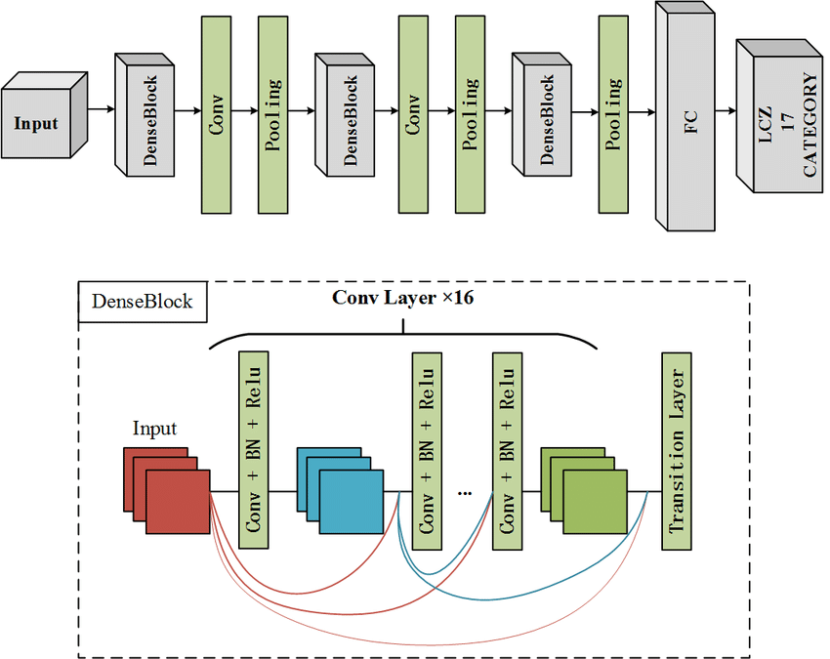
DenseNet

Slide 57
DENSENET
DenseNet is a neural network architecture introduced by Gao Huang, Zhuang Liu, and Kilian Q. Weinberger in the paper "Densely Connected Convolutional Networks" in 2017.
DenseNet addresses some challenges in traditional deep neural networks, such as the vanishing gradient problem and the need for a large number of parameters.
The Key features of DenseNet is as follows
Dense Blocks: The architecture introduces dense blocks where each layer is connected to every other layer in a feed-forward fashion. This dense connectivity allows for feature reuse, facilitates gradient flow, and helps in learning more compact representations.
Bottleneck Layers: Within dense blocks, bottleneck layers are employed to reduce the number of input feature maps, making the network more computationally efficient.

Slide 58
DENSENET
Transition Layers: Transition layers are used to control the growth of the network and reduce the spatial dimensions of the feature maps.
Global Average Pooling (GAP): DenseNet typically uses global average pooling instead of fully connected layers at the end of the network. This reduces the number of parameters and helps improve model generalization.
DenseNet architectures have demonstrated strong performance in image classification and other computer vision tasks.

Slide 59
PixelNet
PixelNet refers to a neural network architecture designed for semantic segmentation tasks, where the goal is to assign a class label to each pixel in an input image.
There might be some confusion here because "PixelNet" is not as widely recognized as some other architectures.
It's possible that you might be referring to "PixelNet: Representation of the pixels, by the pixels, and for the pixels" by Tsung-Yi Lin et al., which is a paper that proposed a method for object instance segmentation.

Slide 60
PixelNet
Key features of PixelNet:
Instance Embedding: PixelNet focuses on instance-level segmentation, embedding each pixel with instance-specific information to distinguish between different object instances.
Pixel Embedding Network: The architecture introduces a Pixel Embedding Network (PEN) to embed pixels with instance information, allowing the network to understand the relationships between pixels belonging to the same object instance.
Objectness Score: PixelNet incorporates an objectness score, which helps in distinguishing between object and non-object pixels, aiding in the segmentation process.

