Slide 1
CHAIN SURVEYING

Slide 2
Chain surveying (or linear surveying) is the method of land surveying in which only linear measurements are made. No angular measurements are taken.
Chain survey is suitable in the following cases:
(i) Area to be surveyed is comparatively small
(ii) Ground is fairly level
(iii) Area is open and
(iv) Details to be filled up are simple and less.
Principles of chain surveying
In chain surveying only linear measurements are made i.e. no angular measurements are made.
Since triangle is the only figure that can be plotted with measurement of sides only, in chain surveying the area to be surveyed should be covered with a network of triangles.

Slide 3
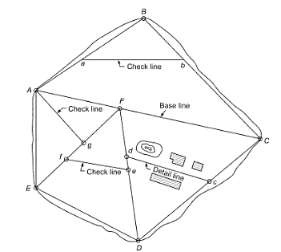
scheme of covering an area with a network of triangles. No angle of the network triangles should be less than 30º to precisely get plotted position of a station with respect to already plotted positions of other station.
As far as possible angles should be close to 60º. However, the arrangements of triangles to be adopted depends on the shape, topography, natural and artificial obstacles in the field.

Slide 4
Basic definitions in chain surveying
Main survey stations: Main survey stations are prominent points which are connected by survey lines to form the triangles.
These are the points at the beginning and at the ends of survey lines
Survey lines: The lines joining the main survey stations are called survey lines or chain lines.
Check lines: These are the lines which are run to check the accuracy of the frame work of the triangles.
The check line is not required for plotting the triangle.
Check lines are also called proof lines.

Slide 5
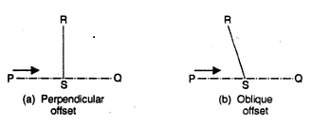
Offsets:
Lateral measurements to chain lines for locating ground features are known as offsets.
The offsets are of two types: (i) Perpendicular offsets.
(ii) Oblique offsets.
The perpendicular offset (or Simply offset) is perpendicular to the survey line or chain line.
It is a short measurement taken at right angles to the chain line to the point of detail.
The oblique offset (or Tie) is a short measurement inclined to the chain.

Slide 6
Range ties:
Rage ties are the oblique offsets taken along the line of the wall of a building.
Plus measurements:
These are the measurements of the building taken along its walls.
The plus measurements are useful for plotting the complete plan.
Tie lines (or) Detail lines (or) Subsidary lines:
If the important objects are far away from the main lines, the offsets are too long, resulting into inaccuracies and taking more time for the measurements. In such cases the secondary lines are run by selecting secondary stations on main lines. Such lines are called tie lines.

Slide 7
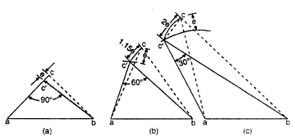
Subsidary stations:
These are the stations located on the survey lines between which the lines or subsidiary lines are run.
Base line:
The base line is long survey line which is run through the middle of the area to be surveyed.
The frame work of the triangles is built up on the base line.
The base line is also called a back-bone line.
Well-conditioned triangle:
For a well conditioned triangle no angle is less than 30º or more than 120º

Slide 8
Selection of survey stations and survey lines
For a good arrangement of survey lines, the following points should be kept in mind while selecting the main stations and survey lines
It should be visible from at least two or more stations.
As far as possible main lines should run on level ground.
All triangles should be well conditioned (No angle less than 30º or more than 120º ).
Main network should have as few lines as possible.
Each main triangle should have at least one check line.
Obstacles to ranging and chaining should be avoided.
Sides of the larger triangles should pass as close to boundary lines as possible.
If there are two base lines, they should intersect preferably in the form of the letter “X”

Slide 9
Field work in chain surveying
Reconnaissance
Marking stations
Running survey lines
Taking offsets
Plotting of a chain survey work ( Office Work )
After carrying field work next step in surveying is plotting to get plan of the area surveyed. It is carried out by the surveyor himself or the assistance of the draftsmen may be obtained.
Steps involved in plotting are as follows:
→ SCALE: Depending upon the are in the field and area of drawing sheet scale is decided. Normally, it is decided before the commencement of survey itself

Slide 10
ORIENTATION: Skeleton of the network of triangles should be drawn to a scale on a tracing sheet and the orientation of the plan on drawing sheet be decided. After the orientation is decided using the skeleton diagram on tracing sheet base line and stations are pricked.
DRAWING NETWORK OF TRIANGLES: First base line is drawn to the scale. By intersection other stations are fixed and main triangles are drawn. The network of triangles is checked using check lines.
PLOTTING OFFSETS: Any one of the following methods may be used-
Mark points along chain line and draw perpendicular with set square. If oblique offsets are taken, arcs are drawn from the respective positions on chain line and the position of the objects fixed up.

Slide 11
Main scale and offset scale may be used. Main scale is kept along direction of chain line and offset scale gives the perpendiculars to it.
OTHER DETAILS: If readings are taken to only one or two faces of buildings, using overall dimension outline of the building may be completed. Graphical scale should be plotted so that even if the paper shrinks, correct measurements may be obtained without calculations.

Slide 12
Conventional Colours
Roads- Burnt Sienna/Brown.
Buildings- Light Grey.
Compound wall- Indigo.
Water- Borders edged with Prussian blue.
Trees- Green.

Slide 13
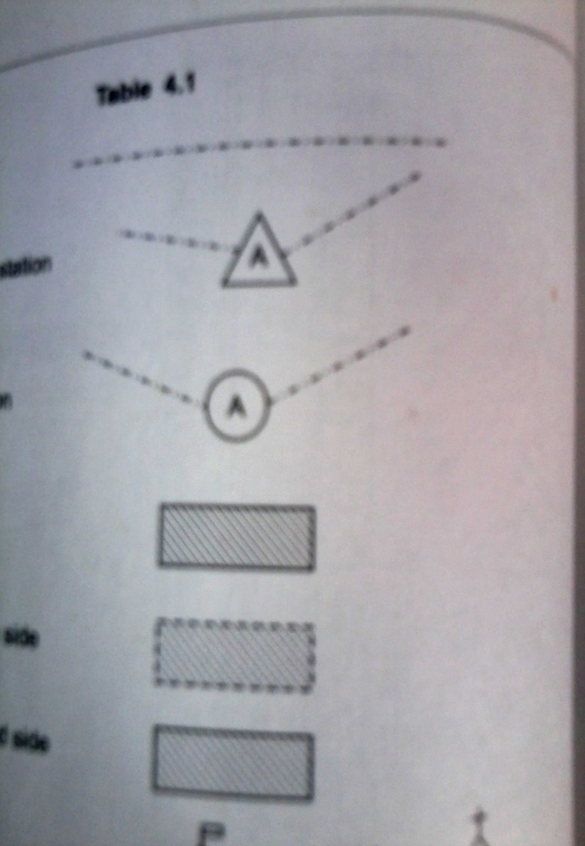
Conventional Symbols
Chain line
Triangulation
station
Traverse station
Building
Shed with open side
Shed with closed side

Slide 14
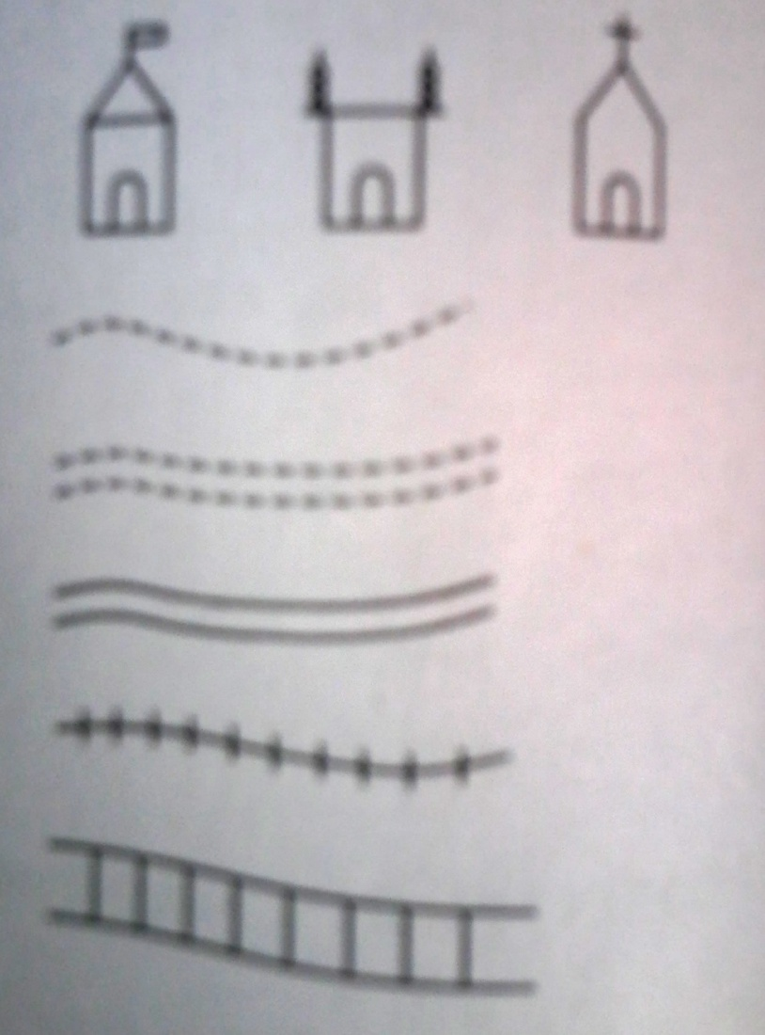
Temple, Mosque, Church
Path
Unfenced road
Fenced road
Railway line: Single
Railway line: Double
Road bridge

Slide 15
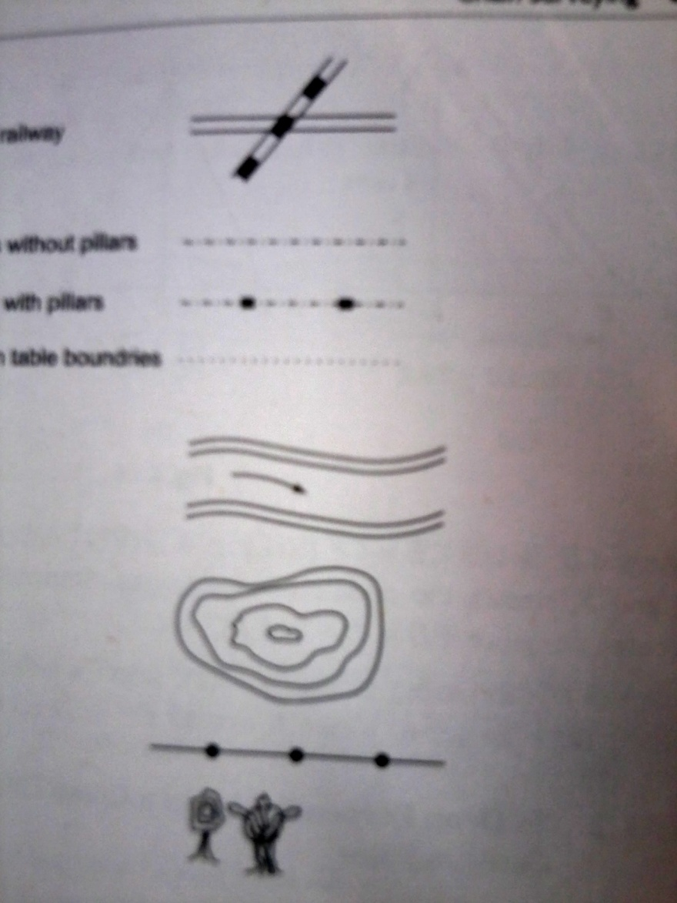
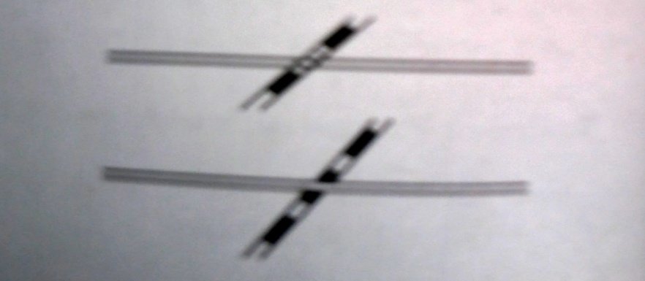
Level crossing
Road and railway
Boundary without pillar
Boundary with pillar
Township on table
boundary
River
Pond
Electric line
Tree

Slide 16
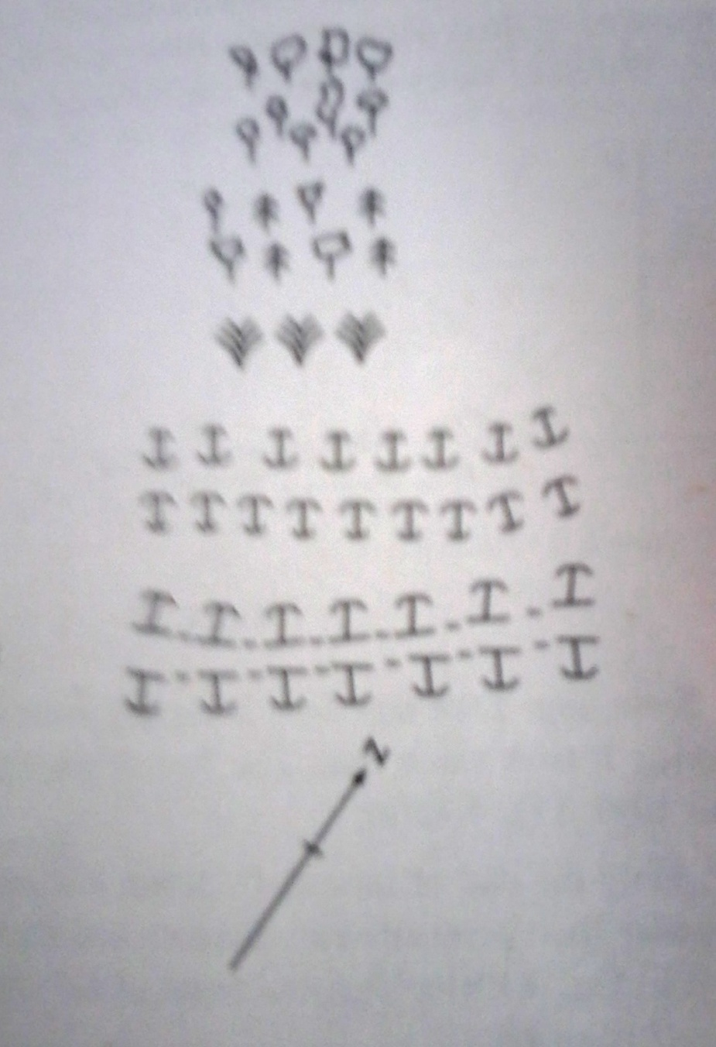
Orchard
Woods
Grass
Cutting
Embankment
North line

Slide 17
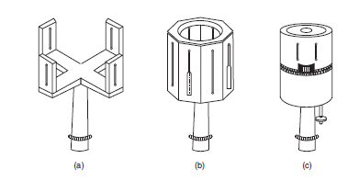
Cross staff
The cross staff is a simple instrument used for setting out offsets to the chain line from a given point.
Types of cross staff
Open cross staff
French cross staff
Adjustable cross staff

Slide 18
Obstacles in chaining ( Problems encountered in chain survey)
While chaining a survey line, some times various obstacles are encountered in the filed.
The obstacles are of various types
Chaining round the obstacle possible
Ex: A building, Small pond , a small bend in the river etc.
Chaining round the obstacle not possible
Ex: A long river across the survey line, Canal
Case (I): Chaining round the obstacle possible
Method I:

Slide 19
Method II Method III
Method IV Method V
Method VI

Slide 20
Case (II): Chaining round the obstacle not possible
Method I
E
A B
Method II
D
C
D
F
C
E
A
B

Slide 21
Method III
Method IV
D
θ
θ
C
A
B
D
B
A
C
E

Slide 22
Method V
G
F
E
B
C
A
B

Slide 23
Surveying chains
Metric chains
Non-metric chains
(i) Gunter’s chain (or) Surveyor’s chain
100 links 66ft 1 link = 0.66ft
(ii) Engineers chain
100 links 100ft 1 link = 1ft
(iii) Revenue chain
16 links 33ft 1 link = 2.06ft

Slide 24
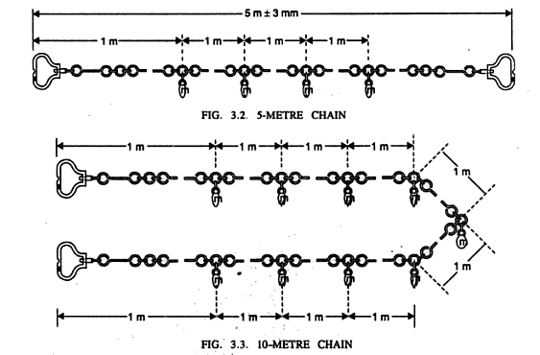
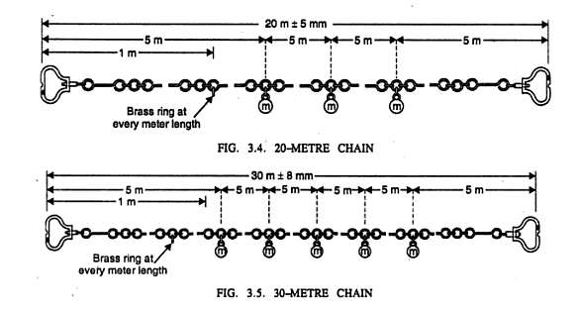

Slide 25
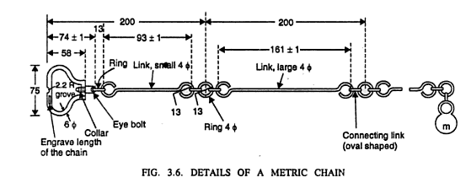
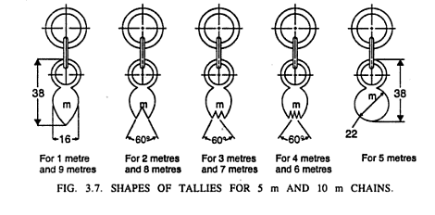

Slide 26
Ranging (or)Ranging out
When a survey line is longer than a chain length, it is necessary to align intermediate points on chain line so that the measurements are along the line. The process of locating intermediate points on survey line is known as ranging.
METHODS OF RANGING
There are basically 3 methods of ranging out
(i) Direct Ranging
(ii) Indirect Ranging
(iii) Random line method

Slide 27
Direct ranging
Direct ranging is done when the end stations are intervisible.
The direct ranging can be done by eye or with an instrument called a line ranger.
(i) Direct ranging by eye
If the first and last points are intervisible this method is possible.
The following Figure shows the intervisible stations A and B in which an intermediate point C is to be located.
Point C is selected at a distance slightly less than a chain length. At points A and B ranging rods are fixed.
The assistant holds another ranging rod near C.
Surveyor positions himself approximately 2 m behind station A and looking along line AB directs the assistant to move at right angles to the line AB till he aligns the ranging rod along AB.
Then surveyor instructs the assistant to mark that point and stretch the chain along AC.

Slide 29
Indirect ranging (or) Reciprocal ranging
When the end points are not intervisible, indirect ranging is required.
Such a condition occurs where there is high intervening ground between the end points.
Indirect ranging is also required when the distance b/w the end points is very long and the ends are not intervisible.
Procedure:
Let A and B be the two end stations of a line with a rising ground between them and M and N the two intermediate points to be established on the chain line (As Shown in Fig).
Two surveyors station themselves at M₁ and N₁ such that the person at M₁ can see both ranging rods at N₁ and B, and the person at N₁ can see both ranging rods at M₁ and A.

Slide 30
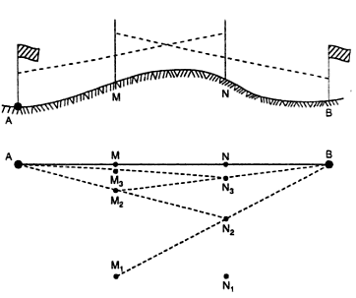
Now the person at N₁ directs the person at M₁ to move to M₂ so as to be in the line with A.
Then the person at M₂ directs the person at N₁ to move to N₂ so as to be in the line with B.
By successively directing each other, the two persons proceed to the line AB and finally come M at N exactly in the line AB.
M and N are the required intermediate points between A and B.

Slide 31
Random line method
If the survey line passes through a thick forest, it is not possible to range out the line by direct method.
The method of indirect ranging is also not possible, as end stations are not visible from intermediate points.
In such a case, the random line method can be used.
The method can also be used when one of the end stations is in depression.
Procedure:
Let AB be the survey line passing through a thick forest.
Range a random line AB₁ in the estimated direction of the line AB such that the line AB₁ is clear of the trees, and B is visible from B₁.
Erect a perpendicular B₁B at B₁ on AB₁, using an optical square.
Alternatively, a chain can be used to erect a perpendicular taking the three sides of the triangle in the ratio 3:4:5.

Slide 32
Measure the distance B₁B, and calculate the length AB as
Select intermediate points such as C₁ and D₁ on the line AB₁. Determine the lengths of the perpendicular offsets C₁C and D1D from the similar triangles. Thus
and
Layout perpendicular offsets CC₁ and DD₁ using an optical square after clearing trees.
Measure the distance CC₁ and DD₁ accurately. Thus the points C and D are located on the line AB.
Like wise, a number of intermediate points can be located on the line AB. After locating the intermediate points on the line AB, the trees coming on the line AB are cleared.

Slide 34
Chain corrections & Problems (Refer note book)
Tape corrections & problems (Refer note book)
(for this material is given separately)

