Slide 1
COMPASS SURVEYING

Slide 2
Compass surveying
Compass surveying is a branch of surveying in which directions of survey lines are determined with a compass and the lengths of the lines are measured with a tape or chain.
Traverse
A Traverse is a succession of straight lines along or through the area to be surveyed. The directions and lengths of these lines are determined by measurements taken in the field.
Methods of traversing
Chain traverse
Compass traverse
Plane table traverse
Stadia traverse
Theodolite traverse

Slide 3
Types of traverse
The traverse may be classified into two types
Closed traverse
Open traverse
Closed traverse
A closed traverse starts from one traverse station and closed either on the same station or another traverse station whose location is already known.
If a traverse starts from one station and closes from on the same station, it forms a closed polygon. This type of closed traverse is known as a loop traverse.
If the traverse starts from the one station whose location is already known or established, and closes at the another station whose location is also known or established. This type of closed traverse is called a link traverse or connecting traverse.

Slide 5
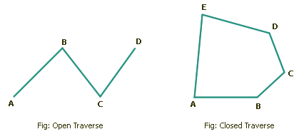
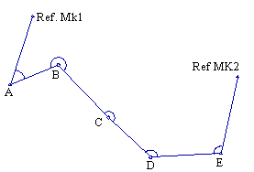
Link traverse
Open traverse
An open traverse starts from one station and closes at another station whose location is neither known nor established.
It consists of a series of connected lines.
An open traverse is generally run for surveying of a long strip of the area for a road, railway line, canal,etc.

Slide 6
Meridian
Meridian is a reference direction ( or fixed line of reference) with respect to which the direction of lines are mentioned.
Generally the magnetic north-south direction is taken as the reference direction in compass surveying.
Types of meridians
Generally there are 4 types of meridians
True meridian
Magnetic meridian
Grid meridian
Arbitrary meridian

Slide 7
True Meridian
The true meridian passing through a station on surface of the earth is the (imaginary) line of intersection of a (imaginary) plane passing through the geographical North and South poles of the earth with its actual surface.
The direction of true meridian at any station is constant and hence, direction of a line with reference to this remains same over time.
At any station, it can be determined through Astronomical survey.
For any engineering works of importance, the direction of at least one line is determined with true meridian as reference.

Slide 8
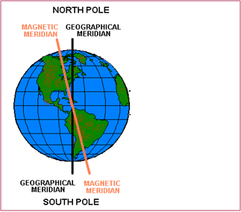
Magnetic meridian
The magnetic meridian at a station on surface of the earth is the (imaginary) line of intersection of a (imaginary) plane passing through the magnetic North and South poles of the earth with its actual surface.
The direction of a freely suspended well balanced magnetic needle provides the magnetic meridian at a station.

Slide 9
As the magnetic poles of the earth changes with time and so the magnetic meridian at any station.
Thus, the direction of a line with reference to magnetic meridian varies with time. Magnetic meridian is employed as a line of reference for rough surveys.
Grid meridian
For survey of a state, the true meridian of a central place is some times taken as a reference meridian for the whole state. Such a reference meridian is called the grid meridian.
This is also called as central meridian.
The meridians of all other places in that state are assumed to be parallel to the grid meridian.

Slide 10
Arbitrary meridian
Any convenient direction from a survey station to some well defined permanent object is known as arbitrary meridian.
This is used for small area survey or to determine the relative directions of small traverse.
Ex: A mosque is taken as reference and location of road will be mentioned with respect to this mosque.
Bearing
Bearing is the horizontal angle which a certain line make with a certain meridian.
Types of bearings
Depending up on the meridian, there are 4 types of bearings
(i) True bearing (ii) Magnetic bearing
(iii) Grid bearing (iv) Arbitrary bearing

Slide 11
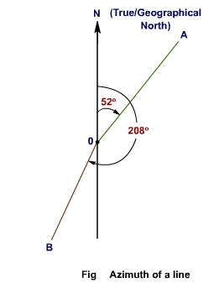
True bearing
The true bearing of a line is its horizontal angle from the North direction of the true meridian measured clockwise.
The true bearing of a line is also known as Azimuth.
As the true bearing of a line does not change with time and it can be re-established even after hundreds of years, it is the general practice to use the true bearings for all important surveys.

Slide 12
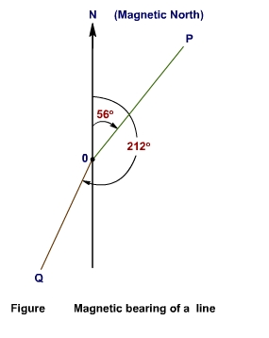
Magnetic bearing
The horizontal angle which a line makes with the magnetic meridian measured from Magnetic North line is called magnetic bearing.
It varies with time.
Magnetic bearing of a line can be measured in the field by using prismatic compass.
The magnetic bearings are used for small, unimportant surveys.

Slide 13
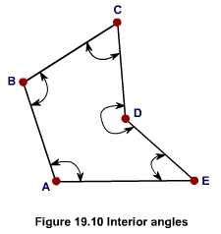
Grid bearing
The grid bearing of a line is the horizontal angle which the line makes with the grid meridian.
Arbitrary bearing
The arbitrary bearing of line is the horizontal angle which the line makes with the arbitrary meridian.
Interior angle
In any closed polygon, the direction of any side can be depicted by the angle it makes with its adjacent side. This angle measured clockwise or anti-clockwise is known as interior angle.

Slide 14
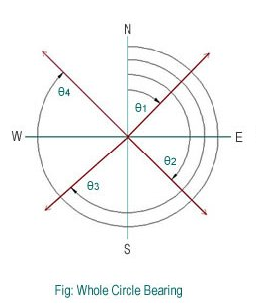
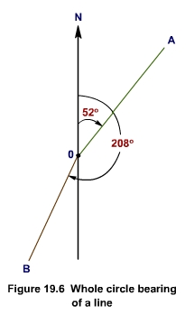
Designation of Bearings
The bearing of a line can be designated in to the following systems.
Whole Circle Bearing (W.C.B) System
Quadrantal bearing ( Q.B) or Reduced Bearing (R.B) system
Whole Circle Bearing (W.C.B) System
The whole circle bearing (W.C.B) of a line is the horizontal angle measured clockwise from the North limb of the meridian.
It varies from 0° to 360°.
The direction of the line is indicated by an arrow.
Ex: In the following fig 2 the whole circle bearing (W.C.B) of the line OA is 52° and that of line OB is 208°.

Slide 15
Quadrantal bearing ( Q.B) (or Reduced Bearing (R.B) system)
The quadrantal bearing (Q.B.) also known as reduced bearing (R.B) of a line is defined by the acute angle which the line makes with the meridian.
Thus, it depends on the quadrant in which the line presents.
It is measured in clockwise or anti-clockwise direction either from the North or from the South limb of the meridian whichever is nearer and thus provides minimum angle.
The values of quandrantal bearings are lies between 0° and 90°.
Thus, reduced bearing of a line is designated by the direction from which it is measured (i.e., either N for North or S for South) followed by the value of the angle at the end, the direction to which it is measured (i.e., either E for East or W for West).

Slide 16
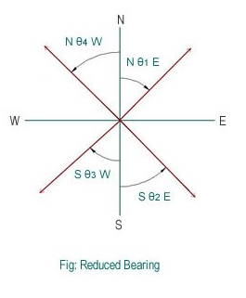
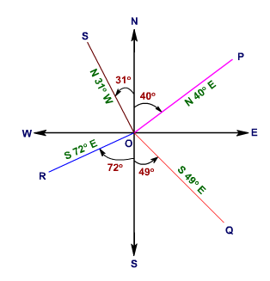
Ex: In the following fig the bearings of OP, OQ, OR and OS are respective.ly, N 40°E, S49° E, S72° W, and N31° W

Slide 17
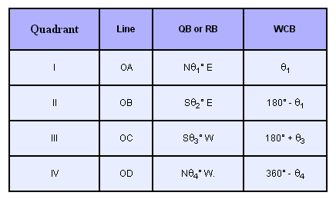
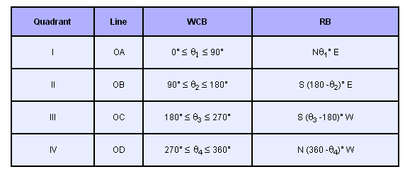
Conversion of Q.B to W.C.B
Conversion of W.C.B to Q.B

Slide 18
***Note:
It is worth noting that although the whole circle bearings are always measured clock wise, the quandrantal bearings are measured clockwise in I and III quadrants and counter-clock wise, in II and Iv quadrants.
When a line points towards north, east, south or west, it is written as “due north” , “due east” , “due south” , “due west” . Thus
N 0° = Due north
N 90°E = S 90°E = Due East
N 90°W = S 90°W = Due West
S 0° = Due south

Slide 19
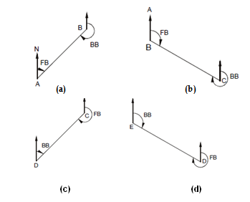
Fore bearing and back bearing
Fore bearing: The bearing of a line measured in the forward direction (i.e., along the progress of survey) is known as fore bearing.
Back bearing: The bearing of a line measured in the backward direction (i.e., opposite to the direction of progress of survey) is known as back bearing.
The F.B and B.B always differs by 180º.

Slide 20
Determination of back bearing from fore bearing
The B.B of a line may determined if its F.B is given and vice versa, remembering that they always differ by 180º.The following two simple rules are applied.
Case (i):
If the F.B of a line is given as the whole circle bearing,
B.B = F.B + 180º , if F.B < 180º
and B.B = F.B - 180º , if F.B > 180º
Case (ii):
If the F.B of a line is given as the quadrantal bearing,
B.B = Numerically equal to F.B
and change N for S , and vice versa
and E for W, and vice versa.
Note:
Unless mentioned otherwise, the bearing of a line means it fore bearing expressed as the whole circle bearing.

Slide 21
Prob 1:
convert the following whole circle bearings to quadrantal bearings.
(i) 20º
(ii) 150º
(iii) 210º
(iv) 320º
Prob 2:
Convert the following reduced bearings into whole circle bearings:
(i) N 65° E
(ii) S 43° 15′ E
(iii) S 52° 30′ W
(iv) N 32° 42′ W

Slide 22
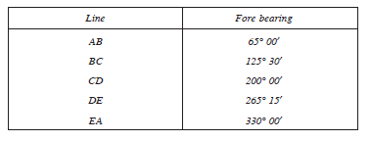
Prob 3:
The following fore bearings were observed for lines, AB, BC, CD, DE, EF and FG respectively. Determine their back bearings:
(i) 148° (ii) 65°
(iii) 285° (iv) 215°
(v) N 36° W (vi) S 40° E
Prob 4:
In a closed traverse the following bearings were observed with a compass. Calculate the interior angles. (Ans: ∠A ′ = 85° 00′, ∠B = 119° 30′, ∠C = 105° 30′, ∠D = 114° 45′, ∠E = 115° 15′)

Slide 23
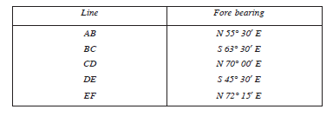
Prob 5:
The angles observed with a surveyor compass in traversing the lines AB, BC, CD, DE and EF are as given below. Compute the included angles and show them in a neat sketch.
(Ans: ∠B = 119° 00′,∠C = 133° 30′,∠D = 115° 30′,∠E = 117° 45′)

Slide 24
Types of compass
The types of compass that are used commonly are:
(i) prismatic compass and (ii) surveyor compass
The essential parts of both type are:
(i) a magnetic needle,
(ii) a graduated circle,
(iii) a line of sight, and
(iv) a box to house them.
There are some differences in the essential parts of the two type of compass.

Slide 25
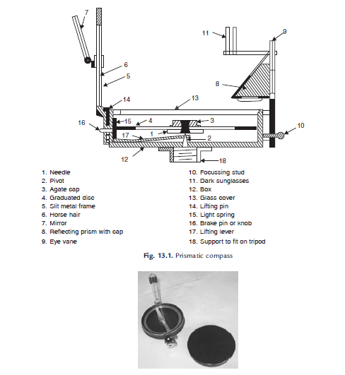
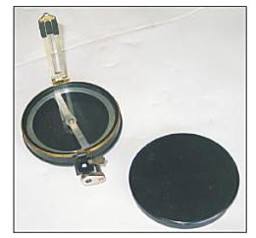
Prismatic compass

Slide 26
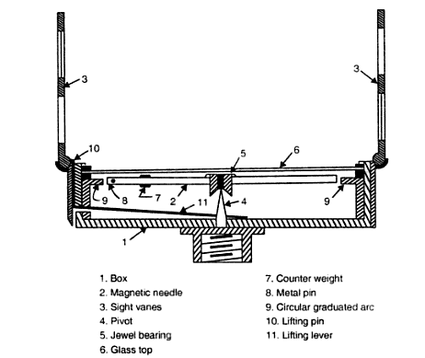
Surveyors compass

Slide 27
Difference Between Prismatic Compass and Surveyors Compass
S.no | Prismatic Compass | Surveyors Compass
1 | Graduation circle is fixed to broad type needle.Hence, it will not rotate with the line of sight. | Graduation circle is fixed to the box. Hence, it rotates with the line of sight.
2 | There is a prism at viewing end. | At viewing end there is no prism. There is only a slit.
3 | Sighting and reading can be done simultaneously. | Sighting and viewing cannot be done simultaneously.
4 | The magnetic needle do not act as an index. | Magnetic needle acts as index while reading.
5 | The graduations are in whole circle bearing. (0 to 360º) | The graduations are in quadrantal system. (0 to 90º)
6 | Graduations are marked inverted since its reflection is read through prism. | Graduations are marked directly. They are not inverted.
7 | The reading is taken through a prism. | The reading is taken by directly viewing from top glass.
8 | Tripod may or may not be used. It can be held on a stretched hand also. | Tripod is essential for using it.

Slide 28
Adjustments of Prismatic Compass & Surveyors compass
The following are the adjustments usually necessary in the prismatic compass:
(i) Temporary adjustments or Station adjustments
(ii) Permanent adjustments
Temporary adjustments of prismatic compass
Centring
Levelling
Focussing
Temporary adjustments of Surveyors compass
Centring
Levelling

Slide 29
Adjustments for sight vanes: The sight vanes in a prismatic compass are not adjustable.
Adjustments of the needle and pivot: The needle in a prismatic compass cannot be straightened.
Magnetic Declination (or) Declination
The magnetic meridian and the true meridian may not coincide with each other in a place. The horizontal angle between these two meridians is known as magnetic declination.
The magnetic north at a place may be towards east or west of true north .
If it is towards east, it is known as eastern or +ve declination.
If towards West declination is known as –ve declination.

Slide 30
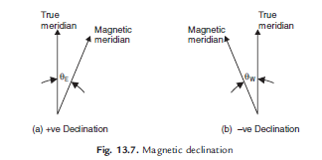
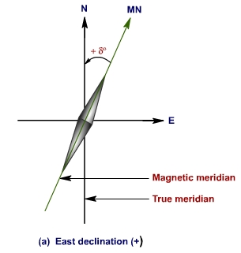
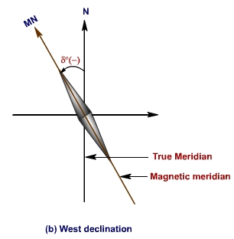
Magnetic declination varies from time to time and also from place to place.
In the noon sun is exactly on the geographical meridian. In India, ‘Survey of India’ department conducts astronomical survey and publishes Isogonic Charts from which magnetic declinations at any point can be found.
The lines joining the points at which declination is the same at the given time are called ‘Isogonic lines’
Lines joining points of zero declinations are called ‘Agonic Lines’.

Slide 31
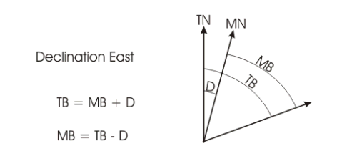
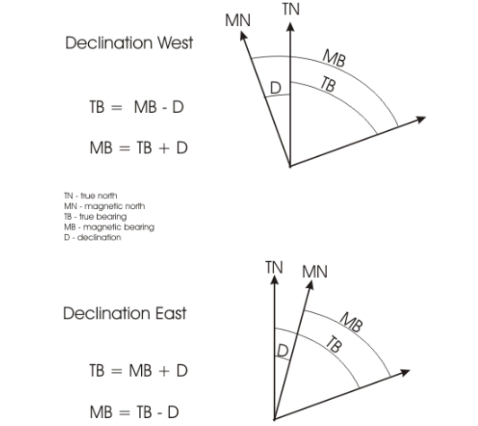
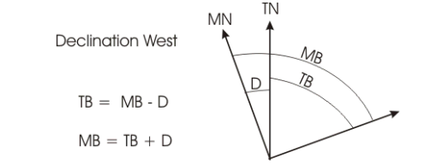
Determination of true bearings from magnetic bearings
IF
IF

Slide 32
Prob 6:
The magnetic bearing of a line AB is 88° 45′.Calculate the true bearing if (a) the magnetic declination is 5° 30′ east (b) the magnetic declination is 4° 45′ W.
Ans: (a) 94° 15′ (b) 84°
Prob 7:
True bearing of line AB is 357° and its magnetic bearing is 1° 30′. Determine the declination. Also find the true bearing of AC which has magnetic bearing equal to 153° 30′.
Ans: 4° 30′ west, 149°
Prob 8:
The magnetic bearing of a line AB is S38°30′W. .Calculate the true bearing if the magnetic declination is (a) 4° 30′ W (b) 3° 30′ E.
Ans: (a) S34°W (b) S42°W

Slide 33
Local attraction
Local is the attraction of the magnetic needle to a local magnetic filed other than earth’s magnetic field.
The local magnetic filed is caused by iron fences, iron poles, steel bars, vehicles, steel doors and windows, iron deposits, etc.
Even small items made of iron or steel such as the wrist watch case, pen, belt buckle, taping arrows and steel tapes cause local attraction. D.C power lines also develop a local magnetic field.
To detect local attraction, it is essential to take both the fore bearing and back bearing of each line.

Slide 34
If the fore bearing and back bearing of a line does not differ by 180°, then there is a possibility of local attraction during the observation of the line.
Otherwise, if the sum of the interior angles of a closed traverse does not provide (2n - 4) right angles [where n is the number of sides in the traverse], then there is a possibility of local attraction during the observation of the traverse.

Slide 35
Correction for local attraction
If local attraction is detected in a compass survey observed bearings may be corrected by any one of the following two methods:
Method I: It may be noted that the included angle is not influenced by local attraction as both readings are equally affected. Hence, first calculate included angles at each station, commencing from the unaffected line and using included angles, the corrected bearings of all lines may be calculated.
Method II: In this method, errors due to local attraction at each of the affected station is found starting from the bearing of a unaffected local attraction, the bearing of the successive lines are adjusted.

Slide 36
Problems on local attraction
Errors in compass surveying
Instrumental errors
The needle is sluggish or has lost its magnetism.
The needle is not perfectly straight.
The pivot is not at the centre of the graduated circle.
The needle does not remain horizontal because of dip.
The graduate ring of the prismatic compass is not horizontal.
The vertical hair in the sight vane is too thick or too loose.
The plane of sight is not vertical.

Slide 37
Manipulation and sighting errors
The compass is not properly centred over the station.
The compass is not properly levelled.
The ranging road placed at the station is not accurately bisected.
There is parallax in reading the bearing in a surveyor’s compass.
In a prismatic compass, the graduated ring is read in the wrong direction.
The observation of the reading is not properly recorded.
Errors due to external forces
Magnetic changes in the atmosphere on a cloudy or stormy day.
Variations in magnetic declination.
Local attraction due to proximity of articles made of iron or steel, and other local magnetic fields.

