Slide 1
MODERN SYSTEMS IN SURVEYING

Slide 2
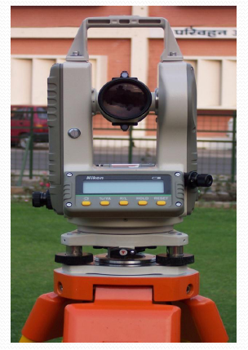
Electronic Theodolite
Provides the value of observation directly in viewing panel.
The precision of this type of instrument varies in the order of 1" to 10".

Slide 3
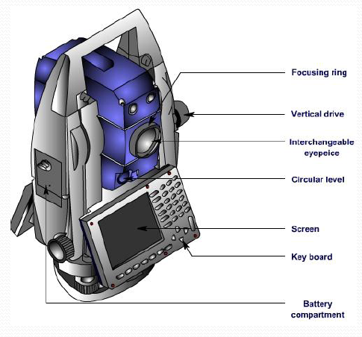

Slide 4
PRINIPLE OF EDM (ELECTRONIC DISTANCE MEASUREMENT)
The general principle involves sending a modulated Electro-magnetic (EM) beam from one transmitter at the master station to a reflector at the remote station and receiving it back at the master station. The instrument measures slope distance between transmitter and receiver by modulating the continuous carrier wave at different frequencies, and then measuring the phase difference at the master station between the outgoing and the incoming signals. This establishes the following relationship for a double distance (2D):
Where, m is unknown integer number of complete wavelengths contained within double distance
Φ is the measured phase difference
λ is modulation wavelength,
and k is constant.

Slide 5
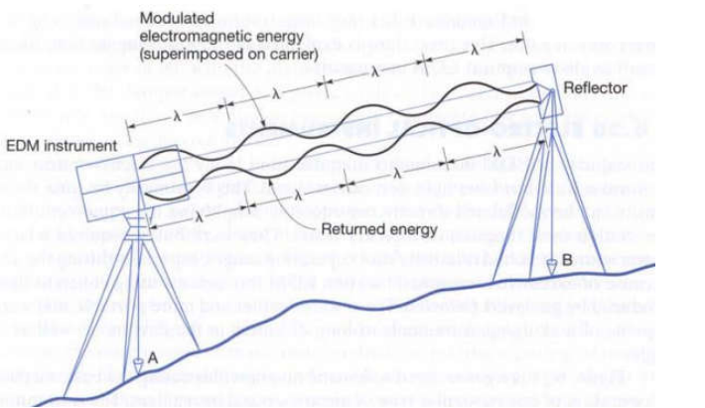
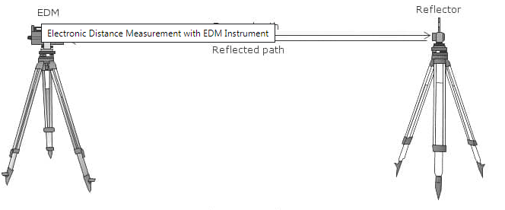

Slide 6
Types Of Electronic Distance Measurement (EDM) Instruments:
Direct measurement of distances and their directions can be obtained by using electronic instruments that rely on propagation, reflection and reception of either light waves or radio waves.
EDM’S are classified in to three types
(i) Infrared wave instruments
(ii) Light wave instruments
(iii) Micro wave instruments

Slide 10
Total Station
A more modern instrument is a total station, which is a theodolite with an electronic distance measurement device (EDM).
Since their introduction, total stations have made the technological shift from being optical-mechanical devices to being fully electronic with an onship computer and software as well as humans.
Total stations require a reflector or prism (used to return the light pulses used for distancing) to return distance.
It is a light weight, compact and fully integrated electronic instrument combining the capability of an EDM and an angular measuring instrument such as wild theodolite.

Slide 11
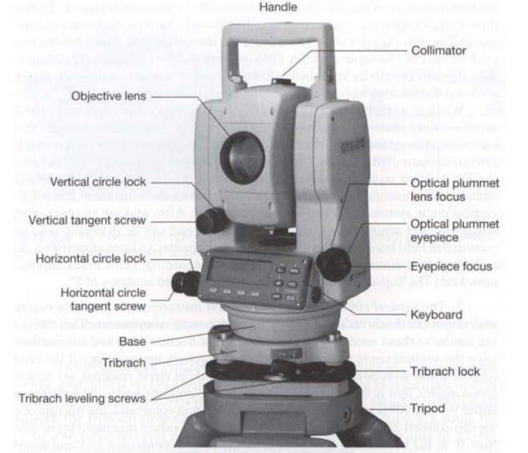
PARTS OF A TOTAL STATION

Slide 12
Accessories of Total station
Prism reflector:
It is a combination of ranging rod, staff and and
optical cuboidal mirror.
having 2/3 lifts with 5cms interval graduations.
adjustable height from 1.5m to 3.75m.
More number of prisms, will give more accuracy.
Microprocessor with memory card of 1 or 2 GB capacity
1MB can store 800 points.
Tripod: with different material
Aluminum tripod weighs 13 to 14lbs
Wooden tripod will be about 18 lbs.
Optical and Laser plumb bobs.
Battery –as an external attachment
with indicators
1.5hours charged battery can work for 3to 5 hours

Slide 13
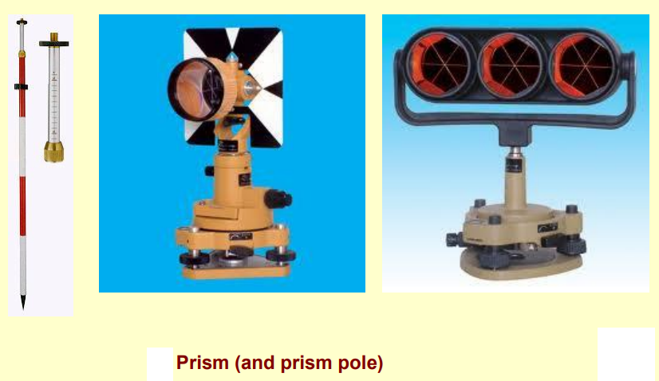

Slide 14
APPLICATIONS OF TOTAL STATION
Detail survey i.e., data collection.
Control Survey (Traverse).
Height measurement (Remove elevation measurement- REM).
Fixing of missing pillars (or) Setting out (or) Stake out.
Resection.
Area calculations, etc.
Remote distance measurement (RDM) or Missing line measurement (MLM).

Slide 17
Filed Procedure for total station

