Slide 1
BAPATLA ENGINEERING COLLEGE :: BAPATLA
(Autonomous)
Deep Learning (20ECJ44)
By
Dr. Naga Raju Challa
Assistant Professor,
Department of ECE,
Bapatla Engineering College,
(Autonomous)
Bapatla.

Slide 2
UNIT- I
Introduction to Deep Learning
&
Architectures

Slide 3
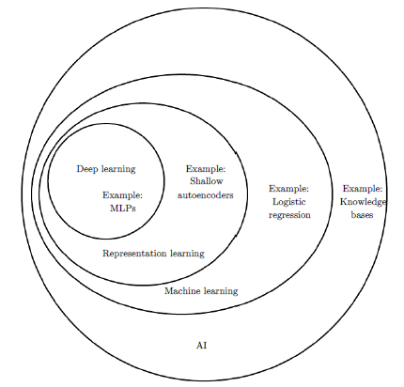
Machine Learning Vs. Deep Learning
Machine learning and deep learning are both subfields of artificial intelligence (AI) that focus on training algorithms to make predictions or decisions based on data.
However, they differ in their approaches, architectures, and applications.

Slide 4
Machine Learning Vs Deep Learning
Features | Machine Learning | Deep Learning
Architecture | ML encompasses a broad range of techniques and algorithms that can be categorized into supervised, unsupervised, and reinforcement learning. These algorithms often rely on handcrafted features extracted from data. | DL is a subset of ML that specifically deals with neural networks consisting of multiple layers. These networks, known as artificial neural networks, can automatically learn features from data.
Data Size | ML models can perform well with smaller datasets, making them suitable for applications with limited data availability. | DL models typically require large amounts of data to generalize effectively. They thrive when trained on big datasets, making them suitable for tasks
Computations | ML models are generally less computationally intensive than deep learning models. They can run on standard hardware and may not require specialized GPUs. | DL models often demand significant computational resources, including powerful GPUs or TPUs, due to the complexity of neural networks with many layers.

Slide 5
Machine Learning Vs. Deep Learning
Features | Machine Learning | Deep Learning
Training Time | ML models often train faster than DL models, which can require prolonged training times, especially on large datasets. | DL models slower than ML models.
Interpretability | Traditional ML models are often more interpretable because they rely on human-engineered features and simpler algorithms. | DL models, particularly DNN, are considered as black boxes because understanding their decision-making processes can be challenging.
Feature Engineering | In traditional ML, a significant amount of time is spent on feature engineering, which involves selecting, transforming, and engineering relevant features from the raw data to improve model performance. | DL models can automatically learn features from the raw data, reducing the need for extensive feature engineering. This is one of the key advantages of deep learning.
Applications | fraud detection, recommendation systems, natural language processing, and more. | Image recognition, speech recognition, NLP, autonomous driving, and game playing.

Slide 6
Representation learning
Definition: The process of automatically discovering and extracting meaningful patterns or features from raw data is known as Representation learning.
It is also known as feature learning or feature extraction.
It is a fundamental concept in deep learning and machine learning.
The representation learning are more informative and relevant for solving a specific task, such as classification, regression, or clustering.
The aim of representation learning is to transform data into a different, more compact, and more useful format.
In traditional machine learning, feature engineering often involves manually selecting or designing features based on domain knowledge.
However, the representation learning, aims to automate this process by allowing the model to learn the most relevant features directly from the data.

Slide 7
Representation learning Models
Convolutional Neural Networks (CNNs): In computer vision tasks, CNNs are designed to automatically learn hierarchical representations of images. They use convolutional layers to capture local patterns and features, followed by fully connected layers for higher-level abstractions.
Recurrent Neural Networks (RNNs): RNNs are used for sequential data, such as natural language text or time series data. They learn to capture temporal dependencies and can be used for tasks like sentiment analysis, machine translation, and speech recognition.
Transfer Learning: Transfer learning involves pre-training a deep neural network on a large dataset and then fine-tuning it on a smaller, task-specific dataset. The pre-trained network serves as a feature extractor, and its learned representations are often useful for various downstream tasks.
Auto-encoders: Auto-encoders are neural networks that are trained to reconstruct their input data. The hidden layers of the auto-encoder learn to capture essential features or representations of the input data during the training process. Variations like de-noising auto-encoders and variational auto-encoders (VAEs) are commonly used for representation learning.

Slide 8
Representation learning Models
Auto-encoders: Auto-encoders are neural networks that are trained to reconstruct their input data. The hidden layers of the auto-encoder learn to capture essential features or representations of the input data during the training process. Variations like de-noising auto-encoders and variational auto-encoders (VAEs) are commonly used for representation learning.
Self-Supervised Learning: Self-supervised learning is a type of representation learning where a model learns from data with automatically generated labels or annotations. For example, predicting missing parts of an image or missing words in a sentence can be used to train self-supervised models.
Representation learning has played a crucial role in improving the performance of deep learning models across various domains, including computer vision, NLP, speech recognition, etc.
By learning informative representations, models can generalize better to new and unseen data, making them more effective and efficient for a wide range of tasks.

Slide 9
Width Vs Depth of Neural Networks
Width and Depth are two important architectural aspects of neural networks that affect their capacity and performance.
The number of neurons (or units) in each layer of a neural network is known as Width.
Increasing the width of a neural network can increase its capacity to learn complex patterns in the data.
However, a very wide network may also require more training data and computational resources and may be prone to overfitting.
Source: NPTEL IIT KGP

Slide 10
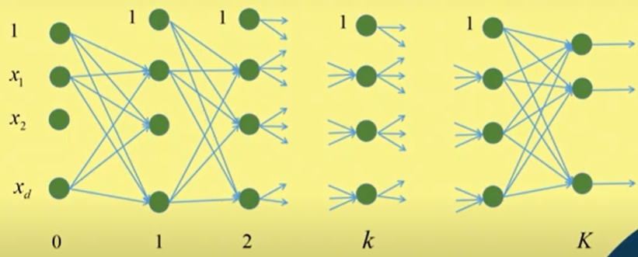
Width Vs. Depth of Neural Networks
The number of layers presented in a neural network is called Depth.
A deep neural network has many hidden layers between the input and output layers.
Deeper networks are capable of capturing hierarchical features in the data, where lower layers learn simple features, and higher layers learn more abstract and complex features.
Image processing, and natural language understanding.
Source: NPTEL IIT KGP

Slide 11
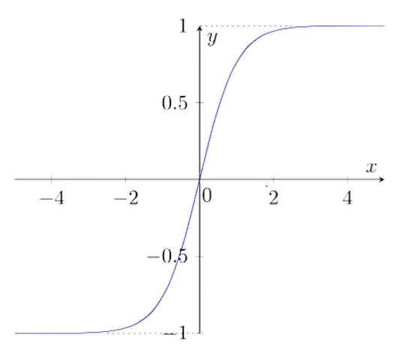
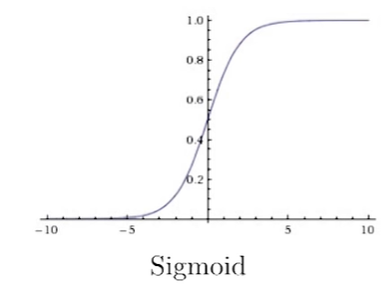
Activation Functions
The sigmoid function compresses all inputs to the range of {0,1}.
The gradient of the function is
Cons
Saturation Region:
A sigmoid neuron is saturated when$σ\left(x\right)$=1 or $σ\left(x\right)$=0.
From the graph, at saturation it would be 0;
A saturated gradient neuron can causes the gradient to vanish
Sigmoid are not zero center
The Tanh function compresses all inputs to the range of {-1,1}.
The gradient of the function is
Pros:
It is a zero center
Cons:
Still gradient vanish problem is there.
Computationally expensive.
$$\frac{∂σ\left(x\right)}{∂x}=σ\left(x\right)\left(1−σ\left(x\right)\right)$$
$$w=w−η∇w$$
$∇w$=0

Slide 12
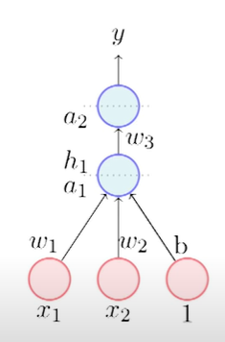
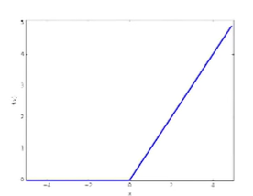
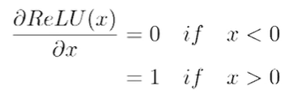
Rectified Linear Unit (ReLU)
ReLU Stands for Rectified Linear Unit.
It is a non linear activation function.
Pros:
It doesn’t saturate in the positive region
Computationally Effective.
Much faster than sigmoid/Tanh
The derivative of ReLU is
Cons:
This causes Dead neuron Problem.
$$f\left(x\right)=max\left(0,x\right)$$

Slide 13
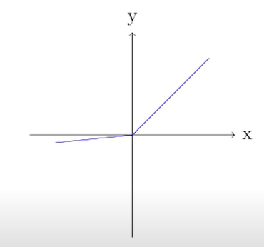
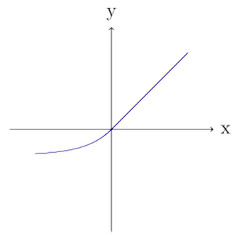
Leaky ReLU & Exponential ReLu
Leaky RELU
Parametric RELU
Exponential RELU
$$α$$
$$f\left(x\right)=max\left(0.01x,x\right)$$
$$\begin{matrix}f\left(x\right)=x \text{if} x\text{>0} \\ \text{ = }ae^{x}−1 \text{if} x≤\text{0}\end{matrix}$$
$$f\left(x\right)=max\left(α x,x\right)$$

Slide 14
Learning Models
Supervised Learning Models: In supervised learning, models are trained on labeled data, where each input is associated with a corresponding target or output. Common algorithms include linear regression, decision trees, support vector machines, and deep neural networks. These models learn to map inputs to outputs and can be used for tasks like classification and regression.
Unsupervised Learning Models: Unsupervised learning models work with unlabeled data and aim to discover patterns, structures, or relationships within the data. Clustering algorithms like k-means and hierarchical clustering, as well as dimensionality reduction techniques like Principal Component Analysis (PCA), are examples of unsupervised learning models.
Reinforcement Learning Models: In reinforcement learning, agents learn to make sequential decisions in an environment to maximize a reward signal. These models are used in applications such as game playing, robotics, and autonomous systems. Popular reinforcement learning algorithms include Q-learning and deep reinforcement learning algorithms like DQN and A3C.

Slide 15
Learning Models
Semi-Supervised Learning Models: Semi-supervised learning combines elements of both supervised and unsupervised learning. These models use a small amount of labeled data and a larger amount of unlabeled data to improve learning performance.
Self-Supervised Learning Models: Self-supervised learning is a type of unsupervised learning where models generate their own labels from the data itself. For example, in natural language processing, models might learn to predict missing words in a sentence or generate contextually relevant representations of words or phrases.
Transfer Learning Models: Transfer learning involves pre-training a model on one task or dataset and then fine-tuning it for another related task. This approach can save time and resources when training models and is commonly used in deep learning, such as with pre-trained convolutional neural networks (CNNs) for image classification.

Slide 16
Learning Models
Neural Network Architectures: Deep learning models, which are a subset of neural networks, have gained prominence in recent years. These models consist of multiple layers of interconnected artificial neurons and are particularly well-suited for tasks involving large amounts of data, such as image and speech recognition. Popular architectures include convolutional neural networks (CNNs) for computer vision and recurrent neural networks (RNNs) for sequence data.

Slide 17
Unsupervised Training of Neural Networks
Unsupervised training of neural networks is a type of machine learning approach where a neural network learns patterns, representations, or structures in data without explicit supervision or labeled target outputs.
In contrast to supervised learning, where the network is provided with labeled examples and aims to minimize the prediction error.
However, the unsupervised learning focuses on extracting useful information from the data itself.
Techniques:
Autoencoder
Restricted Boltzmann Machines (RBMs)
Clustring
Generative Adversarial Networks (GANs)
Variational Autoencoders (VAEs)
Dimensionality Reduction

Slide 18
Autoencoder
An auto encoder is a type of artificial neural network used in unsupervised machine learning and dimensionality reduction tasks.
It is used for data compression and feature learning.
Auto encoders consist of an encoder and a decoder, both of which are neural networks.
The main idea behind auto encoders is to learn a compressed representation (encoding) of the input data and then decode it to reconstruct the original data.
Assumptions:
1. High degree of correlation/ Structure exist in the data.
2. For uncorrelated data (input features are independent), then compression and subsequent reconstruction would be difficult.

Slide 19
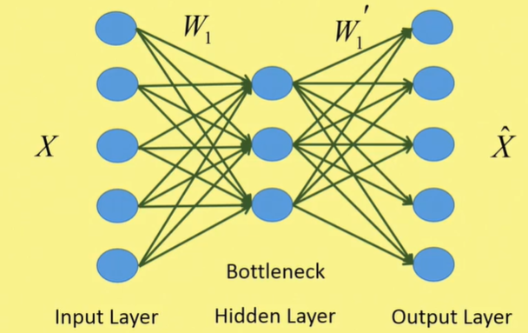
Autoencoder
The number of layers in the bottleneck layer or hidden layer is much lesser than the number of nodes in the input layer.
The number of nodes in the input layer is equal to the number of nodes in the output layer.
The number of nodes in the input layer is
The number of nodes in the output layer is
If the number of nodes in the hidden layer is d then the condition for number of hidden layers in the encoder side is
the condition for number of hidden layers in the decoder side is
$$M×N+1$$
$$M×N$$
$$d<<M×N$$
$$d<<M×N+1$$
Fig: Basic Structure of an Autoencoder

Slide 20
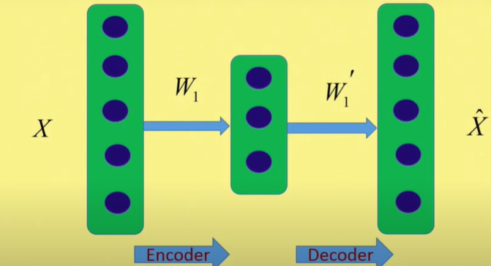
Autoencoder
Fig: Block Diagram of an Autoencoder

Slide 21
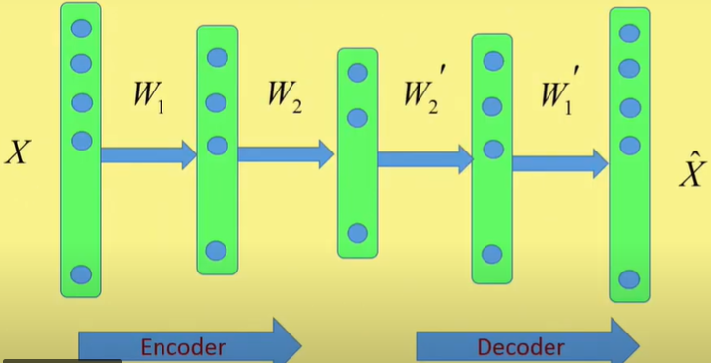
Stacked Autoencoder
Fig: Block Diagram of an Stacked Autoencoder

Slide 22
Autoencoder
Expectations:
Sensitive enough to input for accurate reconstruction.
Insensitive enough that it doesn’t memorize or overfit the training data
$$Loss \text{function}⇒L\left(X,\hat{X}\right)+Regularizer$$
Fig: Basic Structure of an Autoencoder

Slide 23
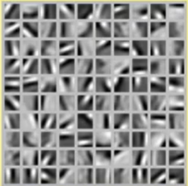
Autoencoder

Slide 24
Under Complete Autoencoder
Fig: Basic Structure of an Autoencoder
In order to minimize the error we use back propogation algorithm.

Slide 25
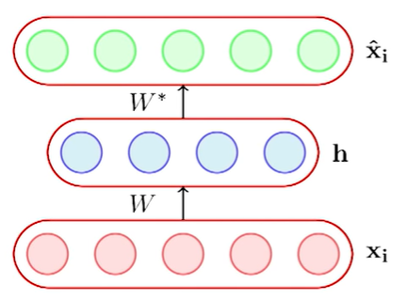
Under Complete Autoencoder
In this case length (h)< length
$$\left(X_{i}\right)$$
$$\begin{matrix}h=g\left(WX_{i}+b\right) \\ {\hat{X}}_{i}=f\left(W^{∗}h+c\right)\end{matrix}$$
Under Complete Autoencoder

Slide 26
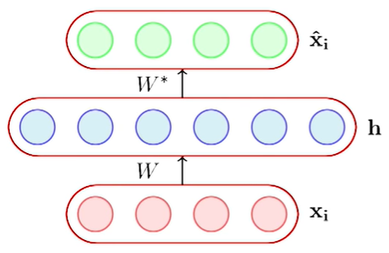
Over Complete Autoencoder
In this case length (h) ≥ length
$$\left(X_{i}\right)$$
$$\begin{matrix}h=g\left(WX_{i}+b\right) \\ {\hat{X}}_{i}=f\left(W^{∗}h+c\right)\end{matrix}$$
Fig: Over Complete Autoencoder

Slide 27
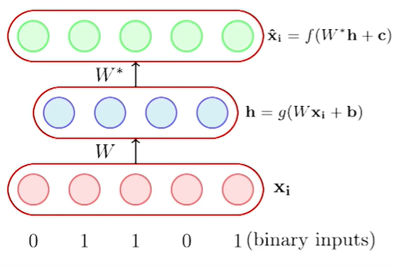
Autoencoder: Examples
Suppose all the inputs are binary each
The most suitable activation function for the decoder is
The logistic function resists all output values to 0 and 1.
However, at the encoder side tanh or linear, or sigmoid activation functions can be used.
$$x_{ij}∈\left\{0,1\right\}$$
$${\hat{X}}_{i}=logistic\left(W^{∗}h+c\right)$$

