Slide 1
Introduction to Java
Presented by
G. Mahesh
Assistant Professor
Department of ECE
Bapatla Engineering College
Source: Herbert Schildt , Javatpoint, geeksforgeeks

Slide 2
Introduction
Java is a high level programming language that was originally developed by Sun Microsystems of USA and released in 1995.
It was developed by James Gosling
Java runs on variety of Platform
Ex: Windows, Linux, Unix etc.
It can be expressed as
WORA – Write once Run Anywhere (The Compiled java code can run on all platforms)

Slide 3
History of Java
Java is a object oriented programming language developed by Sun Microsystems of USA in 1991.
Java was designed for the development of software to the consumer electronic devices like TV’s, VCR’s and other electronic machines.
The goal has a strong impact on the development to make the language simple, portable and highly reliable.

Slide 4
Cont….
The team of the sun Microsystems model their
new language java on C and C++ but remove a number of features of C and C++ that were considered as source of problems and thus made java a really simple, reliable, portable and powerful language.

Slide 5
Java Milestones
In 1990 the Sun Microsystems decided to develop a special software that could be used to manipulate consumer electronic devices. A team of Sun Microsystems headed by James Gosling to undertake this task.
In 1991 after exploring the possibilities of using the most popular object oriented language C++. The Gosling Team announced a new language named as OAK.

Slide 6
Cont….
In 1992 the Team known as Green Project Team by Sun Microsystems demonstrated the application of their new language to control a list of appliances using a handheld devices.
In 1993 the World Wide Web appeared in the internet and transform the test based internet to the graphical rich environment.

Slide 7
Cont…..
The Green Project Team came up with the idea of developing web Applet using the new language that could run on all types of computers connected to the internet.
In 1994, the Team developed a Web Browser called Hot Java. To locate and run applet program on internet.

Slide 8
Cont.....
Hot java is the power of new language does making it instantly popular among the internet users.
In 1995, The language OAK was named as JAVA
In 1996 java established itself not only as a leader for the internet programming but also as a object oriented programming language.

Slide 9
Cont….
In 1996 the Sun Microsystems releases the Java Development Kit (1.0) [JDK 1.0]
In 1997 SMS releases the updated version of JDK 1.0 called JDK 1.1
In 1998, SMS releases the Java 2 with version 1.2 of Software development Kit (SDK)
In 1999 the SMS releases Java 2 platform Standard Edition [J2SE] and Enterprise Edition [J2EE]

Slide 10
Cont…..
In 2000, [J2SE] with [SDK 1.3] was released
In 2002, [J2SE] with [SDK 1.4] was released
In 2004, [J2SE] with [JDK 5.0] was released is known as [J2SE 5.0]

Slide 11
Types of Applications
1) Standalone Application
Standalone applications are also known as desktop applications or window-based applications.
Ex: Media player, antivirus, etc.
2) Web Application
An application that runs on the server side and creates a dynamic page is called a web application.
Ex: Servlet, Spring, Hibernate,etc.

Slide 12
Cont….
3) Enterprise Application
An application that is distributed in nature, such as banking applications, etc. is called an enterprise application. It has advantages like high-level security.
4) Mobile Application
An application which is created for mobile devices is called a mobile application. Currently, Android and Java ME are used for creating mobile applications.

Slide 13
Java Platforms / Editions
There are 4 platforms or editions of Java:
1) Java SE (Java Standard Edition)
It is a Java programming platform. It includes Java programming APIs such as java.lang, java.io, java.net, java.util, java.sql, java.math etc. It includes core topics like OOPs, String, Exception, Inner classes, Multithreading, I/O Stream, Networking, AWT, Swing, Reflection, Collection, etc.
2) Java EE (Java Enterprise Edition)
It is an enterprise platform that is mainly used to develop web and enterprise applications. It is built on top of the Java SE platform. It includes topics like Servlet, JSP, Web Services etc.

Slide 14
Cont…..
3) Java ME (Java Micro Edition)
It is a micro platform that is dedicated to mobile applications.

Slide 15
Java Environment
JDK
JRE
JVM

Slide 16
JRE
JRE is an acronym for Java Runtime Environment. It is also written as Java RTE.
The Java Runtime Environment is a set of software tools which are used for developing Java applications.
JRE Consists of JVM

Slide 17
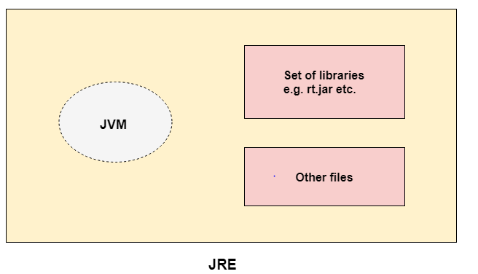

Slide 18
JDK
JDK is an acronym for Java Development Kit. The Java Development Kit (JDK) is a software development environment which is used to develop Java applications and applets.
JDK Consists of JRE + Development tools (Compiler)

Slide 19
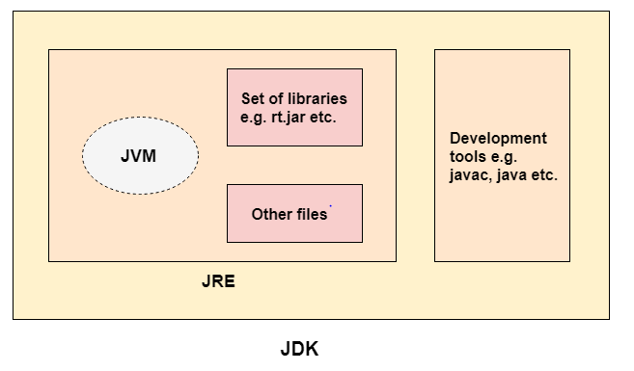

Slide 20
JVM
JVM-Java Virtual Machine
JVM is an abstract machine. It is a specification that provides runtime environment in which java bytecode can be executed.
It is Platform dependent
JVM Does:
Loads code
Verifies code
Executes code
Provides runtime environment

Slide 21
JDK
Compiler
JRE
JVM

Slide 22
Compiler
Java Compiler (JavaC) translates Source code into Bytecode. The bytecode is Machine independent. It can run on any machine (Platform Independent).
Source Code
Compiler
Bytecode
.Java
Javac
.Class

Slide 23
Cont….
JVM translates Bytecode into Machine Code

Slide 25
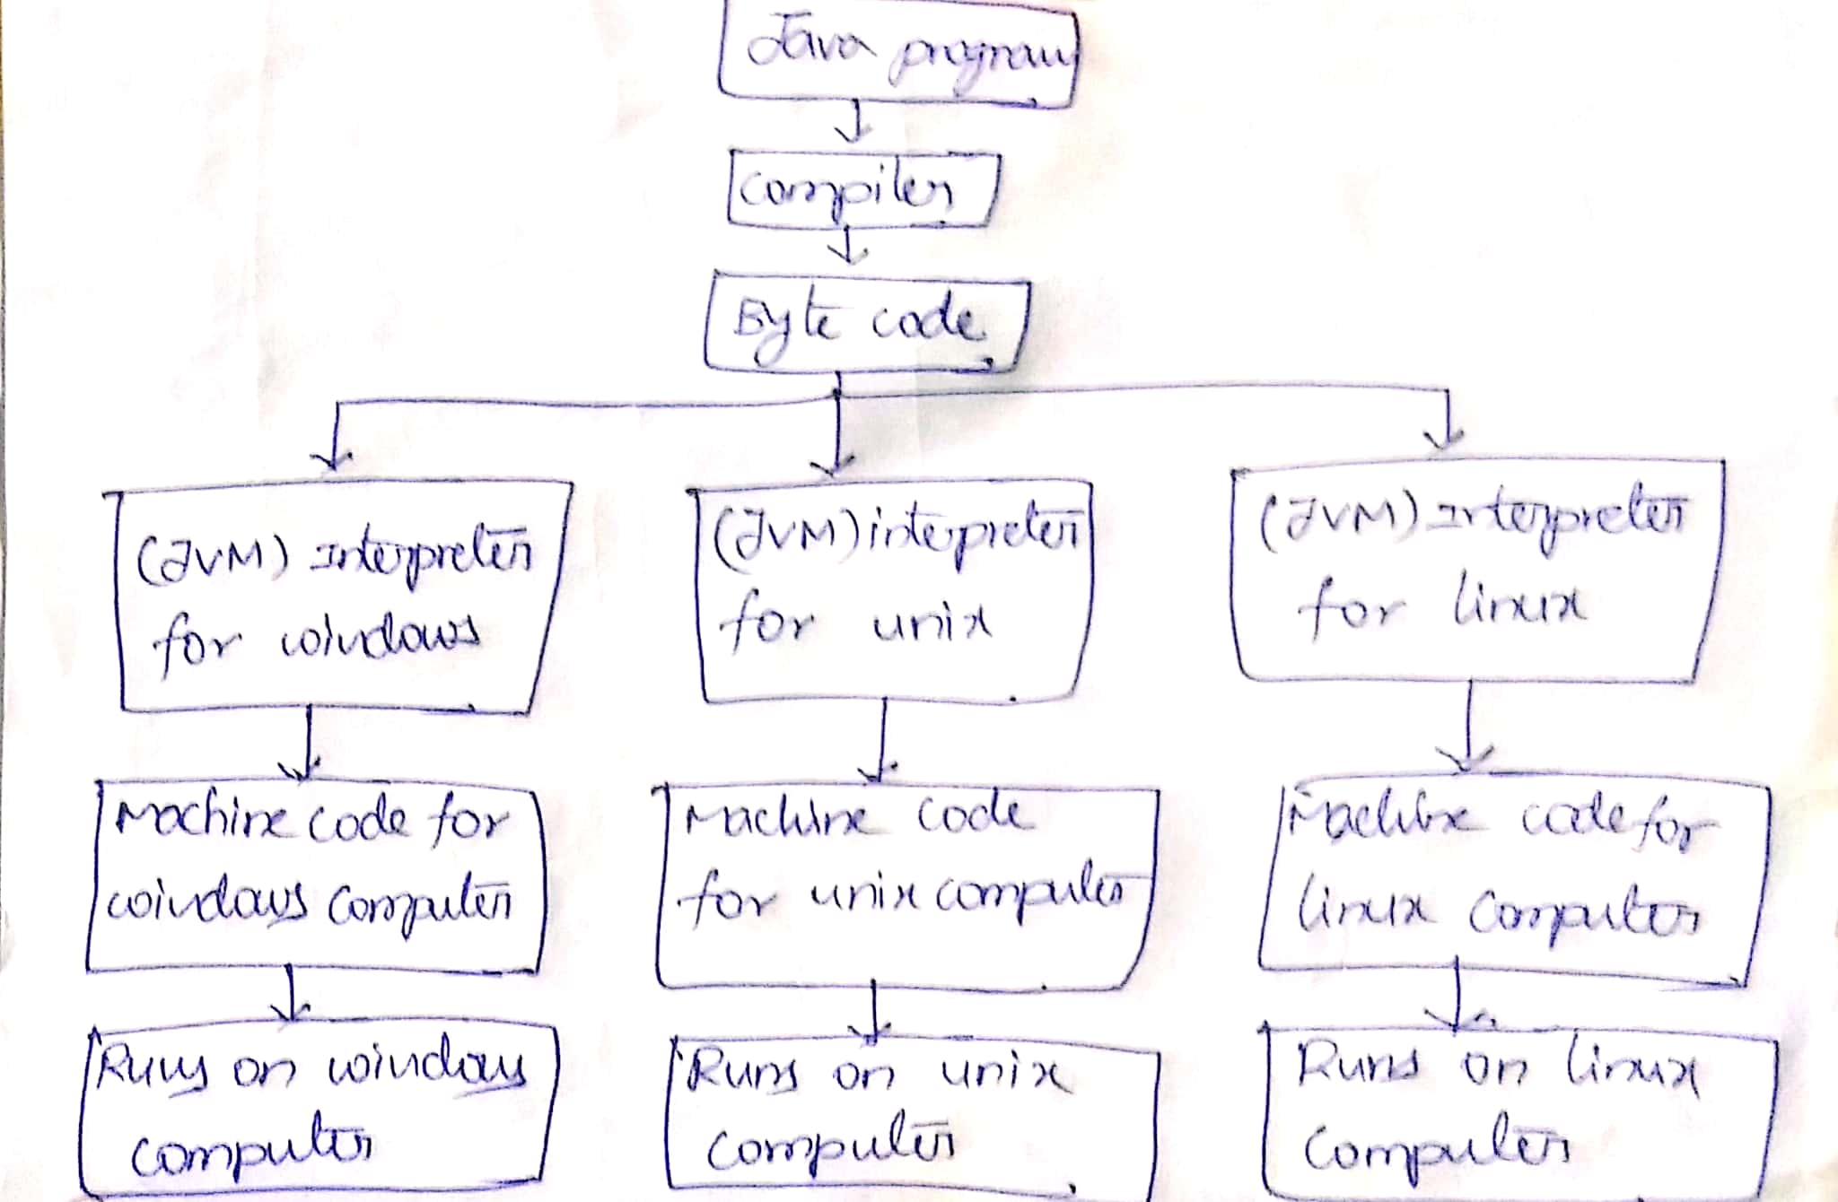

Slide 27
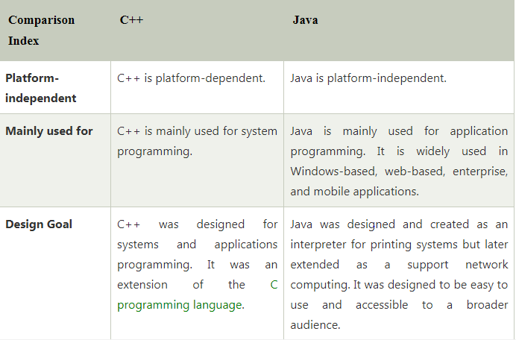

Slide 28
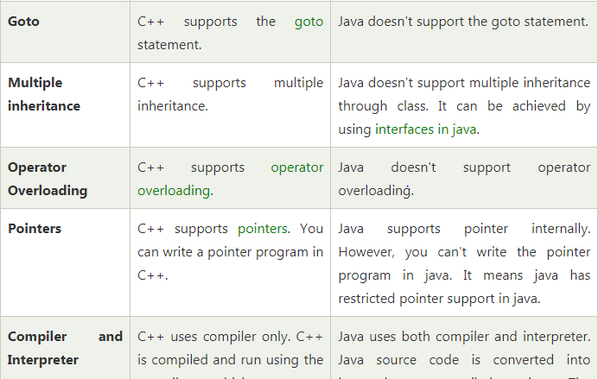

Slide 29
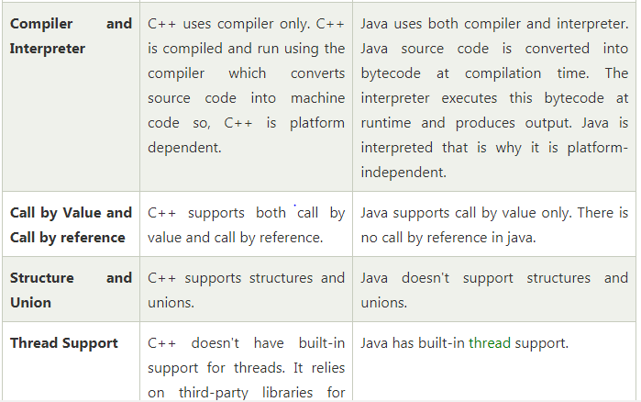

Slide 31
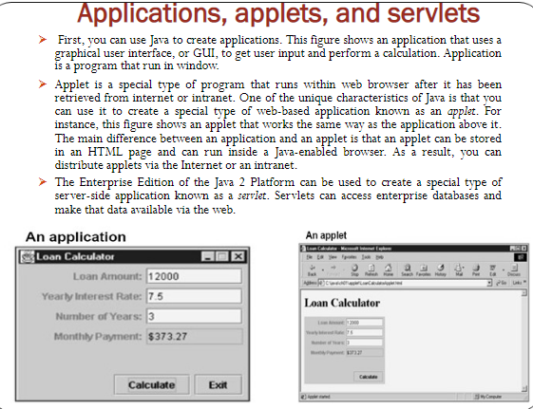

Slide 32
Importance of Java to internet

Slide 33
Cont……..
The internet users can also use the java enabled browsers to download an applet located on a computer anywhere in the internet and run those applets on local Computer.
Note: An interconnection between two or more systems or devices called as networks. These are connected in a logically or physical manner.

Slide 34
Cont....
Internet:
Several networks are connected together
Network of Networks
According to federal networking council internet can be defined as Global information System.

Slide 35
World Wide Web(WWW)
World Wide Web, which is also known as a Web, is a collection of websites or web pages stored in web servers and connected to local computers through the internet.
These websites contain text pages, digital images, audios, videos, etc. Users can access the content of these sites from any part of the world over the internet using their devices such as computers, laptops, cell phones, etc.
Software Application
Makes it easy for anyone to publish and browse web pages on the internet.

Slide 36
Key points
Java associated with internet
Very first program (hot java)
Hot java was a Web browser
Browser is a software application
1.View web pages
2.Send and Receive E-Mails
3. Run Applets

Slide 37
Data Types
Data Types are the Special types of keywords which are used to introduce the data to the compiler.
Each variable in java has a data type
Data type Specifies the Size and the type of values that can be stored
Data types are classified into two types

Slide 38
Cont….
1. Premitive data type (intrinsic)
2. Non premitive dat type (Derived)

Slide 39
How to Set Path
Step-1: Download the JDK Software
Step-2: Goto C-Drive-Program files-java-jdk-Bin
Step-3: Copy the link address
Step-4: Goto Control Panel-System and Security--Systems—Adavanced system settings- Environment variables-User variables-new-copy the link address (Windows 7)

Slide 40
Cont…..
Step-4: Goto Control Panel-System and Security--Systems—Adavanced system settings- Environment variables-System variables- select path-Edit-new-copy the link address (Windows 10)

Slide 41
Type Casting
In Java, type casting is a method or process that converts a data type into another data type in both ways manually and automatically. The automatic conversion is done by the compiler and manual conversion performed by the programmer.

Slide 43
Types of Type Casting
There are two types of type casting:
Widening Type Casting
Narrowing Type Casting

Slide 44
Widening Type Casting
Converting a lower data type into a higher one is called widening type casting. It is also known as implicit conversion or casting down. It is done automatically. It is safe because there is no chance to lose data.
byte -> short -> char -> int -> long -> float -> double

Slide 45
It takes place when
Both data types must be compatible with each other.
The target type must be larger than the source type.

Slide 46
Example:
class WideningTypeCastingExample
{
public static void main(String args[])
{
int x = 7;
//automatically converts the integer type into long type
long y = x;
//automatically converts the long type into float type
float z = y;
System.out.println("Before conversion, int value "+x);
System.out.println("After conversion, long value "+y);
System.out.println("After conversion, float value "+z);
}
}

Slide 47
Output
Before conversion, the value is: 7 After conversion, the long value is: 7 After conversion, the float value is: 7.0

Slide 48
Narrowing Type Casting
Converting a higher data type into a lower one is called narrowing type casting. It is also known as explicit conversion or casting up. It is done manually by the programmer. If we do not perform casting then the compiler reports a compile-time error.
double -> float -> long -> int -> char -> short -> byte
data type variable1= (data type) variable2

Slide 49
Example:
public class NarrowingTypeCastingExample
{
public static void main(String args[])
{
double d = 166.66;
//converting double data type into long data type
long l = (long)d;
//converting long data type into int data type
int i = (int) l;
System.out.println("Before conversion: "+d);
//fractional part lost
System.out.println("After conversion into long type: "+l);
//fractional part lost
System.out.println("After conversion into int type: "+i);
}
}

Slide 50
Output
Before conversion: 166.66
After conversion into long type: 166
After conversion into int type: 166

Slide 51
Java Support Systems
The operation of java and java enabled browsers on the internet requires a variety of supporting systems.

Slide 53
Hardware and software Requirements:

Slide 54
Command Line Arguments
The java command-line argument is an argument i.e. passed at the time of running the java program.
The arguments passed from the command prompt can be received in the java program and it can be used as an input.
So, it provides a convenient way to check the behavior of the program for the different values. You can pass N (1,2,3 and so on) numbers of arguments from the command prompt.

Slide 55
Cont….
class CommandLineExample{
public static void main(String args[]){
System.out.println("Your first argument is: "+args[0]);
}
}

Slide 56
Cont…..
class A{
public static void main(String args[]){
for(int i=0;i<args.length;i++)
System.out.println(args[i]);
}
}

Slide 57
Java Control Statements (or) Control Flow in Java
Java compiler executes the code from top to bottom. The statements in the code are executed according to the order in which they appear.
Java provides statements that can be used to control the flow of Java code. Such statements are called control flow statements.

Slide 58
Cont…..
Java provides three types of control flow statements.
Decision Making statements
if statements
switch statement
Loop statements
do while loop
while loop
for loop
for-each loop
Jump statements
break statement
continue statement

Slide 59
Decision-Making statements:
As the name suggests, decision-making statements decide which statement to execute and when. Decision-making statements evaluate the Boolean expression and control the program flow depending upon the result of the condition provided.
There are two types of decision-making statements in Java, i.e., If statement and switch statement.

Slide 60
1) If Statement:
In Java, the "if" statement is used to evaluate a condition. The control of the program is diverted depending upon the specific condition. The condition of the If statement gives a Boolean value, either true or false.
In Java, there are four types of if-statements given below.

Slide 61
Cont……
Simple if statement
if-else statement
if-else-if ladder
Nested if-statement

Slide 62
1) Simple if statement:
It is the most basic statement among all control flow statements in Java. It evaluates a Boolean expression and enables the program to enter a block of code if the expression evaluates to true.
Syntax of if statement is given below.
if(condition)
{
statement 1; //executes when condition is true
}

Slide 63
Example:
public class Student
{
public static void main(String[] args)
{
int x = 10;
int y = 12;
if(x+y > 20)
{
System.out.println("x + y is greater than 20");
}
}
}

Slide 64
2) if-else statement
The if-else statement is an extension to the if-statement, which uses another block of code, i.e., else block.
The else block is executed if the condition of the if-block is evaluated as false.

Slide 65
Syntax:
if(condition)
{
statement 1; //executes when condition is true
}
else
{
statement 2; //executes when condition is false
}

Slide 66
public class Student
{
public static void main(String[] args)
{
int x = 10;
int y = 12;
if(x+y < 10)
{
System.out.println("x + y is less than 10");
} else
{
System.out.println("x + y is greater than 20");
}
}
}
o/p: x + y is greater than 20

Slide 67
3) if-else-if ladder:
The if-else-if statement contains the if-statement followed by multiple else-if statements.

Slide 68
Syntax of if-else-if statement
if(condition 1)
{
statement 1; //executes when condition 1 is true
}
else if(condition 2)
{
statement 2; //executes when condition 2 is true
}
else
{
statement 2; //executes when all the conditions are false
}

Slide 69
public class Student {
public static void main(String[] args) {
String city = "Delhi";
if(city == "Meerut") {
System.out.println("city is meerut");
}else if (city == "Noida") {
System.out.println("city is noida");
}else if(city == "Agra") {
System.out.println("city is agra");
}else {
System.out.println(city);
}
}
}
Output:
Delhi

Slide 70
4. Nested if-statement
In nested if-statements, the if statement can contain a if or if-else statement inside another if or else-if statement.

Slide 71
Syntax of Nested if-statement
if(condition 1) {
statement 1; //executes when condition 1 is true
if(condition 2) {
statement 2; //executes when condition 2 is true
}
else{
statement 2; //executes when condition 2 is false
}
}

Slide 72
Switch Statement:
In Java, Switch statements are similar to if-else-if statements. The switch statement contains multiple blocks of code called cases and a single case is executed based on the variable which is being switched.
The switch statement is easier to use instead of if-else-if statements. It also enhances the readability of the program.

Slide 73
Cont….
Default statement is executed when any of the case doesn't match the value of expression. It is optional.
Break statement terminates the switch block when the condition is satisfied.
While using switch statements, we must notice that the case expression will be of the same type as the variable. However, it will also be a constant value.

Slide 74
Syntax :
switch (expression)
{
case value1:
statement1;
break;
.
.
.
case valueN:
statementN;
break;
default:
default statement;
}

Slide 75
public class Student
{
public static void main(String[] args) {
int num = 2;
switch (num)
{
case 0:
System.out.println("number is 0");
break;
case 1:
System.out.println("number is 1");
break;
default:
System.out.println(num);
}
}
}
Output:
2

Slide 76
Loop Statements
In programming, sometimes we need to execute the block of code repeatedly while some condition evaluates to true. However, loop statements are used to execute the set of instructions in a repeated order. The execution of the set of instructions depends upon a particular condition.
In Java, we have three types of loops that execute similarly. However, there are differences in their syntax and condition checking time.
1. for loop
2. while loop
3. do-while loop

Slide 77
for loop:
In Java, for loop is similar to C and C++. It enables us to initialize the loop variable, check the condition, and increment/decrement in a single line of code.
We use the for loop only when we exactly know the number of times, we want to execute the block of code.

Slide 78
Syntax:
for(initialization, condition, increment/decrement)
{
//block of statements
}

Slide 79
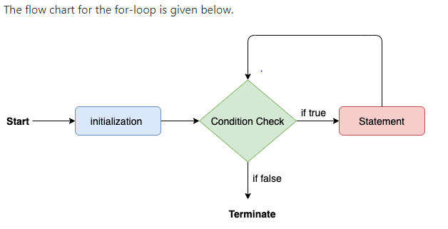

Slide 80
public class Calculattion {
public static void main(String[] args)
{
int sum = 0;
for(int j = 1; j<=10; j++)
{
sum = sum + j;
}
System.out.println("The sum of first 10 natural numbers is " + sum);
}
}
Output:
The sum of first 10 natural numbers is 55

Slide 81
for-each loop:
Java provides an enhanced for loop to traverse the data structures like array or collection. In the for-each loop, we don't need to update the loop variable. The syntax to use the for-each loop in java is given below.

Slide 82
Syntax:
for(data_type var : array_name/collection_name)
{
//statements
}

Slide 83
public class Calculation {
public static void main(String[] args) {
String[] names = {"Java","C","C++","Python","JavaScript"};
System.out.println("Printing the content of the array names:\n");
for(String name:names)
{
System.out.println(name);
}
}
}
Output:
Printing the content of the array names: Java C C++ Python JavaScript

Slide 84
while loop
The while loop is also used to iterate over the number of statements multiple times. However, if we don't know the number of iterations in advance, it is recommended to use a while loop. Unlike for loop, the initialization and increment/decrement doesn't take place inside the loop statement in while loop.

Slide 85
Syntax:
while(condition)
{
//looping statements
}

Slide 86
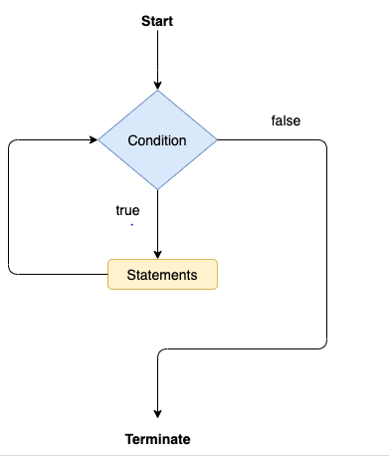

Slide 87
public class Calculation
{
public static void main(String[] args)
{
int i = 0;
System.out.println("Printing the list of first 10 even numbers \n");
while(i<=10)
{
System.out.println(i);
i = i + 2;
}
}
}

Slide 88
do-while loop:
The do-while loop checks the condition at the end of the loop after executing the loop statements. When the number of iteration is not known and we have to execute the loop at least once, we can use do-while loop.
It is also known as the exit-controlled loop

Slide 89
Syntax:
do
{
//statements
} while (condition);

Slide 90
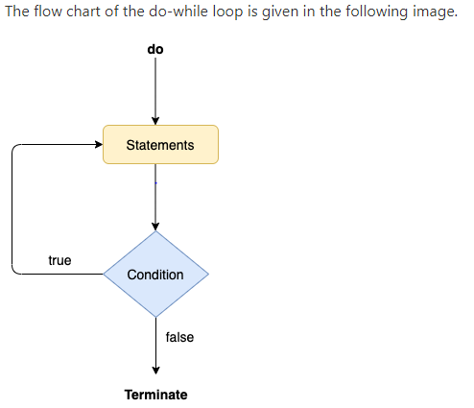

Slide 91
public class Calculation {
public static void main(String[] args) {
int i = 0;
System.out.println("Printing the list of first 10 even numbers \n");
do {
System.out.println(i);
i = i + 2;
}while(i<=10);
}
}

Slide 92
Jump Statements:
Jump statements are used to transfer the control of the program to the specific statements. In other words, jump statements transfer the execution control to the other part of the program.
There are two types of jump statements in Java, i.e., break and continue.

Slide 93
Java break statement
As the name suggests, the break statement is used to break the current flow of the program and transfer the control to the next statement outside a loop or switch statement. However, it breaks only the inner loop in the case of the nested loop.
The break statement cannot be used independently in the Java program, i.e., it can only be written inside the loop or switch statement.

Slide 94
public class BreakExample {
public static void main(String[] args) {
for(int i = 0; i<= 10; i++) {
System.out.println(i);
if(i==6) {
break;
}
}
}
}

Slide 95
Java continue statement
Unlike break statement, the continue statement doesn't break the loop, whereas, it skips the specific part of the loop and jumps to the next iteration of the loop immediately.

Slide 96
public class ContinueExample {
public static void main(String args[]) {
for(int i = 0; i<= 2; i++) {
for (int j = i; j<=5; j++) {
if(j == 4) {
continue;
}
System.out.println(j);
}
}
}
}
Output:
0 1 2 3 5 1 2 3 5 2 3 5

