Slide 1


Levelling

Slide 2
Definition, Principle, & Object of Levelling
Definition:- Levelling is defined as “an art of determining the relative height of different points on, above or below the surface”.

Slide 3
Principle of levelling
 Principle:- The principle of levelling is to obtain horizontal line of sight with respect to which vertical distances of the points above or below this line of sight are found.

Slide 4
Objectives of levelling
The objective of levelling is to
1) Find the elevation of given point with respect to some assumed reference line called datum.
2)To establish point at required elevation with respect to datum.

Slide 5
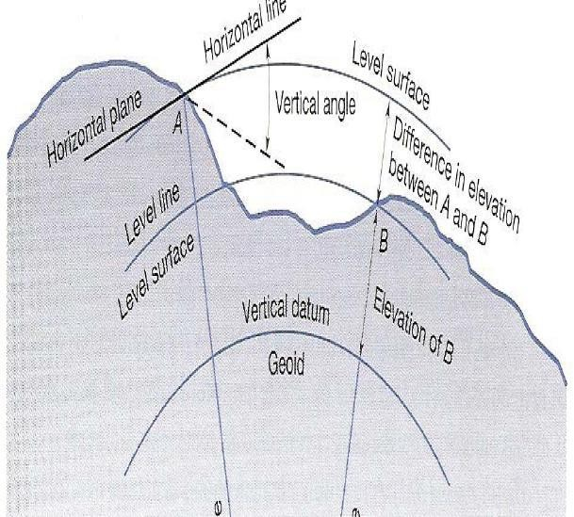

Slide 6
Definitions used in levelling
Level surface:- It is the surface parallel to the mean spheroidal surface of the earth
Level line:- Line lying on level surface.
Horizontal plane:- Horizontal plane through a point is a plane tangential to level surface.
Horizontal line:- It is a straight line tangential to level line.

Slide 7
Datum:- “It is an arbitrary level surface from which elevation of points may be referred”. In India mean sea level is considered as datum of zero elevation it is situated at Karachi.
Mean sea level is the average height of sea for all stages of tides it is derived by averaging the hourly tide height over a period of 19 years.
Elevation or Reduced level:- It is height or depth of any point above or below any datum. It is denoted as R.L.

Slide 8
Bench Mark (B.M.):- It is a fixed reference point of known elevation with respect to datum.
Line of collimation:- It is a line joining the intersection of cross hairs of diaphragm to the optical centre of object glass and its continuation. It is also known as line of sight.
Height of instrument:- It is the elevation of line of collimation with respect to datum
Back sight:- It is a staff reading taken at a known elevation. It is the first staff reading taken after setup of instrument.

Slide 9
Fore sight( F.S.):- It is the last staff reading taken denoting the shifting of the instrument.
Intermediate sight.(I.S.):-It is staff reading taken on a point whose elevation is to be determined.All staff reading between B.S. and F.S. are Intermediate sight.
Change Point:- It is a point on which both fore and back sight are taken.

Slide 10
Instruments for levelling
The following instruments are essentially required for levelling
Level
Levelling staff

Slide 11
Level and types of level
Level:- The instrument used to furnish horizontal line of sight for observing staff readings and determining R.L.s
Types of levels
Dumpy level
Tilting level
Wye level
Automatic level

Slide 12


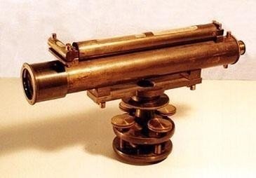
The Dumpy level is a simple, compact and stable
instrument. The telescope is rigidly fixed to its supports. Hence it cannotDbeurmotaptedyalbeouvtehlorizontal axis.

Slide 13

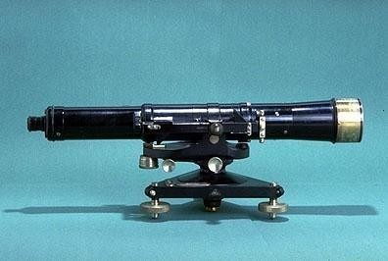
It is also known as I.O.P. level (Indian office Pattern). In
this level the telescope tilts about its horizontal axis hence it is calledTtiillttining glevleel vel

Slide 14
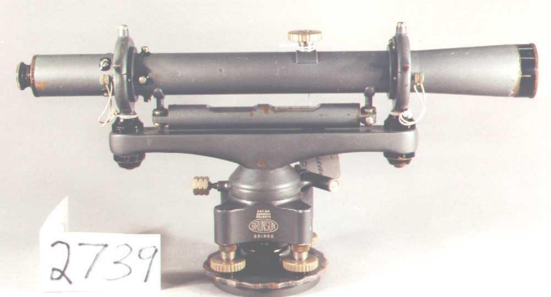
Wye level
 The essential difference between wye level and other levels is that in wye level the telescope is carried by two vertical wye supports.The telescope can be rotated, moved or even raised in wyes.

Slide 15
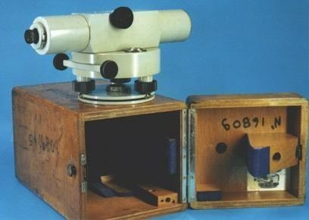
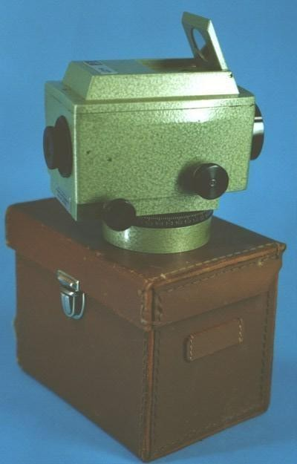
Automatic level
 It is also known as self aligning level. It is a recent development.
The fundamental difference between auto level and other levels is that the levelling is not manually but it is levelled automatically. It is achieved by inclination compensating device.

Slide 16
Levelling Staffs
Levelling staffs are scales on which these distances are measured.
Levelling staffs are of two types
Self reading staff
Target staff

Slide 17
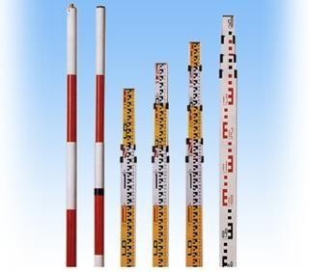
Self reading staff
The self reading staff can be read directly by the level man looking through the telescope.
Common types of self reading staffs
Ordinary staff
Sopwith telescopic staff
Folding Staff

Slide 18
Target staff
 For very precise works and sight target staff are used.A movable target is provided in this staff.A vernier is provided on target to give precise reading. In target staff level man directs the staff man to move the target up and down until it bisects by the line of sight.The staff man observe the staff reading

Slide 19
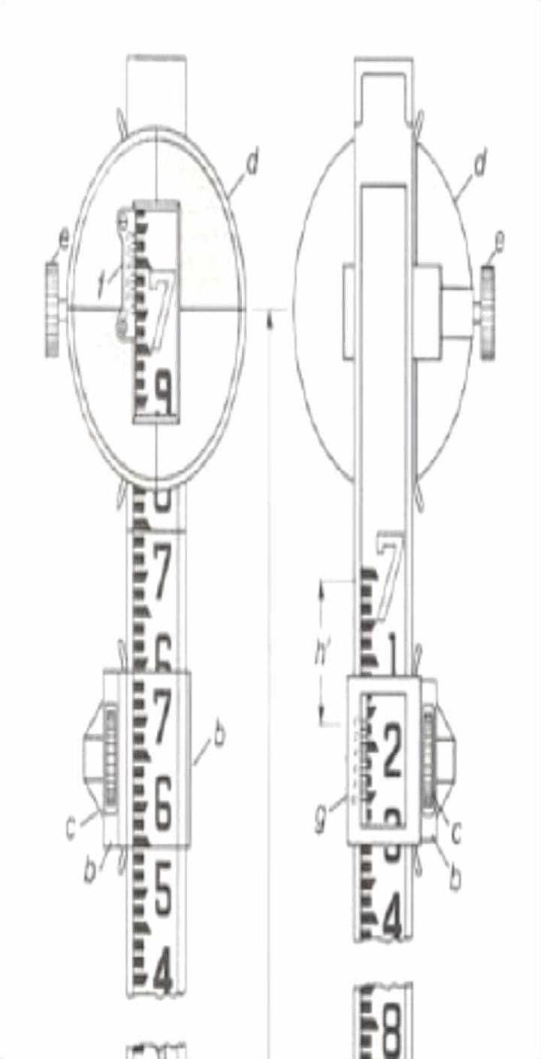

Slide 20
Bench Marks
Bench mark is a point of known elevation
There are 4 kinds of bench marks
GTS (Great trigonometrically survey bench mark)
Permanent bench mark
Arbitrary bench mark
Temporary bench mark

Slide 21
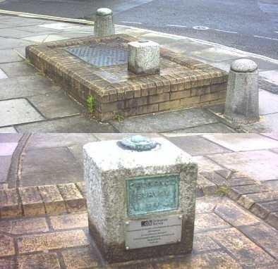
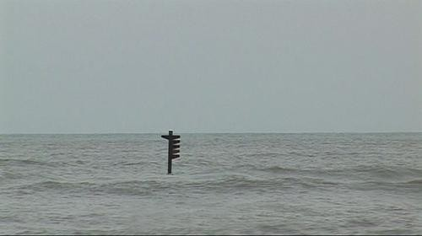
GTS Bench mark
They are the bench marks established with very high degree of precision at regular intervals by the survey of India Department all over the country Their position and R.Ls values above mean seal level at Karachi are given in catalogue formed by the department.
Mean sea level

Slide 22
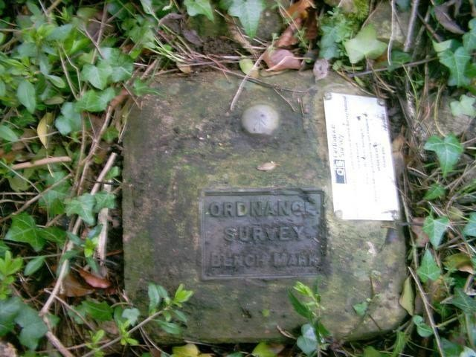
Permanent Bench mark
 Permanent bench marks are fixed in between GTS bench marks by govt. agencies such as railways, PWD, etc. This bench marks are written on permanent objects such as milestones, culverts, bridges etc their value are clearly written and their position are recorded for future reference.

Slide 23
 Arbitrary bench marks:- These are reference points whose
R.L.s are arbitrarily assumed.They are used in small works such bench mark may be assumed as 100. or 50 m
 Temporary bench marks:- They are the reference points established during the levelling operations when there is a break in work, or at the end of day’s work the value of reduced levels are marked on some permanent objects such as stones, trees etc.

Slide 24
Temporary Adjustments of a level
These adjustments are performed at every setup of instrument
Setting up of level
Levelling of telescope
Focusing of the eye piece
Focusing of object glass

Slide 25
Setting up the level:- Thisincludes
A) Fixing the instrument on tripod
B) Levelling the instrument approximately byTripod
Levelling:- Levelling Levelling is done with the help of foot screws. The purpose of levelling is to make vertical axis truly vertical. It is done with the help of foot screws
A) Place the telescope parallel to a pair of foot screw then hold the foot screws between thumb and first finger and turn them either inward or outward until the longitudinal bubble comes in the centre.
B)Turn the telescope through 90⁰ so that it lies parallel to third foot screw, turn the screw until the bubble comes in the centre.

Slide 26
Focusing the eye piece:- To focus the eye piece, hold a white paper in front of object glass, and move the eye piece in or out till the cross hair are distinctly seen.
Focusing of object glass:- Direct the telescope to the levelling staff and on looking through the telescope, turn the focusing screw till the image appears clear and sharp.

Slide 27
Classification of levelling
Direct levelling
Simple levelling
Differential leveling
Fly levelling
Check levelling
Profile levelling
Cross levelling
Reciprocal levelling
Precise levelling
Indirect levelling
Trignometric levelling
Barometric levelling
Hypesometric levelling

Slide 28
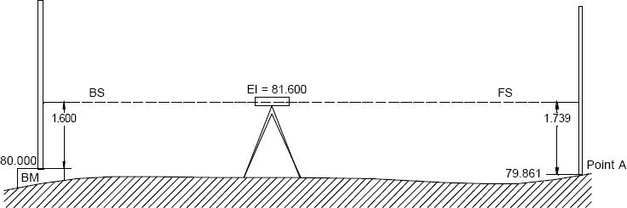
 Simple levelling:- It is the simplest method used, when it is required to find the difference in elevation between 2 points.
 Differential Levelling:- This method is used to find the difference in the elevation between points if they are too far apart or the difference in elevation between them is too much.

Slide 29


Slide 30
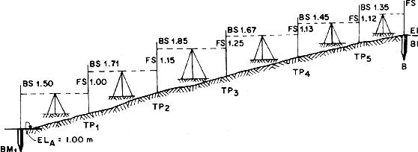
 Fly levelling:- Fly levelling is just like differential levelling carried out to check the accuracy of levelling work. In fly levelling only B.S.and F.S.are taken

Slide 31
Check levelling:- This kind of levelling is carried out to check the accuracy of work. It is done at the end of the days work in the form of fly levelling to connect the finishing point and starting point.
Profile levelling or L-Section:- This method is used for taking levels along the centre line of any alignment like road, railway canal etc.The object is to determine the undulations of the ground surface along the alignment

Slide 32
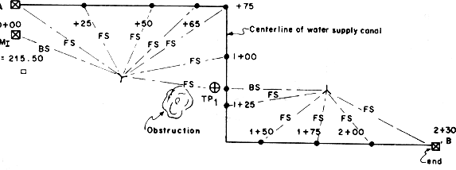
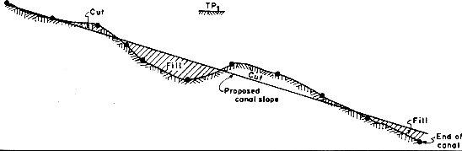

Slide 33
Cross- sectioning:- This operation is carried out perpendicular to alignment at an interval of 10, 20 ,30, 40 m.The idea is to make an estimate of earthwork.
Precise levelling:- It is used for establishing bench marks for future public use. It is carried out with high degree of accuracy using advanced instruments
Trignometric levelling:- In this method vertical distances between points are computed by observing horizontal distances and vertical angle between points.

Slide 34
Barometric levelling:- In this method the altitude difference is determined by means of a barometer.
Hyposometric levelling:- The working of Hyposometry for determining the elevation depends upon the fact that the temperature at which water boils varies with the atmospheric pressure. The boiling point of water reduces at higher altitude thus knowing the boiling point of water, the atmospheric pressure can be calculated and knowing the atmospheric pressure altitude or elevation can be determined

Slide 35
Methods of Reducing levels
 Height of Instrument Method:-
This method consist of finding H.I. for every setup of instrument, and then obtaining the R.L. of point of reference with respect to H.I

Slide 36
HI
B.S 0.9m
B.M 100 M.
I.S
_{F.S 1.05m} B.S 1.45m
F.S=1.55 m
A 100 m
B 99¹.^{.1}8^{m}m
C 99.85 m
C .P.
D 99.750 m
Station | B.S | I.S | F.S | H.I | R.L | Remark
A | 0.9 |  |  | 100.9 | 100.00 | B.M
B |  | 1.1 |  |  | 99.800
C | 1.450 |  | 1.05 | 101.3 | 99.850 | C.P.
D |  |  | 1.550 |  | 99.750

Slide 37
This method consist of determining the difference of
level between consecutive points by comparing each point witRh iismemedaiantedprfeaceldlinmg peoitnht.od
witRh iismemedaiantedprfeaceldlinmg peoitnht.od

Slide 38
Rise And Fall Method
B.S 0.9m
B.M 100 M.
I.S 1.1m
F.S 1.05m
B.S 1.45m
F.S=1.55 m
A 100 m
B 99.8m
C 99.85 m
C .P.
D 99.750 m
Station | B.S | I.S | F.S | Rise | Fall | R.L | Remark
A | 0.9 |  |  |  |  | 100.00 | B.M
B |  | 1.1 |  |  | 0.2 | 99.800
C | 1.450 |  | 1.05 | 0.05 |  | 99.850 | C.P.
D |  |  | 1.550 |  | 0.1 | 99.750

Slide 39
Example
 The following staff readings were observed successively with a level the instrument is moved by third sixth and eighth readings. : 2.228 :1.606 :0.988 :2.090 :2.864 :1.262 0.602 :1.982:1.044 :2.684 m enter the reading in record book and calculate R.L. if the first reading was taken at a B.M of 432.383m

Slide 40
H.I. Method
Station | B.S | I.S | F.S | HI | RL | REMAR KS
1 | 2.228 |  |  | 434.612 | 432.384 M | B.M.
2 |  | 1.606 |  |  | 433.006
3 | 2.090 |  | 0.988 | 435.714 | 433.624 | 3RD C.P.
4 |  | 2.864 |  |  | 432.850
5 | 0.602 |  | 1.262 | 435.054 | 434.452 | 6TH C.P
6 | 1.044 |  | 1.982 | 434.116 | 433.072 | 8TH C.P
7 |  |  | 2.684 |  | 431.432
 | 5.964 |  | 6.916
CHECK ∑ B.S- ∑ F.S= 5.964-6.916= -0.952
= LAST R.L- FIRST R.L= 431.432-432.384=-0.952

Slide 41
Rise and fall method
Station | B.S | I.S | F.S | Rise | Fall | RL | REMARKS
1 | 2.228 |  |  |  |  | 432.384 M | B.M.
2 |  | 1.606 |  | 0.622 |  | 433.006
3 | 2.090 |  | 0.988 | 0.618 |  | 433.624 | 3RD C.P.
4 |  | 2.864 |  |  | 0.774 | 432.850
5 | 0.602 |  | 1.262 | 1.602 |  | 434.452 | 6TH C.P
6 | 1.044 |  | 1.982 |  | 1.38 | 433.072 | 8TH C.P
7 |  |  | 2.684 |  | 1.64 | 431.432
 | 5.964 |  | 6.916
CHECK ∑ B.S- ∑ F.S= 5.964-6.916= -0.952 = LAST R.L- FIRST R.L= 431.432-432.384=-0.952
∑RISE- ∑ FALL= 2.842-3.794=-0.952

Slide 42
Errors in Levelling
 The following are the different sources of Errors
Personal Error
  The Instruments may not be leveled
  The focusing of eye piece and objective glass may not be perfect
  The parallax may not be eliminated
  The position of staff may have changed
  Entry and recording in the field book may not be correct
  The staff may not be fully extended, may not be held vertical.

Slide 43
Instrumental Error:
  The Permanent adjustment of the instrument may not be perfect. That is the line of collimation may not be horizontal line
  The internal arrangement of focusing tube may not be correct
  The graduation of the staff may not be perfect

Slide 44
Errors due to Natural Causes:
  The Curvature of the Earth may affect the staff readings when the distance of sight is long.
  The effect of refraction may cause a wrong staff reading
  There are some errors in staff readings due to high velocity wind.

