Slide 1
2. Orbital Mechanics and Launchers

Slide 2
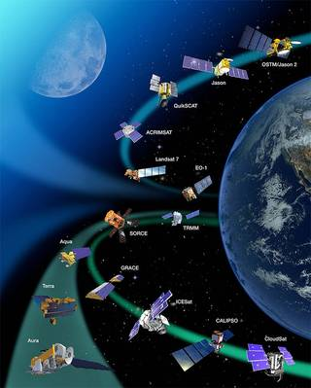

Slide 3
2.1. Developing the Equations of the Orbit-Achieving a Stable Orbit
The path of satellite revolving around the earth is known as orbit. This path can be represented with mathematical notations.
Orbital mechanics is the study of the motion of the satellites that are present in orbits. So, we can easily understand the space operations with the knowledge of orbital motion.
To achieve a stable orbit around the earth, a spacecraft must first be beyond the bulk of the earth’s atmosphere, i.e., popularly called space.

Slide 4
Newton’s laws of motion can be encapsulated into four equations:
s = ut + (1/2)at²
v² = u² + 2at
v = u + at
F = ma
Where
s = Distance traveled from time, t=0, u = Initial Velocity of the object at t = 0, v = Final Velocity of the object at time t, a = Acceleration of the object, F = Force acting on the object, m= mass of the object
Note that the acceleration can be positive or negative, depending on the direction it is acting with respect to the velocity vector.

Slide 5
Out of Newton’s four equations, F=ma helps us understand the motion of a satellite in a stable orbit.
F=ma states that the force acting on a body is equal to the mass of the body multiplied by the resulting acceleration of the body.
Alternatively, the resulting acceleration is the ratio of the force acting on the body to the mass of the body.
Thus, for a given force, the lighter the mass of the body, the higher will be the acceleration.
When in a stable orbit, there are two main forces acting on a satellite:
a centrifugal force due to the kinetic energy of the satellite, which attempts to fling the satellite into a higher orbit, and
a centripetal force due to the gravitational attraction of the planet about which the satellite is orbiting, which attempts to pull the satellite down toward the planet.
If these two forces are equal, the satellite will remain in a stable orbit.

Slide 6
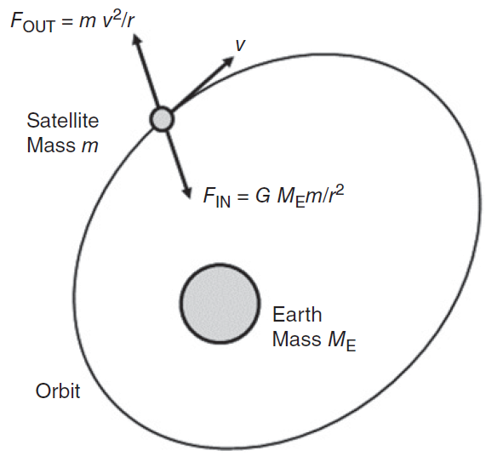
Figure shows the Forces acting on a satellite in a stable orbit around the earth.
Gravitational force is inversely proportional to the square of the distance between the centers of gravity of the satellite and the planet the satellite is orbiting, in this case the earth.
The gravitational force inward (FIN, the centripetal force) is directed toward the center of gravity of the earth.
The kinetic energy of the satellite (FOUT, the centrifugal force) is directed diametrically opposite the gravitational force. Kinetic energy is proportional to the square of the velocity v of the satellite.
When these inward and outward forces are balanced, the satellite moves around the earth in a free fall trajectory: the satellite’s orbit.

Slide 7
Force = mass × acceleration and the unit of force is a Newton, with the notation N.
A Newton is the force required to accelerate a mass of 1 kg with an acceleration of 1m/s².
Therefore the units of a Newton are (kg) × m/s².
The standard acceleration due to gravity at the earth’s surface is 9.80665×10⁻³ km/s²=981 cm/s². This value decreases with height above the earth’s surface.
The acceleration, a, due to gravity at a distance r from the center of the earth is:
where the constant μ is called Kepler’s constant which the product of the universal gravitational constant G and the mass of the earth M_{E.}
The universal gravitational constant G=6.672×10⁻¹¹ Nm²/kg² (or) 6.672×10⁻²⁰ km³/kg s²
Kepler’s constant μ = GM_{E} =3.986 004 418 × 10⁵ km³/s²

Slide 8
Since force = mass × acceleration, the centripetal force acting on the satellite, F_{IN}, is given by:
In a similar fashion, the centrifugal acceleration is given by:
The centrifugal force, F_{OUT}, as:

Slide 9
If the forces on the satellite are balanced F_{IN}= F_{OUT}
Hence the velocity v of a satellite in a circular orbit is given by
If the orbit is circular, the distance traveled by a satellite in one orbit around a planet is 2πr, where r is the radius of the orbit from the satellite to the center of the planet.
Since distance divided by velocity equals time to travel that distance, the period of the satellite’s orbit, T, will be

Slide 10
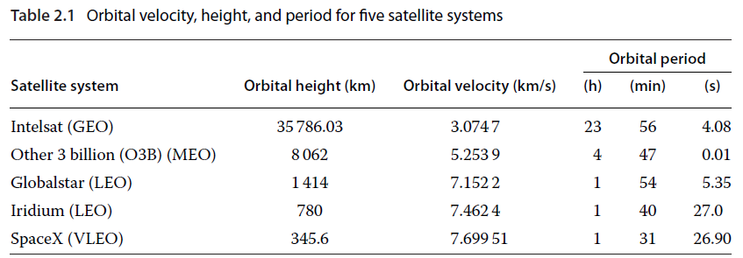
Table 2.1 gives the velocity, v, and orbital period, T, for four satellite systems that occupy typical low earth orbit (LEO), medium earth orbit (MEO), and geostationary earth orbit (GEO) orbits around the earth.
In each case, the orbits are circular and the average radius of the earth is taken as 6378.137 km

Slide 11
Example: A satellite is in a 322 km high circular orbit. Determine:
a. The orbital angular velocity in radians per second;
b. The orbital period in minutes; and
c. The orbital velocity in meters per second.
Note: Assume the average radius of the earth is 6378.137 km and Kepler’s constant has the value 3.986004 418 × 10⁵ km³ /s²
Answer:
(c) The orbital velocity in meters per second:
The total radius r of the orbit
The velocity v of a satellite in a circular orbit is given by (the orbital velocity)

Slide 12
(b) The orbital period in minutes:
(a) The orbital angular velocity in radians per second:
The orbital period from above is 5458.037372 seconds. One revolution of the earth covers 360° or 2π radians.
Hence 2π radians are covered in 5458.037372 seconds, giving the orbital angular velocity as 2π/5458.037 372 rad/s = 0.0011512 rad/s.
An alternative calculation procedure would calculate the distance traveled in one orbit (2πr =2π6700.137 = 42098.20236 km).
This distance is equivalent to 2π radians and so 1 km is equivalent to 2π/42098.202 36 rad = 0.000 149 3 rad.
From above, the orbital velocity was 7.713 066 km/s = 7.713066 × 0.0001493 rad/s = 0.0011512 rad/s.

Slide 13
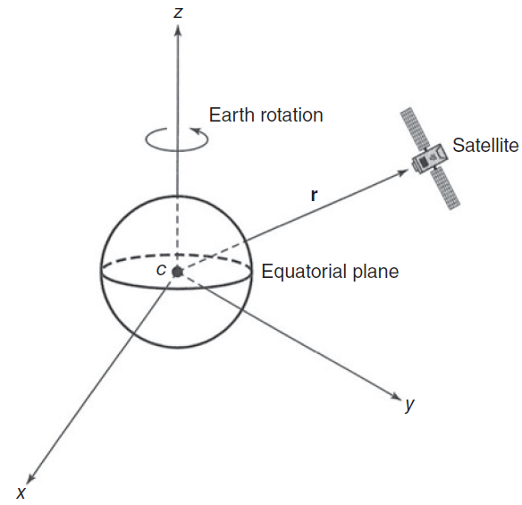
A number of coordinate systems and reference planes can be used to describe the relationship between the earth and a satellite.
Figure 2.2 illustrates a Cartesian coordinate system with the earth at the center and the reference planes coinciding with the equator and the polar axis. This is referred to as a geocentric coordinate system.
A Cartesian coordinate system with the geographical axes of the earth as the principal axes is the simplest coordinate system and the origin at the center of the earth.
The rotational axis of the earth is about the z axis, which passes through the geographic north pole.
The x and y axes are mutually orthogonal to the z axis and lie in the earth’s equatorial plane.
The vector r locates the satellite with respect to the center of the earth.

Slide 14
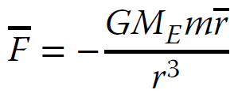
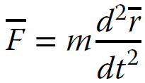
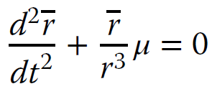
With the coordinate system set up as in Figure 2.2, and with the satellite mass m located at a vector distance r from the center of the earth, the gravitational force F (inward) on the satellite is given by:
Where M_{E} is the mass of the earth and G=6.672× 10⁻¹¹ Nm² /kg².
Outward force = mass × acceleration and above can be written as:
From equations 2.7 and 2.8 we have:
This is a second order linear differential equation and its solution will involve six undetermined constants called the orbital elements.

Slide 15
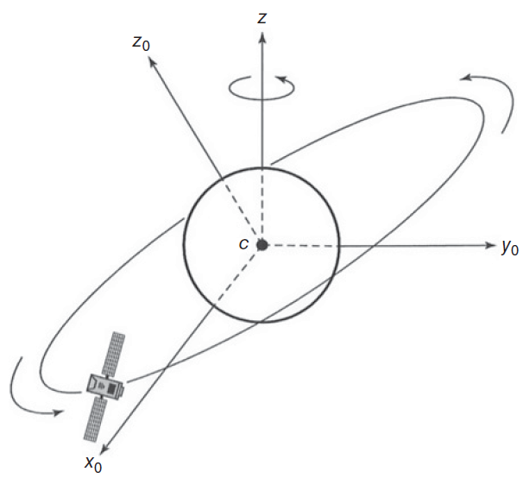
The solution to second order linear differential equation is difficult since the second derivative of r involves the second derivative of the unit vector r.
To remove this dependence, a different set of coordinates can be chosen to describe the location of the satellite such that the unit vectors in the three axes are constant.
This coordinate system is called orbital plane coordinate system with the earth at the center the plane of the satellite’s orbit as the reference plane as shown if Figure 2.3.
The orthogonal axes x₀ and y₀ lie in the orbital plane. The third axis, z₀ is orthogonal to the x₀ and y₀ axes.
The z₀ axis is not coincident with the earth’s z axis through the earth’s north pole unless the orbital plane lies exactly in the earth’s equatorial plane.

Slide 16
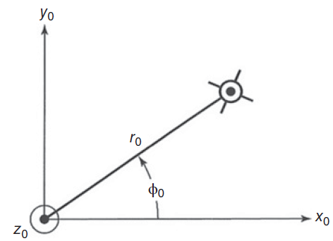
Expressing the equation 2.10 in terms of the new coordinate axes x₀, y₀ and z₀ gives:
Equation (2.11) is easier to solve if it is expressed in a polar coordinate system rather than a Cartesian coordinate system.
Figure 2.4 Polar coordinate system in the plane of the satellite’s orbit. The axis z₀ is straight out of the paper from the center of the earth and is normal to the plane of the satellite’s orbit.
The satellite’s position is described in terms of the distance r₀ from the center of the earth and the angle this makes with the x₀ axis, ϕ0.

Slide 17
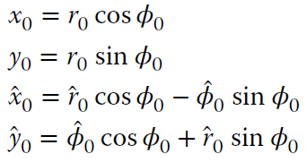
With the polar coordinate system shown in Figure 2.4 and using the transformations and equating the vector components of r₀ and ϕ0 in turn in Eq. (2.11) yields

Slide 18
Using standard mathematical procedures, we can develop an equation for the radius of the satellite’s orbit, r₀, namely:
where θ0 is a constant and e is the eccentricity of an ellipse whose semilatus rectum p is given by:
and h is the magnitude of the orbital angular momentum of the satellite. That the equation of the orbit is an ellipse is Kepler’s first law of planetary motion.

Slide 19
2.2. Kepler’s Three Laws of Planetary Motion
We know that satellite revolves around the earth, which is similar to the earth revolves around the sun.
So, the principles which are applied to earth and its movement around the sun are also applicable to satellite and its movement around the earth.
Johannes Kepler [(1571–1630) was a German astronomer and scientist] developed three laws of planetary motion by careful observations of the behavior of the planets in the solar system over many years.
Kepler’s laws for satellites are basic rules that help in understanding the movement of a satellite.

Slide 20
Kepler’s three laws are:
The orbit of any smaller body about a larger body is always an ellipse, with the center of mass of the larger body as one of the two foci. This law is also called as “the law of Ellipse or orbit”.
The orbit of the smaller body sweeps out equal areas in equal time. This law is also known as “the law of equal areas”.
The square of the period of revolution of the smaller body about the larger body equals a constant multiplied by the cube of the semimajor axis of the orbital ellipse. That is $T^{2}=\left(\frac{4π^{2}}{μ}\right)a^{3}.$where T is the orbital period, a is the semimajor axis of the orbital ellipse, and μ is Kepler’s constant. This law is also called as “the law of orbital period”
If the orbit is circular, then a becomes distance r, and we have the orbital period:

Slide 21
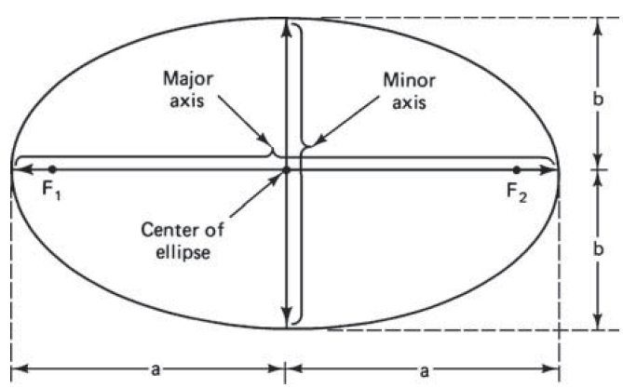
2.2.1. Kepler's First Law-the law of Ellipse or orbit
Statement: The orbit of any smaller body about a larger body is always an ellipse, with the center of mass of the larger body as one of the two foci. This law is also called as “the law of Ellipse or orbit”.
The path followed by a satellite around the earth will be an ellipse. (or) Orbit is an ellipse with the larger body (earth) at one focus.
An ellipse is a shape that appears to resemble an elongated circle. In fact, a circle is a special type of an ellipse.
An ellipse has two focal points shown as F1 and F2.
The semimajor axis of the ellipse is denoted by a, and the semiminor axis is denoted by b.
The eccentricity e (which is a measure of its elongation/thinness) is given by
e = $\frac{\sqrt{a^{2}−b^{2}}}{a}$
For an elliptical orbit, 0<e<1.
When e =0, the orbit becomes circular.

Slide 22
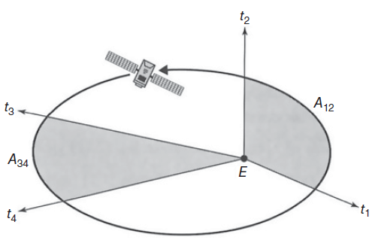
2.2.2. Kepler’s Second Law-the law of equal areas
Statement: The orbit of the smaller body sweeps out equal areas in equal time. This law is also known as “the law of equal areas”. (Or) Satellites will cover equal areas in equal intervals of time;
A satellite does not have a uniform velocity in an elliptical orbit. It will move faster when close to Earth and slower when far from Earth. The satellite will have a constant speed in the case of a circular orbit.
While close to perigee, the satellite moves in the orbit between t₁ and t₂ and sweeps out an area denoted by A₁₂.
While close to apogee, the satellite moves in the orbit between times t₃ and t₄ and sweeps out an area denoted by A₃₄.
If t₂ - t₁ = t₄ - t₃ then A₁₂ = A₃₄
Velocity of satellite is SLOWEST at APOGEE; FASTEST at PERIGEE

Slide 23
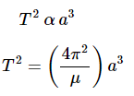
2.2.3. Kepler’s third law-the law of orbital period
Statement: The square of the periodic time of an elliptical orbit is proportional to the cube of its semi major axis length.
Where, is the proportionality constant.
The orbital period is the time taken by satellites to complete one orbit. The period of the orbit depends only on the average distance between the satellite and Earth.

Slide 24
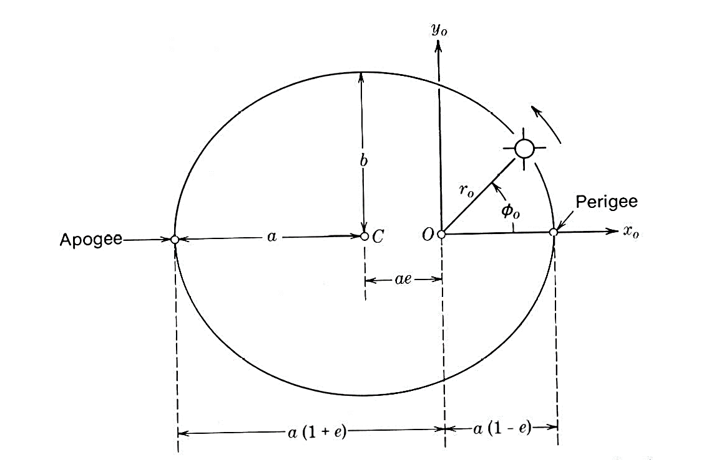
Example 1. A satellite is in an elliptical orbit with a perigee of 1000 km and an apogee of 4000 km from the surface of the earth. Find the period of the orbit and eccentricity of the orbit, assuming the mean earth radius as 6378.14 km.
The major axis (2a) of elliptical orbit is a straight line between Apogee and Perigee points.
Given data:
Perigee height hp=1000 km,
Apogee height ha=4000 km,
earth radius re =6378.14 km
μ = =3.986004418 ×10⁵ km³/s²
Major axis, 2a = r_{e} + ha + r_{e} + hp
2a=2re + ha + hp
2a=(2x6378.14)+4000+1000=17756.28 km
Semimajor axis, a=8878.14 km
The orbital period, T² = (4 π² a³) / μ,
T² = [(4 π² x 8878.14³)]/ 3.986004418 ×10⁵ km³/s²
T=2 hr 18 min 44.99 sec
If the satellite is at perigee, r₀=r_{e}+ h_{p} and Eccentric anomaly ϕ₀ =0
Now, r₀=a(1-e cos ϕ₀ )=a(1-e)
Hence, r_{e}+ h_{p} =a(1-e)
eccentricity of the orbit e= 1-(r_{e}+ h_{p} )/a=e=0.169

Slide 25
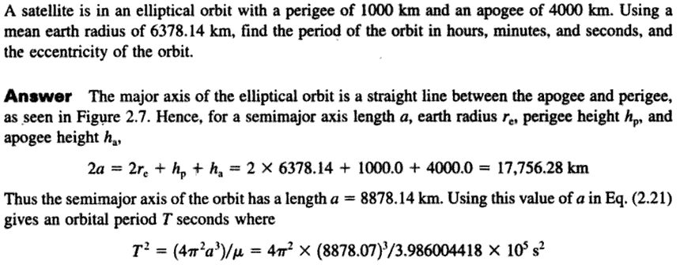
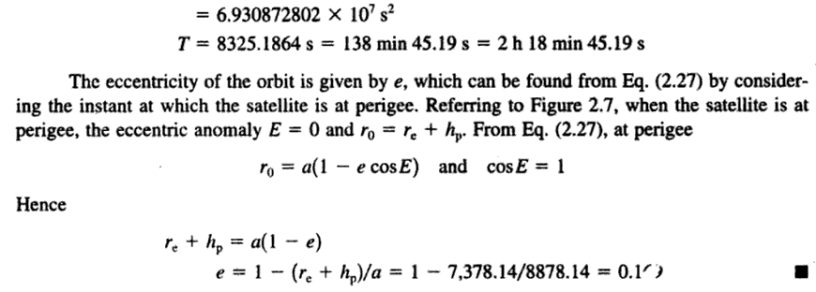

Slide 26
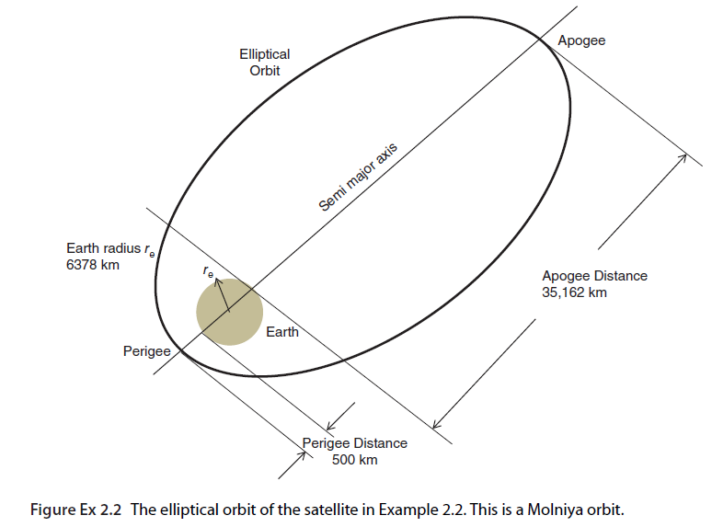
Example 2 : A satellite in an elliptical orbit around the earth has an apogee of 39152 km and a perigee of 500 km. What is the orbital period of this satellite? Give your answer in hours. Note: Assume the average radius of the earth is 6378.137 km and Kepler’s constant has the value 3.986004418 ×10⁵ km³/s²
Given data:
Perigee height hp=500 km,
Apogee height ha=39152 km,
earth radius re =6378.137 km
Kepler’s constant, μ =3.986004418 ×10⁵ km³/s²
Major axis, 2a= r_{e} + ha + r_{e} + hp
2a=2re + ha + hp
2a=(2x6378.137)+ 39152 + 500 =52408.274 km
Semimajor axis, a=26204.137 km
The orbital period, T² = (4 π² a³) / μ,
T² = [(4 π² x 26204.137³)]/ 3.986004418 ×10⁵ km³/s²
T² = 1782097845.0 s²
Therefore, T = 42214.90075 s = 11.72636132 h
T= (11 hours 43 minutes 34.9 seconds)

Slide 27
2.3. Describing the Orbit of a Satellite
We know the equation for the radius of the satellite’s orbit, r₀
The quantity θ_{o} in Eq. (2.15) serves to orient the ellipse with respect to the orbital plane axes x_{o} and y_{o}.
we know that the orbit is an ellipse, we can always choose x_{o} and y_{o} so that θ_{o} is zero.
This now gives the equation of the orbit as:

Slide 28
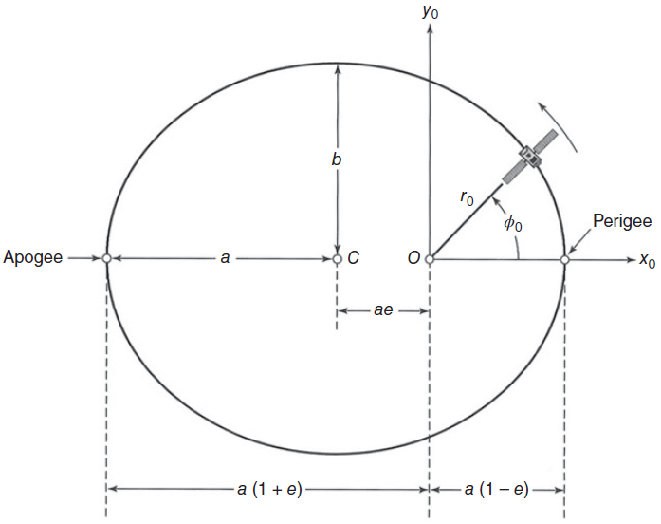
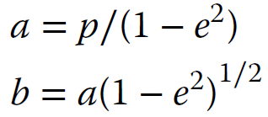
The path of the satellite in the orbital plane is shown in Figure 2.6.
The lengths a and b of the semimajor and semiminor axes are given by:
where
and
The point in the orbit where the satellite is closest to the earth is called the perigee. The point where the satellite is farthest from the earth is called the apogee.
The perigee and apogee are always exactly opposite each other.
To make θ_{o} equal to zero, we have chosen the x_{o} axis so that both the apogee and the perigee lie along it and the x_{o} axis is therefore the major axis of the ellipse.

Slide 29
The differential area dA swept out by the vector r_{o} from the origin to the satellite in time dt is given by:
Remembering that h is the magnitude of the orbital angular momentum of the satellite, the radius vector of the satellite can be seen to sweep out equal areas in equal times. This is Kepler’s second law of planetary motion.
By equating the area of the ellipse (πab) to the area swept out in one orbital revolution, we get the elliptical orbital period T as:
This equation is the mathematical expression of Kepler’s third law of planetary motion: the square of the period of revolution is proportional to the cube of the semimajor axis.

Slide 30
e=0, circle
e<1, ellipse
e=1, parabola
e>1, hyperbola
e=infinite, line
Time period of elliptical orbit
Time period of circular orbit
The elliptical orbit time period is the square of period of the circular orbit (semimajor axis a = semiminor axis b = circular orbit radius from the center of the earth r. )
Kepler’s third law extends the result from Eq. (2.6), which was derived for a circular orbit, to the more general case of an elliptical orbit.
Equation (2.21) is extremely important in satellite communications systems.
This equation determines the period of the orbit of any satellite, and it is used in every GPS receiver in the calculation of the positions of GPS satellites.
Equation (2.21) is also used to find the orbital radius of a GEO satellite, for which the period T must be made exactly equal to the period of one revolution of the earth for the satellite to remain stationary over a point on the equator.

Slide 31
To be perfectly geostationary, the orbit of a satellite needs to have three features:
it must be exactly circular (i.e., have an eccentricity of zero);
it must be at the correct altitude (i.e., have the correct orbital period); and
it must be in the plane of the equator (i.e., have a zero inclination with respect to the equator).
If the inclination of the satellite is not zero and/or if the eccentricity is not zero, but the orbital period is correct, then the satellite will be in a geosynchronous orbit.

Slide 32
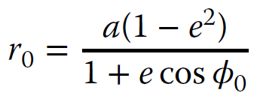
2.4. Locating the Satellite in the Orbit
The equation of the orbit may be rewritten by combining Eqs. (2.15) and (2.18) to obtain:
The angle ϕ_{o} (see Figure 2.6) is measured from the x_{o} axis and is called the true anomaly.
Since we defined the positive x_{o} axis so that it passes through the perigee, ϕ_{o} measures the angle from the perigee to the instantaneous position of the satellite.

Slide 33
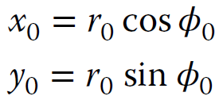
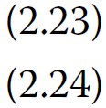
The rectangular coordinates of the satellite are given by
As noted earlier, the orbital period T is the time for the satellite to complete a revolution in inertial space, traveling a total of 2π radians. The average angular velocity η is thus:
If the orbit is an ellipse, the instantaneous angular velocity will vary with the position of the satellite around the orbit

Slide 34
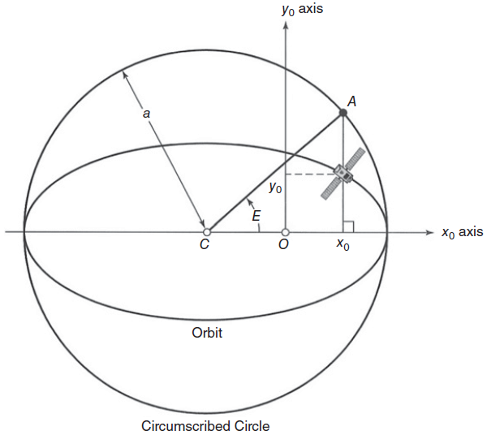
If we enclose the elliptical orbit with a circumscribed circle of radius a (see Figure 2.7), then an object going around the circumscribed circle with a constant angular velocity η would complete one revolution in exactly the same period T as the satellite requires to complete one (elliptical) orbital revolution.
Consider the geometry of the circumscribed circle as shown in Figure 2.7.
Locate the point (indicated as A) where a vertical line drawn through the position of the satellite intersects the circumscribed circle.

Slide 35
A line from the center of the ellipse (C) to this point (A) makes an angle E (called eccentric anomaly of the satellite) with the x_{o} axis. It is related to the radius r_{o} by:
Thus
We can also develop an expression that relates eccentric anomaly E to the average angular velocity η, which yields:
Let t_{p} be the time of perigee. This is simultaneously the time of closest approach to the earth; the time when the satellite is crossing the x_{o} axis; and the time when E is zero.

Slide 36
If we integrate both sides of Eq. (2.28), we obtain
The left side of Eq. (2.29) is called the mean anomaly, M. Thus
The mean anomaly M is the arc length (in radians) that the satellite would have traversed since the perigee passage if it were moving on the circumscribed circle at the mean angular velocity η.

Slide 37
If we know the time of perigee, t_{p}, the eccentricity, e, and the length of the semimajor axis, a, we now have the necessary equations to determine the coordinates (r_{o}, ϕ_{o}) and (x_{o}, y_{o}) of the satellite in the orbital plane. The process is as follows:
1. Calculate angular velocity η using Eq. (2.25)
2. Calculate mean anomaly M using Eq. (2.30)
3. Solve Eq. (2.30) for eccentric anomaly E
4. Find radius r_{o} from E using Eq. (2.27)
5. Solve Eq. (2.22) for angle ϕ_{o}
6. Use Eqs. (2.23) and (2.24) to calculate x_{o} and y_{o}
Now we must locate the orbital plane with respect to the earth.

Slide 38
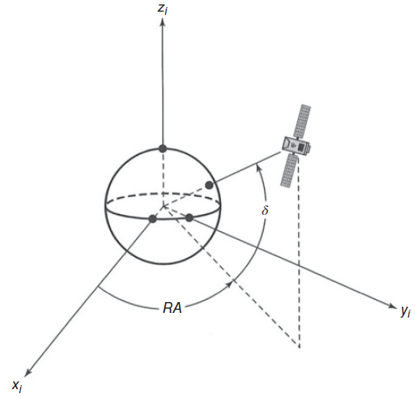
2.5. Locating the Satellite With Respect to the Earth
At the end of the last section, we summarized the process for locating the satellite at the point (x_{o}, y_{o} z_{o}) in the rectangular coordinate system of the orbital plane. The location was with respect to the center of the earth.
In most cases, we need to know where the satellite is from an observation point that is not at the center of the earth.
We will begin with a geocentric equatorial coordinate system as shown in Figure 2.8.

Slide 39
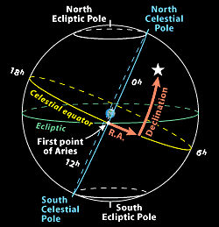
The rotational axis of the earth is the z_{i} axis, which is through the geographic North Pole.
The x_{i} axis is from the center of the earth toward a fixed location in space called the first point of Aries.
The (x_{i}, y_{i}) plane contains the earth’s equator and is called the equatorial plane.

Slide 40
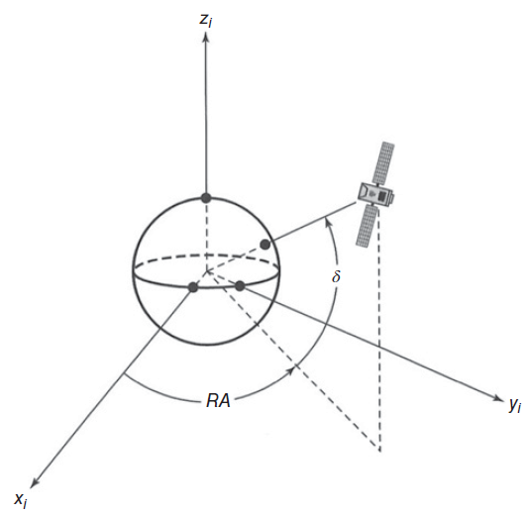
Angular distance measured eastward in the equatorial plane from the xi axis is called right ascension and given the symbol RA.
The two points at which the orbit penetrates the equatorial plane are called nodes; the satellite moves upward through the equatorial plane at the ascending node and downward through the equatorial planeat the descending node, given the conventional picture of the earth, with north at the top, which is in the direction of the positive z axis for the earth centered coordinate set.
Remember that in space there is no up or down; that is a concept we are familiar with because of gravity at the earth’s surface.
For a weightless body in space, such as an orbiting spacecraft, up and down have no meaning unless they are defined with respect to a reference point.

Slide 41
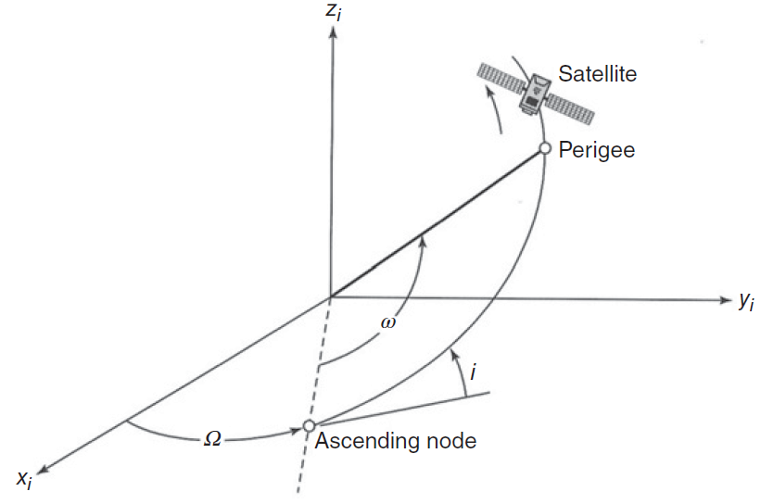
The right ascension of the ascending node is called Ω. The angle that the orbital plane makes with the equatorial plane (the planes intersect at the line joining the nodes) is called the inclination, i. Figure 2.9 illustrates these quantities.
The variables Ω and i together locate the orbital plane with respect to the equatorial plane.
To locate the orbital coordinate system with respect to the equatorial coordinate system we need ω, the argument of perigee west. This is the angle measured along the orbit from the ascending node to the perigee.

