Slide 1
BAPATLA ENGINEERING COLLEGE :: BAPATLA
(Autonomous)
Deep Learning (20ECJ44)
By
Dr. Naga Raju Challa
Assistant Professor,
Department of ECE,
Bapatla Engineering College,
(Autonomous)
Bapatla.

Slide 2
UNIT- IV
Sequence Modelling–Recurrent and Recursive Nets

Slide 3
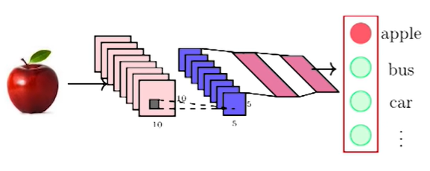
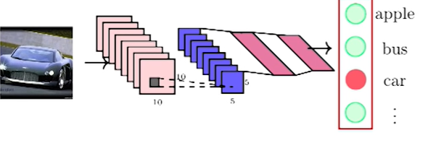
Sequence Learning Problem
In previous chapters, Feedforward neural networks and CNN have been discussed in detailed.
However, in this networks the size of the inputs were always fixed.
For example, we fed fixed size of (32×32) images to CNN for image classification.
Further, each input to the network was independent of the previous or future inputs.
For many applications the inputs are not in fixed size and also the successive inputs may not be independent each other.

Slide 4
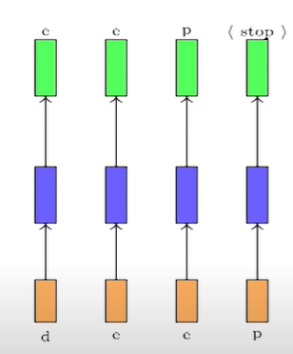
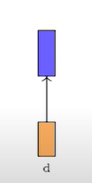
Sequence Learning Problem
Let us consider an example, consider the task of auto completion such as typing a message or WhatsApp messages.
Let us consider type a “deep”, the first character is ‘d’ you want to predict the next character ‘e’ and so on.
This is what is my task.

Slide 5
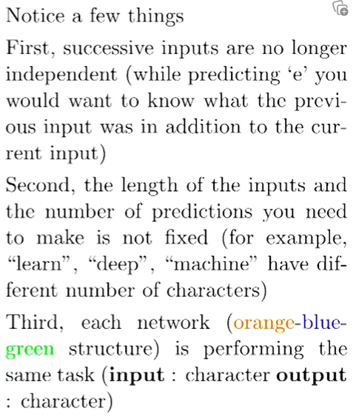
Sequence Learning Problem
This problem is known as sequence learning problem.

Slide 6
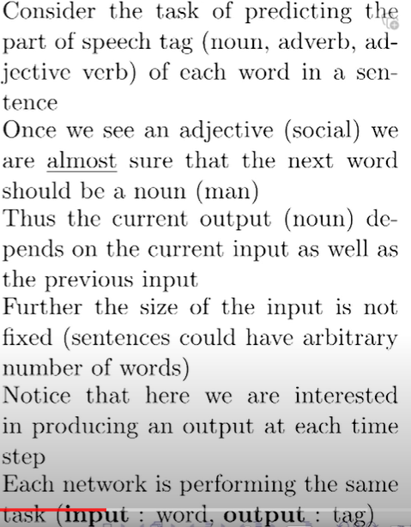
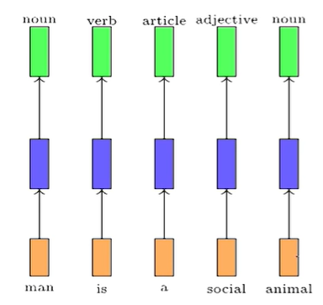
Sequence Learning Problem

Slide 7
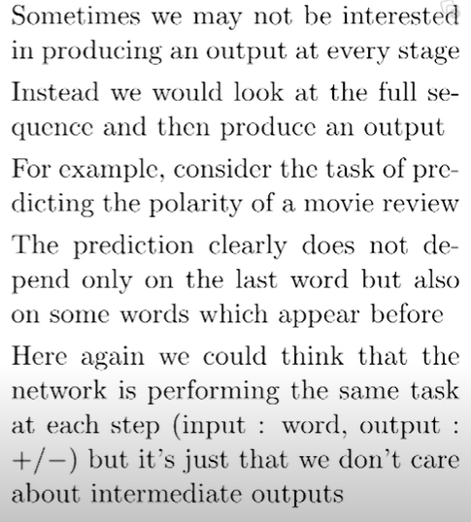
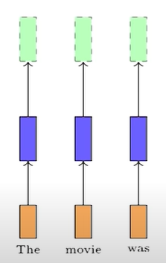
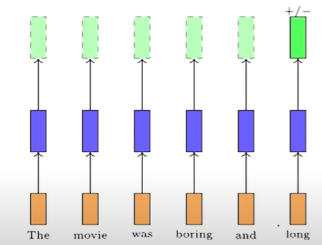
Sequence Learning Problem

Slide 8
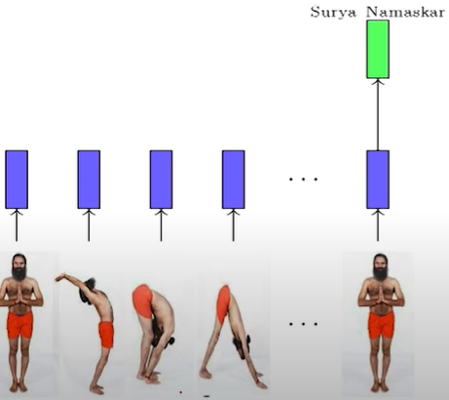
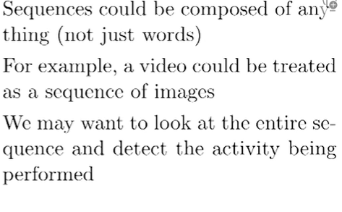
Sequence Learning Problem

Slide 9
Recurrent Neural Networks
How do we model such sequence learning problem sequence?
Wish list:
Accounts depends between inputs
Because that is the strong case that we have made that the output actually depends on multiple inputs and not a single input.
Accounts for variable number of inputs
Because a video should be 300 seconds or it could be 20 seconds 25 seconds and an sentence could be arbitrary lines an so on.
Make sure that the function executed at each time step should be same
Because in every time step you have to do the same time activity.
So we will focus on each of these items from our wish list and try to arrive at a model for dealing with such problems.

Slide 10
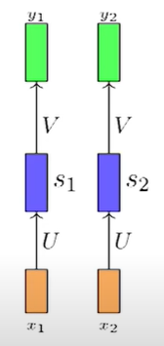
Recurrent Neural Networks
Where, X=Input Layer; S= Hidden Layer ;Y= Output Layer
What is the function can be executed at each step is
$$\begin{matrix}s_{i}=σ\left(Ux_{i}+b\right) \\ y_{i}=ο\left(Vs_{i}+c\right) \\ i= \text{timestep}\end{matrix}$$

Slide 11
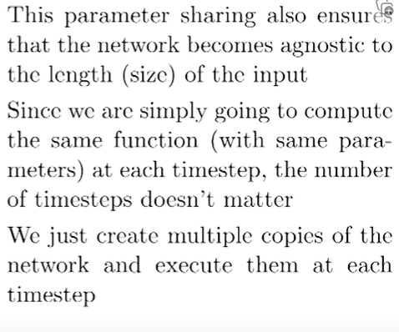
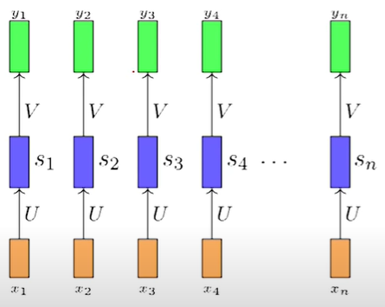
Recurrent Neural Networks

Slide 12
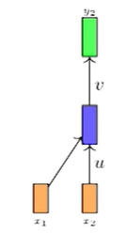
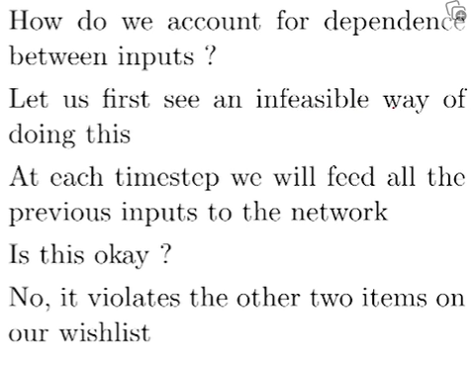
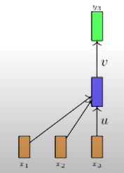
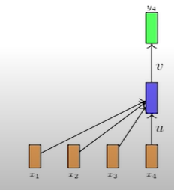
Recurrent Neural Networks
How do we account for dependence between the inputs?

Slide 13
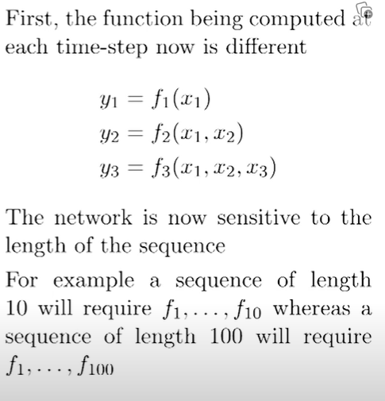
Recurrent Neural Networks
How do we account for dependence between the inputs?

Slide 14
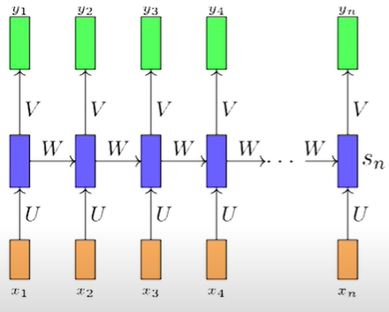
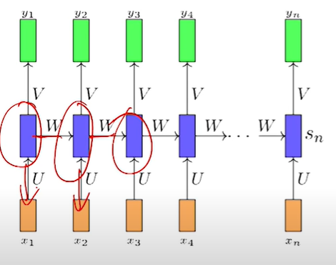
Recurrent Neural Networks
The solution is to add a recurrent connection in the network is
$$\begin{matrix}s_{i}=σ\left(Ux+W_{s_{i−1}}+b\right) \\ y_{i}=ο\left(Vs_{i}+c\right)\end{matrix}$$
$$y_{i}=f\left(x_{i},s_{i},W,U,V,b,c\right)$$
$s_{i}$ is the state of network at time step I
W, U, V, b,c which are shared across the time steps.
The same network can be computed $y_{1, }y_{2}, …y_{100}$.

Slide 15
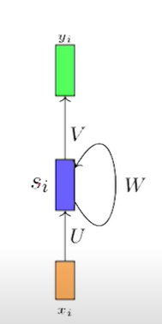
Recurrent Neural Networks
This is more compact way of representing RNN
$$\begin{matrix}s_{i}=σ\left(Ux+W_{s_{i−1}}+b\right) \\ y_{i}=ο\left(Vs_{i}+c\right)\end{matrix}$$
$$y_{i}=f\left(x_{i},s_{i},W,U,V,b,c\right)$$
$s_{i}$ is the state of network at time step I
W, U, V, b,c which are shared across the time steps.
The same network can be computed $y_{1, }y_{2}, …y_{100}$.

Slide 16
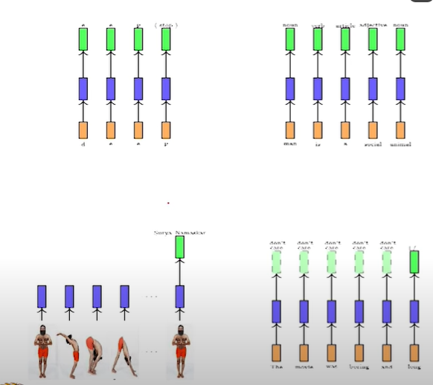
Recurrent Neural Networks
This is more compact way of representing RNN
$$\begin{matrix}s_{i}=σ\left(Ux+W_{s_{i−1}}+b\right) \\ y_{i}=ο\left(Vs_{i}+c\right)\end{matrix}$$
$$y_{i}=f\left(x_{i},s_{i},W,U,V,b,c\right)$$
$s_{i}$ is the state of network at time step I
W, U, V, b,c which are shared across the time steps.
The same network can be computed $y_{1, }y_{2}, …y_{100}$.

Slide 17
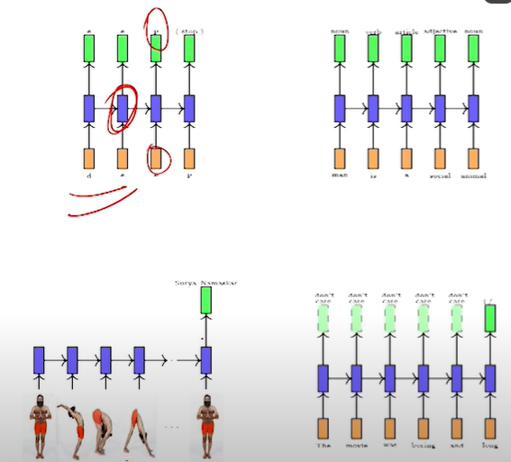
Recurrent Neural Networks
Let us revisit the Sequence Learning Problem

Slide 18
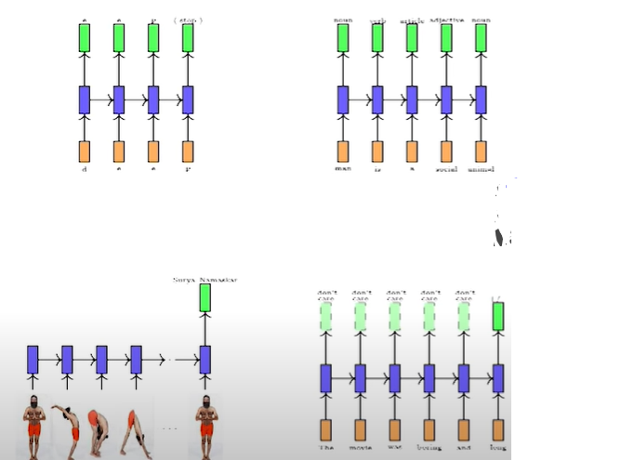
Recurrent Neural Networks
Let us revisit the Sequence Learning Problem

Slide 19
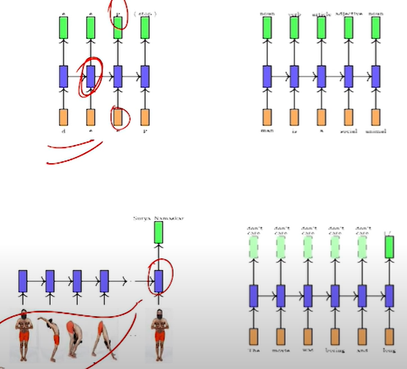
Recurrent Neural Networks
Let us revisit the Sequence Learning Problem

Slide 20
Recurrent Neural Networks
Recurrent Neural Networks (RNNs) are a type of artificial neural network designed for sequence data. Unlike traditional feedforward neural networks, RNNs have connections that form a directed cycle, allowing them to maintain a hidden state that captures information about previous inputs in the sequence. This makes RNNs particularly well-suited for tasks involving sequential or time-dependent data.
Structure of an RNN:
In an RNN, each node in the network represents a time step, and the connections between nodes carry information from one time step to the next. The hidden state at each time step is updated based on the input at that time step and the previous hidden state.
Input Layer: The input layer represents the features of the data at each time step in the sequence. The input at each time step is fed into the network.
Hidden Layer: The hidden layer maintains a hidden state vector that captures information from previous time steps. The hidden state at each time step is updated based on the current input and the previous hidden state. The connections between the hidden layer at one time step and the next form a directed cycle, allowing the network to maintain memory of past inputs.

Slide 21
Recurrent Neural Networks
Output Layer: The output layer processes the hidden state at each time step and produces the output for that time step. The output can be used for tasks such as sequence prediction, classification, or generation.
Activation Function: Each node in the hidden layer typically uses a non-linear activation function, such as the hyperbolic tangent (tanh) or rectified linear unit (ReLU), to introduce non-linearity to the model.
Advantages of RNN
Sequential Information Handling: RNNs can model and capture sequential dependencies in data, making them suitable for tasks like time series prediction, speech recognition, and natural language processing.
Flexibility in Input/Output Length: RNNs can handle input sequences of varying lengths and produce output sequences, making them versatile for tasks with variable-length input or output.
Parameter Sharing: RNNs use the same set of weights for each time step, which allows them to share parameters across different parts of the sequence. This parameter sharing can lead to more efficient training, especially when dealing with long sequences.

Slide 22
Recurrent Neural Networks
Disadvantages of RNN:
Vanishing and Exploding Gradient Problems: RNNs often suffer from vanishing and exploding gradient problems, which can make it difficult for the network to learn long-term dependencies. This occurs when gradients become too small or too large during backpropagation through time.
Limited Memory: Standard RNNs have a short memory, meaning they may struggle to capture information from earlier time steps when the gap is too large. Long Short-Term Memory (LSTM) networks and Gated Recurrent Unit (GRU) networks are designed to address this issue.
Computational Intensity: Training RNNs can be computationally intensive, especially for long sequences. The sequential nature of RNNs makes parallelization challenging, limiting their efficiency on certain hardware.
Difficulty in Capturing Long-Term Dependencies:** Despite efforts to address the vanishing gradient problem, RNNs may still face challenges in capturing long-term dependencies in sequences, especially when the dependencies span a large number of time steps.

Slide 23
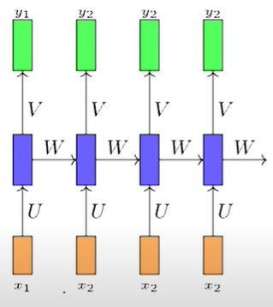
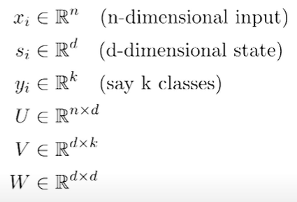
Backpropagation through Time for training RNN
Look at the dimensions of the parameters
We train this network using Back propagation algorithm

Slide 24
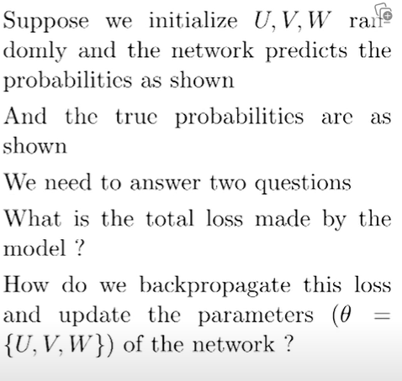
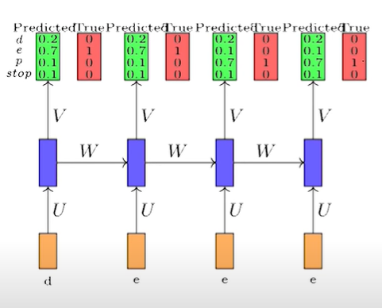
Backpropagation through Time for training RNN

Slide 25
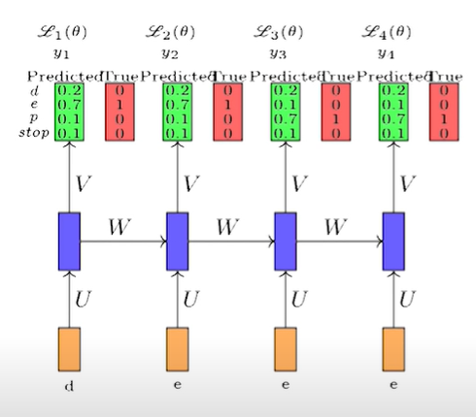
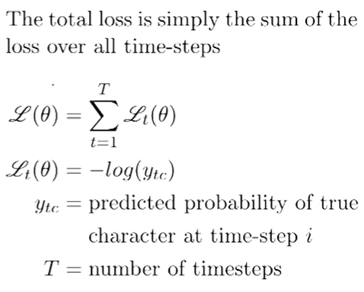
Backpropagation through Time for training RNN

Slide 26
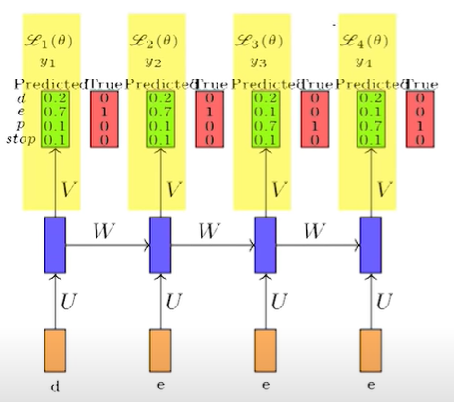
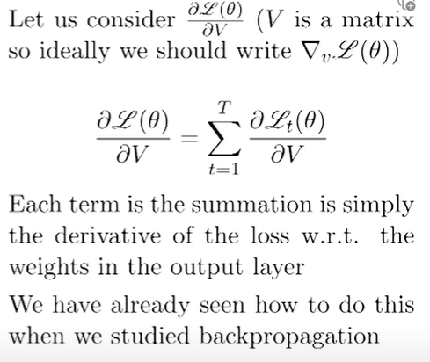
Backpropagation through Time for training RNN

Slide 27
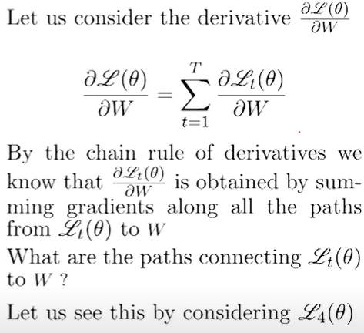
Backpropagation through Time for training RNN

Slide 28
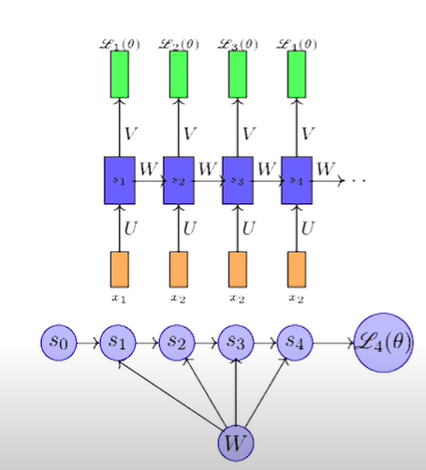
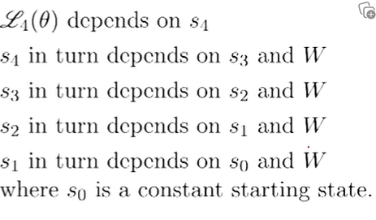
Backpropagation through Time for training RNN

Slide 29
Backpropagation through Time for training RNN

Slide 30
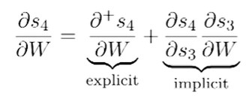
Backpropagation through Time for training RNN

Slide 31
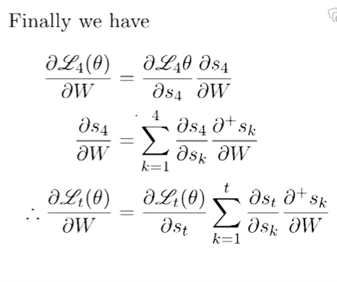
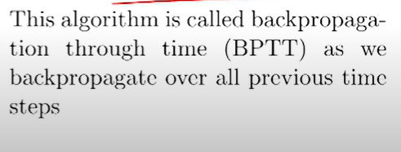
Backpropagation through Time for training RNN

