Slide 1
CURVES RANGING

Slide 2
The design and construction of curves is an important aspect of route surveying of roads, railways, canals, etc. the initial design of the route is generally based on a series of connected straight lines.
In the final design, a curve is provided at the intersection of the straight lines to effect a gradual change in the direction.
Curves are generally of two types
(i) Horizontal curves
(ii) Vertical curves
A horizontal curve is provided at the point where the two straight lines intersect in the horizontal plane. The horizontal curves are generally circular in shape.
A vertical curve is provided at the point where the two straight lines at different gradients intersect in the vertical plane. The horizontal curves are generally circular in shape.
The vertical curve provides a smooth change in the gradients. The vertical curves are generally parabolic.

Slide 3
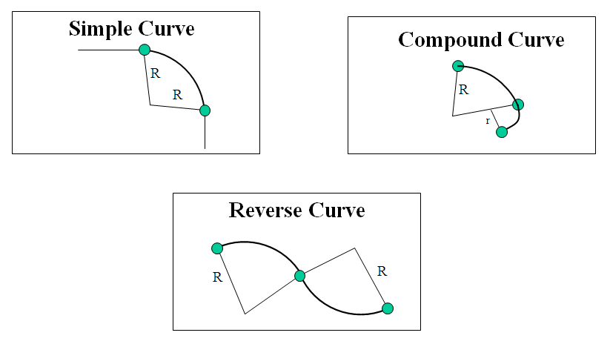
The horizontal curves are of three types.
(i) Simple circular curve
(ii) Compound curve
(iii) Reverse curve
A simple circular curve consists of a single arc of the circle. The curve is tangential to two straight lines of the route.
A compound curve consists of two circular arcs of different radii with their centres of curvature on the same side of the common tangent.
A reverse curve consists of two circular arcs which have their centres of curvature on the opposite side of the common tangent.

Slide 4
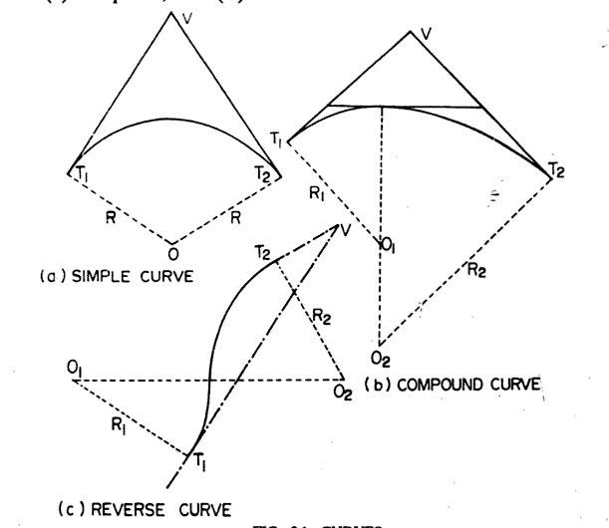

Slide 5
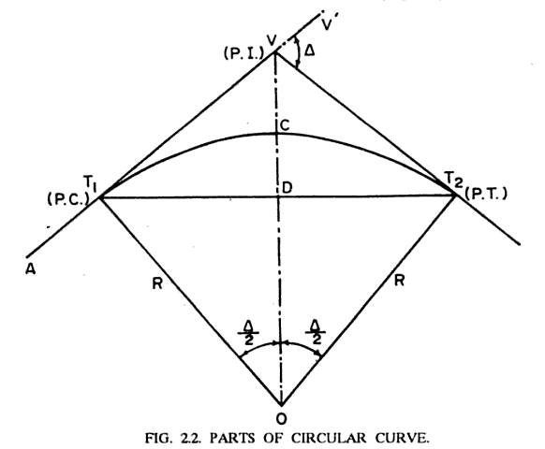
Definitions and Notations

Slide 6
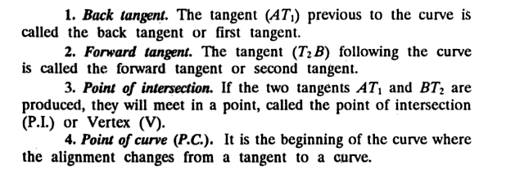
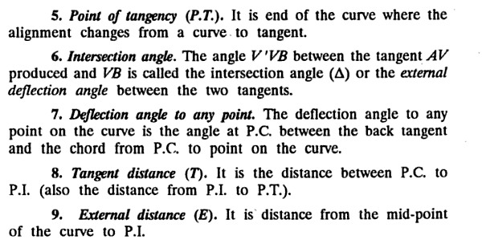

Slide 7
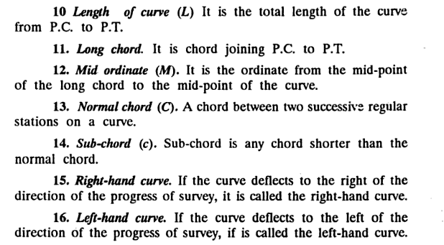

Slide 8
Designation of a Curve
A curve can be designated in terms of either the radius (R) or the degree (D) of curve.
The degree of curve (D) is the angle subtended at the centre by an arc or a chord of a specified length.
According to the arc definition of the degree of curve, it is the angle subtended at the centre by an arc of 30 m,
According to the chord definition of the degree of curve, it is the angle subtended at the centre by a chord of 30 m.
The arc definition is generally used in highway practice, and the chord definition in railway practiced.
The sharpness of the curve depends upon its radius. A sharp curve has a small radius. A flat curve has a large radius. The railway curves are generally flat, whereas the highway curves are relatively sharp.
The degree of curve is inversely proportional to the radius of curve. A sharp curve has a large degree of curve, whereas a flat curve has a small degree of curve.
To satisfy the requirements of safety at high speeds, the curve should be kept as flat as economically feasible. In other words, the radius of the curve should be as large as possible and the degree of curve as small as possible.

Slide 9
RELATIONSHIP BETWEEN RADIUS AND DEGREE OF CURVE
A relationship between the radius (R) of the curve and the degree (D) of the curve can be derived. The relationship will depend upon whether the arc definition or the chord definition is considered.
Arc definition:
According to the arc definition, the degree of curve is equal to the angle subtended at the center by an arc of 30 m.
30 m
Chord Definition: According to the chord definition, the degree of curve is equal to the angle subtended at the centre by a chord of length 30 m.
15
R
sin (D_{c}/2) =
30 m
R
R
R
D_{c}
R
D_{a}
O
For small angles, sin Dc/2 = D/2 radians.
360⁰
2ΠR
O
1718.87
R
D_{c} Π 15
2 180 R
1718.87
R
D_{a} = x 30 =
x
=
D_{c} =

Slide 10
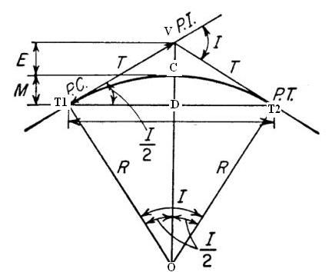
ELEMENTS OF A SIMPLE CIRCULAR CURVE
1. Length of Curve (l) – The length of curve T₁CT₂ is given by
( )
ΠRI
180
2ΠR
360
l = x I =
Alternatively, the length of the curve can be written in terms of the degree of curve (D). If the arc definition is considered, and the specified length of the arc is 30 m,
D_{a} I
30 l
l
30 I
D_{a}
=
=
This equation can also be used for the chord definition, if the curve is flat.
2. Tangent Length (T):
T = length T₁V = length T₂V
= OT₁ tan I/2 = OT₂ tan I/2
T = R tan I/2
3. Length of the long chord (L):
L = length T₁DT₂
L = 2 x R sin I/2
4. External Distance (E):
E = length VC
= VO – CO
= R (sec I/2 – 1)

Slide 11
5. Chainages of Tangent points: The Chainage of the point of intersection (V) is generally known. The chainages of the tangent point T1 and T2 can be obtained as
(a) Chainage of T₁ = Chainage of V – T
(b) Chainage of T₂ = Chainage of T₁ + length of curve (l)
Chainage of T₂ = Chainage of T₁ +
ΠRI
180
It may be noted that the chainage of T2 is not equal to the chainage of V + T, because the route proceeds from T1 to T2 via the curve C, and not via the vertex V.
The convention for expressing chainage is to write the number of hundreds of meters followed by a plus sign and remaining distance. For example, the chainage of 4425.5 m should be expresses as 44 + 25.5 m
In this case, 44 is full station, and + 25.5 m is the plus station.
6. Mid-ordinate (M):
M = length CD
= CO – DO
= R – R cos I/2
= R ( 1 – cos I/2)
The mid-ordinate of the curve is also known as the versine of the curve.

