Slide 1
THEODOLITE TRAVERSE

Slide 2
Traverse
A traverse is a series of connected lines whose lengths and directions are measured in the field.
In a theodolite traverse, the directions are measured with a theodolite.
Types of traverse
CLOSED TRAVERSE
OPEN TRAVERSE

Slide 3
Computation of Latitudes and Departures
The latitude (L) of a line is its orthographic projection on the N-S axis representing the meridian.
The latitude is considered to be positive when the projection of the line is towards the north, and negative when towards the south.
The positive latitude is also known as the northing, and the negative latitude is also called southing.

Slide 4
The departure (D) of a line is its orthographic projection on the axis perpendicular to the meridian. This perpendicular axis is also known as the E-W axis.
The departure is considered positive when the projection of the line is towards the east, and negative when towards the west.
The positive departure is also known as the easting, and the negative departure is also called westing.
In general L = l cosθ and D =l sin θ
Where l is the length of the line and θ is the reduced bearing of the line
And L = l cosα and D =l sin α
Where l is the length of the line and α is the whole circle bearing of the line

Slide 5
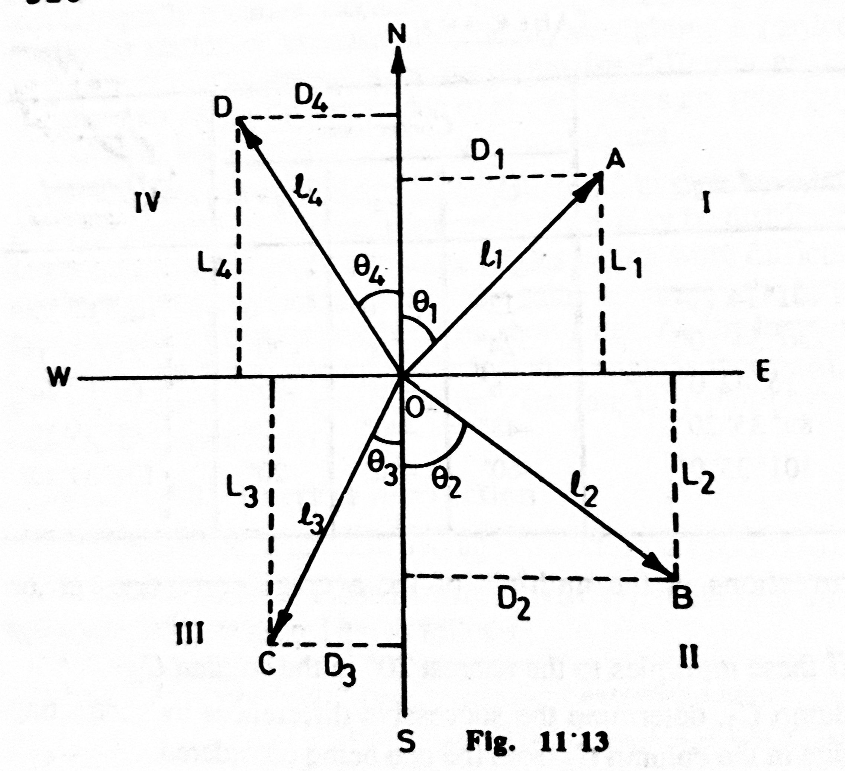

Slide 6
Consecutive and Independent coordinates
The coordinates of the end point of a line with reference to its initial point are called consecutive coordinates or dependent coordinates of the end point of the line.
Obviously, the consecutive coordinates are equal to the latitudes and departures with their proper signs.
The coordinates of a point with respect to a common origin are known as the independent coordinates of the point. These coordinates are also called the total latitude and the total departure of the point.
Total latitude of any point P= Total latitude of the starting point + algebraic sum of the latitudes of all the lines up to the point P.
Total departure of any point P= Total departure of the starting point + algebraic sum of the departures of all the lines up to the point P.

Slide 7
Error of closure
If the conditions of a closed traverse are not satisfied, there is an error of closure.
If the error is in with in the permissible limits, it is adjusted.
If the error is large, the field work is repeated.
Relative error of closure
It is the ratio of the error of closure and the perimeter of the traverse.
Relative error of closure = e/p
It is conventional to express the relative error of closure with numerator as unity, i.e Relative error of closure = 1/(p/e)

Slide 8
Checks in a closed traverse
Loop traverse
The algebraic sum of all the latitudes should be equal to zero. Thus ∑L = L₁ + L₂ + ------ = 0
In other words, the arithmetic sum of the northings should be equal to the arithmetic sum of the southings.
The algebraic sum of all the departures should be equal to zero. Thus ∑D = D₁ + D₂ + ------ = 0
In other words, the arithmetic sum of the eastings should be equal to the arithmetic sum of the westings.

Slide 9
(b) Link traverse
The algebraic sum of all altitudes should be equal to the difference in the latitudes of the final control point and the initial control point. Thus
∑L = L₁ + L₂ + --- = Latitude of the final control point – latitude of the initial control point
The algebraic sum of all departures should be equal to the difference in the departures of the final control point and the initial control point. Thus
∑D = D₁ + D₂ + --- = Departure of the final control point – Departure of the initial control point

Slide 10
Checks in an open traverse
Cutoff lines method
Tying –in to known stations
Closing the traverse
Astronomical observations

Slide 11
Omitted measurements

