Slide 1
TRIANGULATION
Triangulation is the surveying technique in which unknown distances between stations are determined using the trigonometric relations of a triangle.
The calculations are started from the triangle in which one side is the base line.
For determination of the remaining two sides, atleast two interior angles of the triangle must be measured.
However, if all the three angles are measured, accuracy of the computed distances is considerably increased, and a check is provided.
It is, therefore, the standard practice to measure all the angles.
A triangulation system consists of a series of joined and overlapping triangles in which only one line (base line) is measured.
All the angles are measured, and the remaining sides are calculated from angles.
Knowing the true bearing of any one line, the bearings of all other lines can be calculated from the angles.
The coordinated of all triangulation stations are then determined from the coordinates of any one given station, the vertices of the individual triangles are the triangulation stations.

Slide 2
Geodetic surveying is a type of surveying which is done to the highest practicable standard of accuracy to cover large areas on the earth.
Most of the geodetic surveying already conducted in the world used triangulation systems.
In surveys of large areas, it is necessary to establish the positions of a few control points with great precision to insure the accuracy of survey as a whole.
Triangulation is ideally suited for establishing horizontal control spread over the entire country.
N
C
D
α
A
E
B
BASE LINE

Slide 3
Classification of Triangulation:
Triangulation systems are classified according to the accuracy required for horizontal control. It depends upon the type of survey and purpose of the survey. On the basis of accuracy and purpose, triangulation systems are generally classified as under:
Primary triangulation or first-order triangulation
Secondary triangulation or second-order triangulation
Tertiary triangulation or third-order triangulation

Slide 4
Primary Triangulation:
This system of triangulation is of the highest grade. It provides the principal frame-work for the national control network for subsidiary triangulations.
Primary triangulation is generally conducted for determination of the shape and size of the earth's surface, for earth crustal movement studies in areas of seismic activity, for engineering projects of high precision and extending over long distances, and for surveys conducted in metropolitan areas.
Secondary Triangulation:
This system of triangulation is of the grade slightly lower than that of the primary triangulation. It provides control points closer than those of the primary triangulation.
Generally, a secondary triangulation system is provided within a primary triangulation system. It is connected to the primary triangulation stations at various points. It strengthens the entire network of the primary triangulation.
Secondary triangulation is used for detailed surveys in areas where good accuracy is required. It is used to establish control for interstate and inland subdivisions. If a primary triangulation does not attain the required standard, it may be classified as secondary triangulation.

Slide 5
Tertiary triangulation:
This system of triangulation is of the grade lower than that of the secondary triangulation. It is used to provide control points between stations of primary and secondary triangulation systems.
Tertiary triangulation is used to establish control for local developments, topographic surveys, hydrographic surveys and other such projects where lower accuracy can be accepted. Tertiary triangulation is also known as topotriangulation because it is normally used for providing control for topographic surveys.

Slide 6
Selection of site for Base Line:
The measurement of the baseline is one of the most important operations in triangulation. The accuracy of the triangulation depends to a large extent on the accuracy of the measurement of the base line.
Following factors should be considered while selecting its site;
1. The site should be fairly level or gently undulating. Highly undulating grounds should be avoided.
If the ground is sloping, the slope should be uniform and gentle.
2. The site should be free from obstructions throughout the base length. If the it has obstructions, line clearing should not be difficult and costly.
3. The ground should be firm and smooth.
4. The two extremities of the base line should be intervisible.
5. The site should be such that well-shaped triangles can be obtained while connecting its end stations to the main triangulation stations.
6. The site should be such that a minimum length of the base line as specified available.
There is no problem in selecting a suitable site for the base line in an open and flat country. However, in rough country, the choice is limited. In such cases, sometimes the triangulation stations are selected to suit the base line.

Slide 7
Signals
Signals are centered vertically over the station mark, and the observations are made to these signals from other stations. The accuracy of triangulation is entirely dependent on the degree of accuracy of centering the signals. Therefore, it is very essential that the signals are truly vertical, and centered over the station mark. Greatest care of centering the transit over the station mark will be useless, unless some degree of care in centering the signal is impressed upon.
A signal should have the following qualities:
It should be clearly visible against any background. To make the signal conspicuous, its height above the station mark should be at least 75 cm.
It should be capable of being accurately centred over the station mark.
It should be suitable for accurate bisection from other stations.
It should carry a flag on its top.
The signals may be classified into the following types:
(i)Non-luminous, opaque or daylight signals
(ii) Luminous signals.

Slide 8
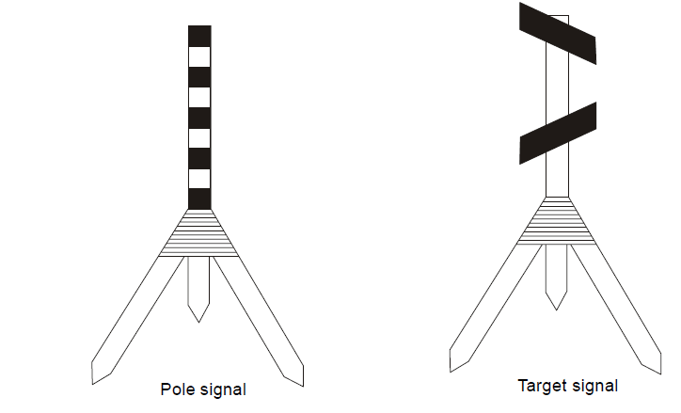
1. Non-luminous signals:
Non-luminous signals are used during day time and for short distances. These are of various types, and the most commonly used are of following types.
Pole signal : It consists of a round pole painted black and white in alternate strips, and is supported vertically over the station mark, generally on a tripod. Pole signals are suitable upto a distance of about 6 km.
(b) Target signal :It consists of a pole carrying two squares or rectangular targets placed at right angles to each other. The targets are generally made of cloth stretched on wooden frames.Target signals are suitable upto a distance of 30 km.

Slide 9
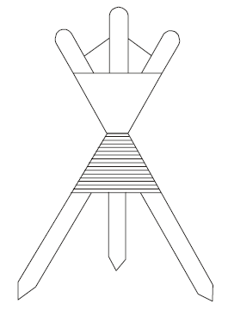
(iii) Beacons– It consists of red and white cloth tied round the three straight poles. The beacon can easily be centered over the station mark. It is very useful for making
simultaneous observations.

Slide 10
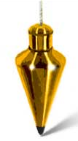
(iv) Plumb Bob Signals– It consists of a wire with a plumb bob, the plumb bob is generally hung from a slanting rod such that the plumb bob is exactly over the station mark.

Slide 11
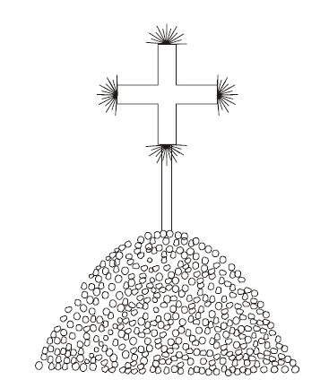
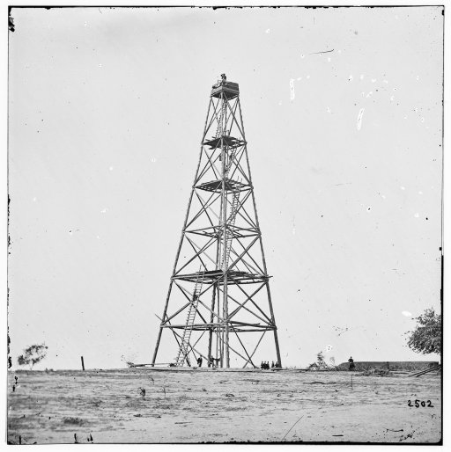
(v) Elevated Signals – If the country is quite plane, elevated towers erected over the station mark. These signals are used upto a distance of 30 to 40 kms.
(vi) Pole and Brush signals – It consists of a straight pole about 2.5 m long with a bunch of long grass tied symmetrically around its top to form a cross shape.
The signal is erected vertically over the station mark by heaping a pile of stones around the base of the pole. A coat of white wash is applied to the signal to make it conspicuous.

Slide 12
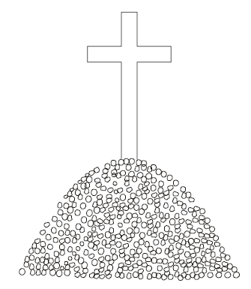
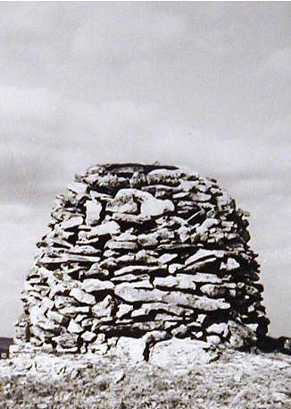
(vii) Stone Cairns – A pile of stone heaped in a conical shape about 3 m high with a cross shape signal erected over the stone heap, is stone cairn. This white washed opaque signal is very useful if the background is dark.

Slide 13
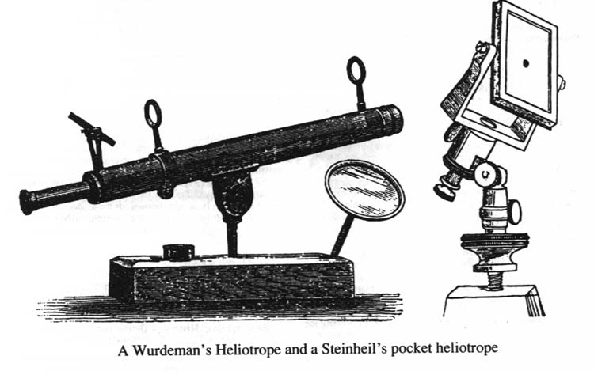
2. Luminous Signals:
Luminous signals may be further classified into two types;
(a) Sun signals
(b) Night signals
(a) Sun signals – Sun signals reflect the rays of the sun towards the station of observation, and are also known as heliotropes. Such signals can be used only in day time in clear weather.

Slide 14
Night Signals:
Signals less than 80 kms – oil lamps with parabolic reflectors; for sights greater than 80 kms, the acetylene lamps; Magnesium lamps with parabolic reflector are used for long sights.
Towers:
A tower is erected at the triangulation station when the station or the signal or both are to be elevated to make the observations possible form other stations in case of problem of intervisibility.
The height of tower depends upon the character of the terrain and the length of the sight.The towers generally have two independent structures.The outer structure is for supporting the observer and the signal whereas the inner one is for supporting the instrument only.
The two structures are made entirely independent of each other so that the movement of the observer does not disturb the instrument setting. The two towers may be made of masonary, timber or steel.
For small heights, masonary towers are most suitable. Timber scaffolds are most commonly used, and have been constructed to heights over 50 m. Steel towers made of light sections are very portable, and can be easily erected and dismantled.

