Slide 1
PEHV UNIT-II

Slide 2
Engineering Ethics
The scope of engineering ethics are twofold:
1. Ethics of the workplace which involves the co-workers and
employees in an organization.
2. Ethics related to the product or work which involves the
transportation, warehousing, and use, besides the safety of the
end product and the environment outside the factory.
There are conventionally two approaches in the study of ethics:
1. Micro-ethics which deals with decisions and problems of individuals,
professionals, and companies.
2. Macro-ethics which deals with the societal problems on a
regional/national level. For example, global issues, collective
responsibilities of groups such as professional societies and consumer
groups.

Slide 3
SENSES OF ENGINEERING ETHICS
There are two different senses (meanings) of engineering ethics, namely the Normative and the Descriptive senses.
The normative sense include:
(a) Knowing moral values, finding accurate solutions to moral problems
and justifying moral judgments in engineering practices,
(b) Study of decisions, policies, and values that are morally desirable in the
engineering practice and research, and
(c) Using codes of ethics and standards and applying them in their
transactions by engineers.
The descriptive sense refers to what specific individual or group of engineers believe and act, without justifying their beliefs or actions.

Slide 4
VARIETY OF MORAL ISSUES
It would be relevant to know why and how do moral issues (problems) arise in a profession or why do people behave unethically?
The reasons for people including the employer and employees, behaving unethically may be classified into three categories:
Resource Crunch:
Due to pressure, through time limits, availability of money or budgetary constraints, and technology decay or obsolescence.
Pressure from the government to complete the project in time (e.g., before the elections), reduction in the budget because of sudden war or natural calamity (e.g., Tsunami).

Slide 5
VARIETY OF MORAL ISSUES
2. Opportunity:
(a) Double standards or behavior of the employers towards the employees
and the public. The unethical behaviors of World Com (in USA), Enron (in USA as well as India) executives in 2002 resulted in bankruptcy for those companies,
(b) Management projecting their own interests more than that of their
employees. Some organizations over-emphasize short-term gains and
results at the expense of themselves and others,
(c) Emphasis on results and gains at the expense of the employees, and
(d) Management by objectives, without focus on empowerment and
improvement of the infrastructure.

Slide 6
VARIETY OF MORAL ISSUES
3. Attitude: Poor attitude of the employees set in due to
(a) Low morale of the employees because of dissatisfaction and downsizing,
(b) Absence of grievance redressal mechanism,
(c) Lack of promotion or career development policies or denied promotions,
(d) Lack of transparency,
(e) Absence of recognition and reward system, and
(f) Poor working environments.
To get firm and positive effect, ethical standards must be set and adopted by the senior management, with input from all personnel.

Slide 7
TYPES OF INQUIRIES
The three types of inquiries, in solving ethical problems like
1.Normative inquiry
2. Conceptual inquiry
3. Factual or Descriptive inquiry.
The three types of inquiries are discussed below to illustrate the differences and preference.
1. Normative Inquiry: It seeks to identify and justify the morally-desirable norms or standards that should guide individuals and groups.
It also has the theoretical goal of justifying particular moral judgments.
Normative questions are about what ought to be and what is good, based on moral values

Slide 8
TYPES OF INQUIRIES
2. Conceptual Inquiry: It is directed to clarify the meaning of concepts or ideas or principles that are expressed by words or by questions and statements. For example,
(a) What is meant by safety?
(b) How is it related to risk?
(c) What is a bribe?
(d) What is a profession?
When moral concepts are discussed, normative and conceptual issues are closely interconnected.

Slide 9
TYPES OF INQUIRIES
3.Factual or Descriptive Inquiry:
It is aimed to obtain facts needed for understanding and resolving issues.
The facts provide not only the reasons for moral problems but also enable us to develop alternative ways of resolving moral problems. For example,
1. How were the benefits assessed?
2. What are the procedures followed in risk assessment?
3. What are short-term and long-term effects of drinking water
being polluted? and
4. Who conducted the tests on materials?

Slide 10
MORAL DILEMMA
Dilemmas are situations in which moral reasons come into conflict, or in which the application of moral values are problems, and one is not clear of the immediate choice or solution of the problems.
These situations do not mean that things had gone wrong, but they only indicate the presence of moral complexity.
This makes the decision making complex.
For example, a person promised to meet a friend and dine, but he has to help his uncle who is involved in an accident — one has to fix the priority.
There are some difficulties in arriving at the solution to the problems, in dilemma. The three complex situations leading to moral dilemmas are:
1. The problem of vagueness
2. The problem of conflicting reasons
3. The problem of disagreement:

Slide 11
Steps to Solve Dilemma
The logical steps in confronting moral dilemma are:
1. Identification of the moral factors and reasons. The clarity to
identify the relevant moral values from among duties, rights,
goods and obligations is obtained (conceptual inquiry).
2. Collection of all information, data, and facts (factual inquiry) relevant to
the situation.
3. Rank the moral options i.e., priority in application through value system,
and also as obligatory, all right, acceptable, not acceptable, damaging,
and most damaging etc.
4. Generate alternate courses of action to resolve the dilemma. Write
down the main options and sub-options as a matrix or decision tree to
ensure that all options are included.
5. Discuss with colleagues and obtain their perspectives, priorities, and
suggestions on various alternatives.
6. Decide upon a final course of action, based on priority fixed or assumed.
If there is no ideal solution, we arrive at a partially satisfactory or
‘satisfying’ solution.

Slide 12
MORAL AUTONOMY
Moral autonomy is defined as, decisions and actions exercised on the basis of moral concern for other people and recognition of good moral reasons.
Alternatively, moral autonomy means ‘self determinant or independent’.
Moral autonomy may also be defined as a skill and habit of thinking rationally about the ethical issues, on the basis of moral concern.
Periodical performance appraisals, tight-time schedules and fear of foreign competition threatens this autonomy.
The attitude of the management should allow latitude in the judgments of their engineers on moral issues.

Slide 13
MORAL AUTONOMY
The engineering skills related to moral autonomy are listed as follows
1. Proficiency in recognizing moral problems in engineering and
ability to distinguish as well as relate them to problems in law,
economics, and religion,
2. Skill in comprehending, clarifying, and critically-assessing
arguments on different aspects of moral issues,
3. Ability to form consistent and comprehensive view points based
on facts,
4. Awareness of alternate responses to the issues and creative
solutions for practical difficulties,
5. Sensitivity to genuine difficulties and subtleties, including
willingness to undergo and tolerate some uncertainty while
making decisions,
6. Using rational dialogue in resolving moral conflicts and developing
tolerance of different perspectives among morally reasonable people,
7. Maintaining moral integrity.

Slide 14
MORAL DEVELOPMENT (THEORIES)
Kohlberg Theory: Kohlberg became a professor of education and social psychology at Harvard in 1968. His book on moral development is used by teachers around the world to promote moral reasoning.
Gilligan’s Theory: Thus Gilligan produces her own stage theory of moral development for women. Like Kohlberg's, it has three major divisions: preconventional, conventional, and post conventional. But for Gilligan, the transitions between the stages are fueled by changes in the sense of self rather than in changes in cognitive capability.
Piaget's theory: describes how children transition from doing right because of the consequences of an authority figure to making right choices due to ideal reciprocity or what is best for the other person. ... Piaget published his work in the 1920s, though it took several decades to become prominent.

Slide 15
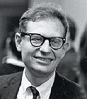
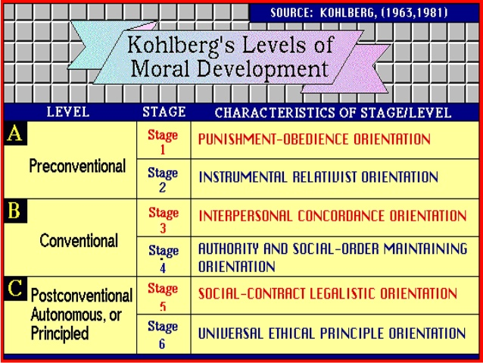

Slide 16
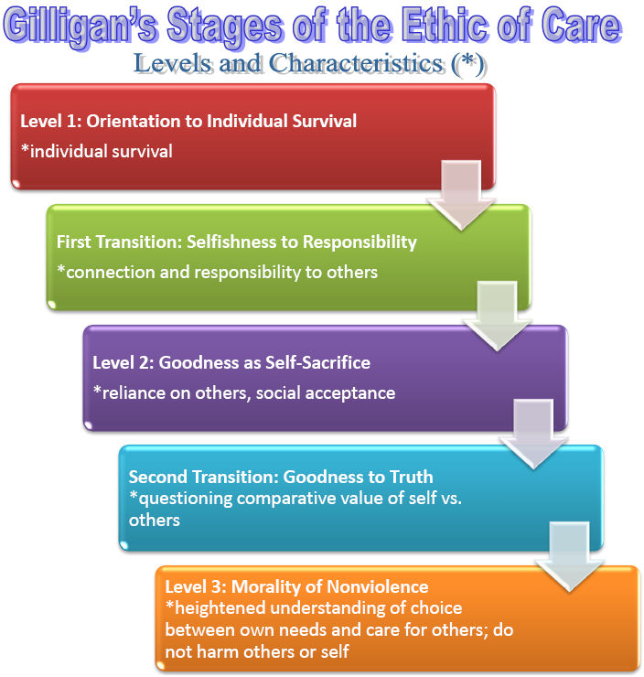

Slide 17
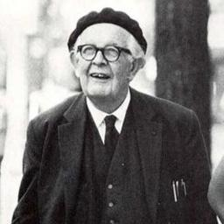

Slide 18
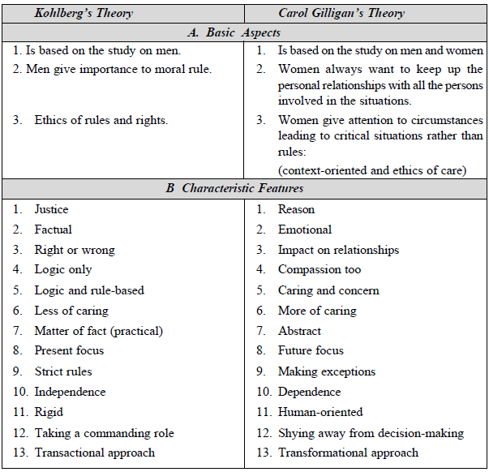
The theories of moral development by Kohlberg and Gilligan differ in the following respects.

Slide 19
Consensus & Controversy
Consensus – Agreement
Controversy – Disagreement
In a study of moral autonomy, consensus and controversy are the relevant factors to discuss on.
We already know that Autonomy means self-governing or self-determining i.e act independently. Moral autonomy is concerned with the independent attitude of a person related to ethical issues.
A controversial issue is a matter about which individuals and groups disagree.

Slide 20
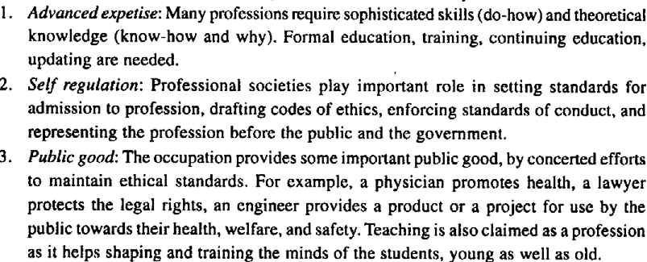
Profession
The criteria for achieving and sustaining professional status or professionalism are:

Slide 21
Profession

Slide 22
Characteristics of Profession
The characteristics of the ‘profession’ as distinct from ‘non-professional occupation’ are listed as follows:
1. Extensive Training:
Entry into the profession requires an extensive period of training of intellectual (competence) and moral (integrity) character.
The theoretical base is obtained through formal education, usually in an academic institution. It may be a Bachelor degree from a college or university or an advanced degree conferred by professional schools.
2. Knowledge and Skills
Knowledge and skills (competence) are necessary for the well-being of the society.
Knowledge of physicians protects us from disease and restores health.
The knowledge, study, and research of the engineers are required for the safety of the air plane, for the technological advances and for national defense.

Slide 23
Characteristics of Profession
3. Monopoly
The monopoly control is achieved in two ways:
(a) the profession convinces the community that only those who have graduated from the professional school should be allowed to hold the professional title. The profession also gains control over professional schools by establishing accreditation standards
(b) By persuading the community to have a licensing system for those who want to enter the profession. If practicing without license, they are liable to pay penalties.
4. Autonomy in Workplace
Professionals engaged in private practice have considerable freedom in choosing their clients or patients.
Even the professionals working in large organizations exercise a large degree of impartiality, creativity and discretion (care with decision and communication) in carrying their responsibilities.
Besides this, professionals are empowered with certain rights to establish their autonomy.

Slide 24
Characteristics of Profession
5. Ethical Standards
Professional societies promulgate the codes of conduct to regulate the professionals against their abuse or any unethical decisions and actions (impartiality, responsibility) affecting the individuals or groups or the society.

Slide 25
MODELS OF PROFESSIONAL ROLES
Promotion of public good is the primary concern of the professional engineers. There are several role models to whom the engineers are attracted. These models provoke their thinking, attitudes and actions.
1. Savior
The engineer as a savior, save the society from poverty, illiteracy, wastage, inefficiency, ill health, human (labor) dignity and lead it to prosperity, through technological development and social planning.
2. Guardian
He guards the interests of the poor and general public.
3. Bureaucratic Servant
He serves the organization and the employers.
4. Social Servant
It is one who exhibits social responsibility.
5. Social Enabler and Catalyst
One who changes the society through technology.
6. Game Player
He is neither a servant nor master. He plays a unique role successfully within the organization, enjoying the excitement of the profession and having the satisfaction of surging ahead in a competitive world.

Slide 26
Responsible Professionalism
The most comprehensive virtue of engineers is responsible
professionalism. It can also be called Professional Responsibility. This consists of five types of virtues, as follows:
1. Self-direction (Self-governance) virtues are fundamental and
necessary in exercising moral responsibility.
On the basis of ‘commitment and action’, it covers courage, self-
discipline, perseverance, self-respect, and integrity.
2. Public-spirited virtues focus on the good of the clients and the
public. It includes the respect for rights (to make decisions and face the risk), non-malfeasance (not harming others intentionally).
3. Team-work virtues enable the professionals to work successfully
with others. They include collegiality, cooperativeness, communicative ability, and respect for legitimate authority. Responsible exercise of authority and the ability to motivate other to achieve are also the relevant to team-work virtues.

Slide 27
Responsible Professionalism
4. Proficiency virtues, which mean the mastery of technical skills
(called as Intellectual Virtue by Aristotle).
It includes competence (having qualified, licensed, and prepared
to execute the job that is undertaken), diligence (alert to
dangers, careful attention, and avoidance of laziness or
workaholic nature), creativity (learning to respond to the
changing technological society), excellence (perform at the
highest level), and self-renewal through continuing education.
5. Cardinal (chief) virtues: Wisdom (prudence), courage (fortitude),
temperance and justice.
Some of these may overlap other virtues.

Slide 28
Social Responsibility
Corporate organizations have social responsibility to all of their ‘stakeholders’.
This includes the wellbeing of the employees and their unions, socially responsible investors, customers, dealers, suppliers, local communities, governments, non-governmental organizations, and the business owners and managers.
Besides showing concern with employee relations and other internal organizational matters, the organization is concerned with..

Slide 29
Social Responsibility
(a) how the product/project is marketed, used or misused, how it fails, and how it is disposed or discarded. The ways in which the used battery cells and computers are discarded have been debated in the engineers’ forums.
(b) protecting the work environment during manufacture as well as the external environment during transport or use
(c) training the disadvantaged or physically-challenged workers
(d) subcontracting and hiring practices, and
(e) contribution to local communities to enrich their cultural, social, and civic life. It may be even compensatory against the harm to environment (e.g., planting trees).

Slide 30
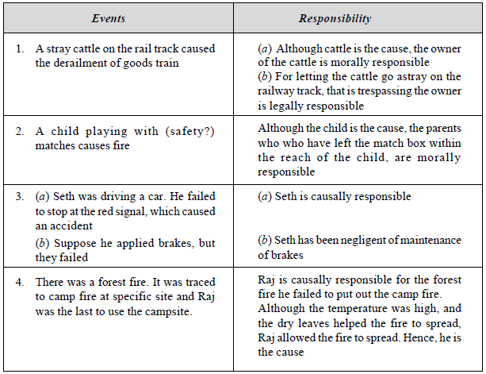
Various types of responsibilities such as causal, moral, and legal are distinguished through appropriate examples, as shown below:

Slide 31
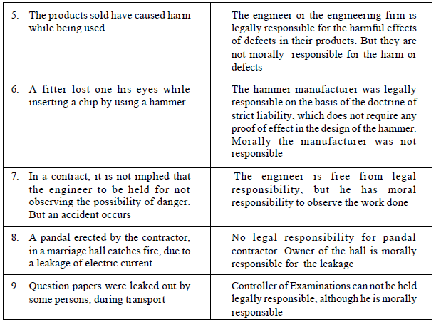

Slide 32
THEORIES ABOUT RIGHT ACTION (ETHICAL THEORIES)
Uses and Criteria
The ethical theories are useful in many respects.
1. In understanding moral dilemma. They provide clarity, consistency, systematic and comprehensive understanding.
2. It provides helpful practical guidance in moral issues towards the solution.
3. Justifying professional obligations and decisions, and
4. In relating ordinary and professional morality

Slide 33
THEORIES ABOUT RIGHT ACTION (ETHICAL THEORIES)
Different criteria may be applied for evaluating various ethical theories and deciding upon the best.
1. The theory must be clear and (coherent) formulated with concepts that are logically connected.
2. It must be internally consistent, i.e., none of its principles conflicts with any other
3. The theory and its defense must depend, only upon facts.
4. It must organize basic moral values in systematic and comprehensive manner. It is to fix priority of values and provide guidance in all situations
5. It must provide guidance compatible with our moral convictions (judgments) about concrete situations. For example, if an ethical theory says that it is all right for engineers to make explosive devices without the informed consent of the public, we can conclude that the theory is inadequate.

Slide 34
Utilitarian Theory
The term Utilitarianism was conceived in the 19th century by Jeremy Bentham and John Stuart Mill to help legislators determine which laws were morally best.
They suggested that the standard of right conduct is maximization of good consequences.
In analyzing an issue in this approach, we have to:
(a) Identify the various courses of action available to us.
(b) Ask who will be affected by each action and what benefits or harms will be derived from each.
(c) Choose the action that will produce the greatest benefits and the least harm. The ethical action is the one that provides the greatest good for the greatest number.
The ACT UTILITARIAN theory proposed by J.S. Mill (1806-73) focuses on actions, rather than on general rules.
The RULE UTILITARIAN theory, developed by Richard Brandt (1910-97), stressed on the rules, such as ‘do not steal’, ‘do no harm others’, ‘do not bribe’, as of primary importance.

Slide 35
Duty Ethics
A. The duty ethics theory, proposed by Immanuel Kant (1724-1804) states, that actions are consequences of performance of one’s duties such as, ‘being honest’, ‘not cause suffering of others’, ‘being fair to others including the meek and week’, ‘being grateful’, ‘keeping promises’ etc.
B. On the other hand, the DUTY ethics theory, as enunciated by John Rawl, gave importance to the actions that would be voluntarily agreed upon by all persons concerned, assuming impartiality.
C.W.D. Ross, the British philosopher introduced the term prima facie duties, which means duties might have justified exceptions.
He has listed various aspects of Duty Ethics that reflect our moral convictions shown on next..

Slide 37
Rights Theory
Rights are entitlement to act or to have another individual act in a certain way.
Minimally, rights serve as a protective barrier, shielding individuals from unjustified infringement of their moral agency by others.
For every right, we have a corresponding duty of noninterference.
A. The RIGHTS approach to ethics has its roots in the 18th century philosopher Immanuel Kant, who focused on the individual’s right to choose for oneself.
Other rights he advocated are:
1. The right to access the truth: We have a right to be told the truth and to be informed about matters that significantly affect our choices.
2. The right of privacy: We have the right to do, believe, and say whatever we choose in our personal lives so long as we do not violate the rights of others.
3. The right not to be injured: We have the right not to be harmed or injured unless we freely and knowingly do something to deserve punishment or we freely and knowingly choose to risk such injuries.
4. The right to what is agreed: We have a right to what has been promised by those with whom we have freely entered into a contract or agreement.

Slide 38
Rights Theory
B. In deciding whether an action is moral or immoral, we must ask, does the action respect the moral rights of everyone?
C. As per A.I. Melden’s theory based on rights, nature mandates that we should not harm others’ life, health, liberty or property. Melden allowed welfare rights also for living a decent human life.
D. Human rights: Human rights are explained in two forms, namely liberty rights and welfare rights.
E. Economic rights: In the free-market economy, the very purpose of the existence of the manufacturer, the sellers and the service providers is to serve the consumer.

Slide 39
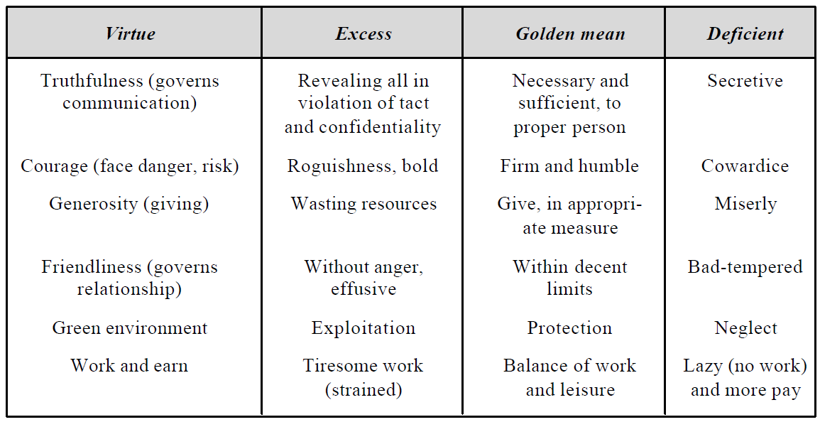
The Virtue Theory
This emphasizes on the character rather than the rights or duties. The character is the pattern of virtues (morally-desirable features).
The theory advocated by Aristotle, stressed on the tendency to act at proper balance between extremes of conduct, emotion, desire, attitudes to find the golden mean between the extremes of ‘excess’ or ‘deficiency’. The examples shown below illustrate the theory:

Slide 40
SELF-CONTROL
It is a virtue of maintaining personal discipline.
It means a strong will and motivation and avoidance of fear, hatred, lack of efforts, temptation, self-deception, and emotional response.
It encompasses courage and good judgment also.
Self-respect promotes self-control.

Slide 41
SELF-INTEREST
Self-interest is being good and acceptable to oneself. It is pursuing what is good for oneself. It is very ethical to possess self-interest.
As per utilitarian theory, this interest should provide for the respect of others also.
In Ethical Egoism, the self is conceived in a highly individualistic manner.
It says that every one of us should always and only promote one’s own interest.
The ethical egoists do not accept the well being of the community or caring for others.
However this self interest should not degenerate into egoism or selfishness, i.e., maximizing only own good in the pursuit of self-interest.

Slide 42
CUSTOMS
Ethical Pluralism: Various cultures in our pluralistic society lead to tolerance for various customs, beliefs, and outlooks.
Although many moral attitudes appear to be reasonable, the rational and morally concerned people can not fully accept any one of the moral perspectives.
There are many varied moral values, which allow variation in the understanding and application of values by the individuals or groups in their everyday transactions.
Ethical Relativism: According to this principle, actions are considered morally right when approved by law or custom, and wrong when they violate the laws or customs.
The deciding factor is the law or the customs of the society.

Slide 43
RELIGION
Religions have played major roles in shaping moral views and moral values, over geographical regions.
Christianity has influenced the Western countries, Islam in the Middle-East countries, Buddhism and Hinduism in Asia, and Confucianism in China.
Further, there is a strong psychological link between the moral and religious beliefs of people following various religions and faiths.
Religions support moral responsibility.
They have set high moral standards.
Faith in the religions provides trust and this trust inspires people to be moral.
Each religion lays stress on certain high moral standards.
For example, Christianity believes in one deity and emphasizes on virtues of Love, Faith, and Hope.

Slide 45
Review
One Marks
Professional Rights
Moral Leadership
Customs
Professionalism
Explain the term Ethics and Engineering Ethics
What is the difference between bribe and gift

Slide 46
Review
Essay Q.
Explain Kohlberg’s theory for moral development
Explain the theory of right action and its uses
How did Gillgan view the three levels of moral development initiated by Kholberg’s
Explain professional idea’s and virtues
Distinguish between professions and professionalism
Problems of Professional Egoism, Feminist consequentialism and Respect for Other persons

