Slide 1
UNIT-II
Union Government and its Administration :
Structure of the Indian Union:
Federalism,
Centre- State relationship,
President: Role, power and position,
PM and Council of ministers,
Cabinet and Central Secretariat,
LokSabha, RajyaSabha

Slide 2
Political scientists have classified governments into unitary and federal on the basis of the nature of relations between the national government and the regional governments. By definition, a unitary government is one in which all the powers are vested in the national government and the regional governments.
A federal government, on the other hand, is one in which powers are divided between the national government and the regional governments by the Constitution itself and both operate in their respective jurisdictions independently.
The term ‘federation’ is drived from a Latin word foedus which means ‘treaty’ or ‘agreement’. Thus, a federation is a new state (political system) which is formed through a treaty or an agreement between the various units.

Slide 3
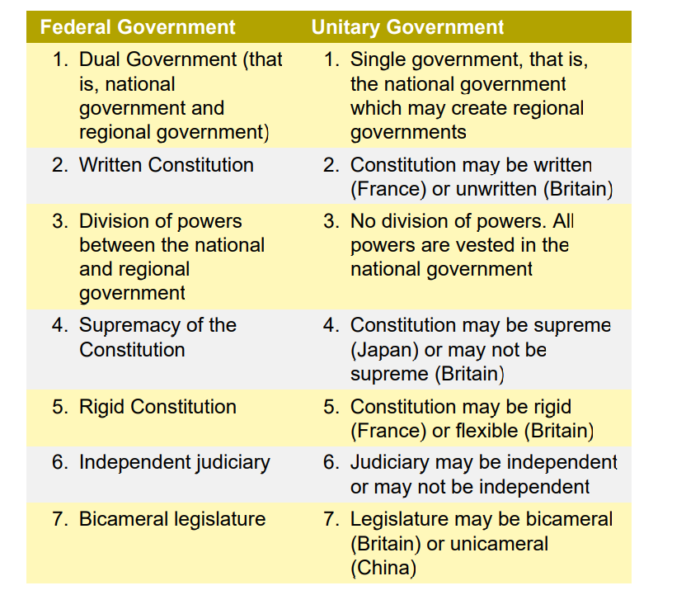

Slide 4
FEDERAL FEATURES OF THE CONSTITUTION
The federal features of the Constitution of India are explained below:
Dual Polity :The Constitution establishes a dual polity consisting the Union at the Centre and the states at the periphery. The Union government deals with the matters of national importance like defence, foreign affairs, currency, communication and so on. The state governments, on the other hand, look after the matters of regional and local importance like public order, agriculture, health, local government and so on.
Written Constitution The Constitution is not only a written document but also the lengthiest Constitution of the world. Originally, it contained a Preamble, 395 Articles (divided into 22 Parts) and it specifies the structure, organisation, powers and functions of both the Central and state governments and prescribes the limits within which they must operate. Thus, it avoids the misunderstandings and disagreements between the two.

Slide 5
3.Division of Powers :The Constitution divided the powers between the Centre and the states in terms of the Union List, State List and Concurrent List in the Seventh Schedule. Both the Centre and the states can make laws on the subjects of the concurrent list, but in case of a conflict, the Central law prevails.
4. Supremacy of the Constitution: The Constitution is the supreme (or the highest) law of the land. The laws enacted by the Centre and the states must conform to its provisions. Otherwise, they can be declared invalid by the Supreme Court or the high courts through their power of judicial review.
5. Rigid Constitution :The division of powers established by the Constitution as well as the supremacy of the Constitution can be maintained only if the method of its amendment is rigid. Hence, the Constitution is rigid to the extent that those provisions which are concerned with the federal structure (i.e., Centre-state relations and judicial organisation) can be amended only by the joint action of the Central and state.

Slide 6
6. Independent Judiciary :The Constitution establishes an independent judiciary headed by the Supreme Court for two purposes: one, to protect the supremacy of the Constitution by exercising the power of judicial review; and two, to settle the disputes between the Centre and the states or between the states. The Constitution contains various measures like security of tenure to judges, fixed service conditions and so on to make the judiciary independent of the government.
7. Bicameralism The Constitution provides for a bicameral legislature consisting of an Upper House (Rajya Sabha) and a Lower House (Lok Sabha). The Rajya Sabha represents the states of Indian Federation, while the Lok Sabha represents the people of India as a whole.

Slide 7
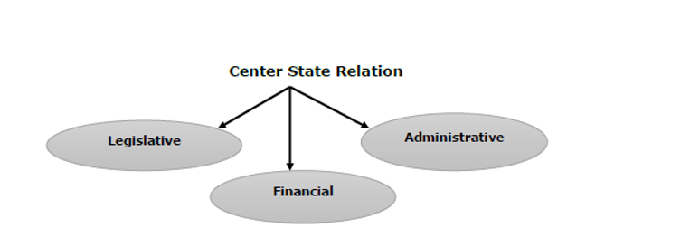
The Centre-state relations
It can be studied under three heads:
• Legislative relations.
• Administrative relations.
• Financial relations.

Slide 8
LEGISLATIVE RELATIONS
Articles 245 to 255 in Part XI of the Constitution deal with the legislative relations between the Centre and the states.
Like any other Federal Constitution, the Indian Constitution also divides the legislative powers between the Centre and the states with respect to both the territory and the subjects of legislation.
Thus, there are four aspects in the Centre-states legislative relations, viz.,
• Territorial extent of Central and state legislation;
• Distribution of legislative subjects;
• Parliamentary legislation in the state field; and
• Centre’s control over state legislation.

Slide 9
Territorial extent of Central and state legislation
The Parliament can make laws for the whole or any part of the territory of India
A state legislature can make laws for the whole or any part of the State. The laws made by a state legislature are not applicable outside the state.
The laws of parliament are also applicable to Indian citizens and their property in any part of the world.

Slide 10
However there are restrictions on the territorial jurisdiction of the parliament which means the laws of parliament are not applicable in following areas:
1. The President can make regulations for the peace, progress and good government of the 5 Union Territories– the Andaman and Nicobar Islands, Lakshadweep, Dadra and Nagar Haveli, Daman and Diu and Ladakh. A regulation so made has the same force and effect as an act of Parliament. The President may cancel or amend any act of Parliament in relation to these union territories
2. The governor is empowered to direct that an act of Parliament does not apply to a scheduled area in the state or apply with specified modifications and exceptions.
3. The Governor of Assam may likewise direct that an act of Parliament does not apply to a tribal area (autonomous district) in the state or apply with specified modifications and exceptions.
4. The President enjoys the same power with respect to tribal areas (autonomous districts) in Meghalaya, Tripura and Mizoram.

Slide 11
Distribution of legislative subjects
The Parliament has exclusive powers to make laws with respect to any of the matters enumerated in the Union List. This list has at present 98 subjects (originally 971 subjects) like defence, banking, foreign affairs, currency, atomic energy, insurance, communication, inter-state trade and commerce, census, audit and so on.
The state legislature has exclusive powers to make laws with respect to any of the matters enumerated in the State List. This has at present 59 subjects (originally 66 subjects) like public order, police, public health and sanitation, agriculture, prisons, local government, fisheries, markets, theaters, gambling and so on.

Slide 12
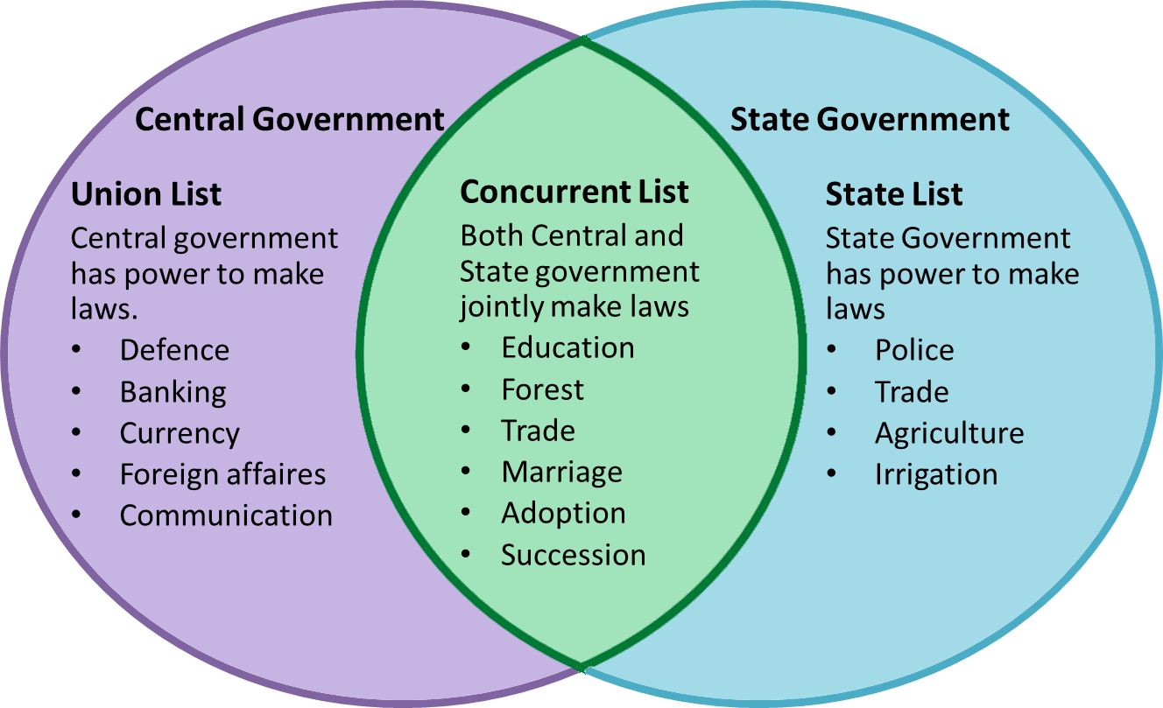

Slide 13
3.Both, the Parliament and state legislature can make laws with respect to any of the matters enumerated in the Concurrent List. This list has at present 52 subjects (originally 47 subjects) like criminal law and procedure, civil procedure, marriage and divorce, population control and family planning, electricity, labour welfare, economic and social planning, drugs, newspapers, books and printing press, and others.
4.It is clear that the matters of national importance and the matters which require uniformity of legislation nationwide are included in the Union List. The matters of regional and local importance and the matters which permit diversity of interest are specified in the State List. The matters on which uniformity of legislation throughout the country is desirable but not essential are enumerated in the concurrent list

Slide 14
Parliamentary legislation in the state field
The above scheme of distribution of legislative powers between the Centre and the states is to be maintained in normal times. But, in abnormal times, the Constitution empowers the Parliament to make laws on any matter enumerated in the State List under the following five extraordinary circumstances:
When Rajya Sabha Passes a Resolution
During a National Emergency
When States Make a Request
To Implement International Agreements
During President’s Rule

Slide 15
Centre’s control over state legislation
Besides the Parliament’s power to legislate directly on the state subjects under the exceptional situations, the Constitution empowers the Centre to exercise control over the state’s legislative matters in the following ways:
The Governor can reserve certain types of bills passed by the state legislature for the consideration of the President. The president enjoys absolute veto over them.
The Centre can direct the states to reserve money bills and other financial bills passed by the state legislature for the President’s consideration during a financial emergency.
From the above, it is clear that the Constitution has assigned a position of superiority to the Centre in the legislative sphere.

Slide 16
Administrative Relations
Articles 256 to 263 describe administrative relations.
Distribution of executive powers:
The executive power has been divided between the Centre and the states as follows:
The executive power of the centre extends to the subjects enumerated in the union list. The executive power of the states extends to the subjects enumerated in the state list.
The execution of the laws on the subjects enumerated in the concurrent list is with the states except when the parliament has directed otherwise.

Slide 17
Centre’s directions to the states:
The Centre is empowered to give directions to the states with regard to the exercise of their executive power in the following matters:
(i) the construction and maintenance of means of communication (declared to be of national or military importance) by the state;
(ii) the measures to be taken for the protection of the railways within the state;
(iii) the provision of adequate facilities for instruction in the mother tongue at the primary stage of education to children belonging to linguistic minority groups in the state; and
(iv) the drawing up and execution of the specified schemes for the welfare of the Scheduled Tribes in the state.

Slide 18
All India services
The Centre and the states also have their separate public services called as the Central Services and the State Services respectively. In addition, there are all-India services–IAS, IPS and IFS. The members of these services occupy top positions (or key posts) under both the Centre and the states and serve them by turns. But, they are recruited and trained by the Centre. These services are controlled jointly by the Centre and the states. The ultimate control lies with the Central government while the immediate control vests with the state governments
Public Service Commissions
In the field of public service commissions, the Centre-state relations are as follows: (i) The Chairman and members of a state public service commission, though appointed by the governor of the state, can be removed only by the President.
(ii) The Parliament can establish a Joint State Public Service Commission (JSPSC) for two or more states on the request of the state legislatures concerned. The chairman and members of the JSPSC are appointed by the president.
(iii) The Union Public Service Commission (UPSC) can serve the needs of a state on the request of the state governor and with the approval of the President.

Slide 19
Integrated Judicial System
The Constitution of India established an integrated judicial system with the Supreme Court at the top and the state high courts below it. This single system of courts enforces both the Central laws as well as the state laws. This is done to eliminate diversities in the remedial procedure. The judges of a state high court are appointed by the president in consultation with the Chief Justice of India and the governor of the state. They can also be transferred and removed by the president. The Parliament can establish a common high court for two or more states.
For example, Maharashtra and Goa or Punjab and Haryana have a common high court.

Slide 20
Relations During Emergencies
(i) During the operation of a national emergency (under Article 352), the Centre becomes entitled to give executive directions to a state on ‘any’ matter. Thus, the state governments are brought under the complete control of the Centre, though they are not suspended.
(ii) When the President’s Rule is imposed in a state (under Article 356), the President can assume to himself the functions of the state government and powers vested in the Governor or any other executive authority in the state.
(iii) During the operation of a financial emergency (under Article 360), the Centre can direct the states to observe canons of financial propriety and can give other necessary directions including the reduction of salaries of persons serving in the state

Slide 21
Other Provisions
The Constitution contains the following other provisions which enable the Centre to exercise control over the state administration:
Article 355 imposes two duties on the Centre: (a) to protect every state against external aggression and internal disturbance; and (b) to ensure that the government of every state is carried on in accordance with the provisions of the Constitution.
The Governor of a state is appointed by the president. He holds office during the pleasure of the President. In addition to the Constitutional head of the state, the Governor acts as an agent of the Centre in the state. He submits periodical reports to the Centre about the administrative affairs of the state.
The state election commissioner, though appointed by the governor of the state, can be removed only by the President.

Slide 22
Financial Relations
Articles 268 to 293 describe Financial relations.
Allocation of Taxing Powers
The Constitution divides the taxing powers between the Centre and the states in the following way:
The Parliament has exclusive power to levy taxes on subjects enumerated in the Union List
The state legislature has exclusive power to levy taxes on subjects enumerated in the State List
Both the Parliament and the state legislature can impose taxes on subjects enumerated in the concurrent List
The residuary power of taxation (that is, the power to impose taxes not enumerated in any of the three lists) is vested in the Parliament. Under this provision, the Parliament has imposed gift tax, wealth tax and expenditure tax.

Slide 23
The Constitution also draws a distinction between the power to levy and collect a tax and the power to appropriate the proceeds of the tax so levied and collected.
For example, the income-tax is levied and collected by the Centre but its proceeds are distributed between the Centre and the states
Distribution of Tax Revenues
The 10th finance commission recommended that out of the total income obtained from certain central taxes and duties, 29% should go to the states.

Slide 24
Distribution of Non-tax Revenues
A. The Centre:
The major sources of non-tax revenues of the Centre: (i) posts and telegraphs; (ii) railways; (iii) banking; (iv) broadcasting (v) coinage and currency; (vi) central public sector enterprises; etc.
B. The States
The major sources of non-tax revenues of the states: (i) irrigation; (ii) forests; (iii) fisheries; (iv) state public sector enterprises; etc.

Slide 25
Grants-in-Aid to the States
Besides sharing of taxes between the Centre and the states, the Constitution provides for grants-in-aid to the states from the Central resources. There are two types of grants-in-aid, viz, statutory grants and discretionary grants:
Statutory grants
Article 275 empowers the Parliament to make grants to the states which are in need of financial assistance and not to every state.
The statutory grants under Article 275 (both general and specific) are given to the states on the recommendation of the Finance Commission.
Discretionary grants:Article 282 empowers both the Centre and the states to make any grants for any public purpose.
.

Slide 26
Finance Commission
It is required to make recommendations to the President on the following matters:
• The distribution of the net proceeds of taxes to be shared between the Centre and the states, and the allocation between the states, the respective shares of such proceeds.
• The principles which should govern the grants-in-aid to the states by the Centre • The measures needed to augment the Consolidated fund of a state to supplement the resources of the panchayats and the municipalities in the state on the basis of the recommendations made by the State Finance Commission

Slide 27
The Parliament of India (IAST: Bhāratīya Sansad) is the supreme legislative body of the Republic of India.
It is a bicameral legislature composed of the President of India and the two houses: the Rajya Sabha (Council of States) and the Lok Sabha (House of the People).
The President in his role as head of legislature has full powers to summon and prorogue either house of Parliament or to dissolve Lok Sabha.
The president can exercise these powers only upon the advice of the Prime Minister and his Union Council of Ministers.
Salary of Indian President is Rs.5 lakh. Until 2017, the President used to get Rs 1.50 lakh per month. In Budget 2018, it was increased to Rs 5 lakh per month.
In addition to the salary, the President receives many other allowances and free facilities which include free medical, housing, and treatment facilities (whole life).
Maximum strength of Rajya Sabha-250
The maximum strength of the Lok sabha is 552

Slide 28
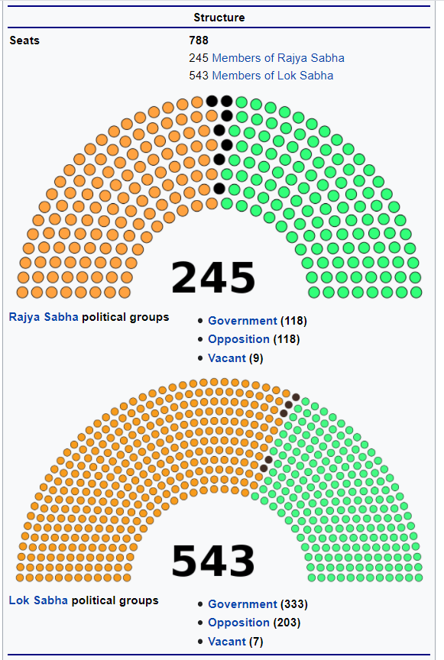

Slide 29
PRESIDENT –(Articles 52-62)
52. The President of India.—There shall be a President of India.
53. Executive power of the Union.—
(1) The executive power of the Union shall be vested in the President and shall be exercised by him either directly or through officers subordinates to him in accordance with this Constitution.
(2) Without prejudice to the generality of the foregoing provision, the supreme command of the Defense Forces of the Union shall be vested in the President and the exercise thereof shall be regulated by law.
(3) Nothing in this article shall—
(a) Be deemed to transfer to the President any functions conferred by any existing law on the Government of any State or other authority; or
(b) Prevent Parliament from conferring by law functions on authorities other than the President.

Slide 30
PRESIDENT
Articles 52 to 78 in Part V of the Constitution deal with the Union executive.
The Union executive consists of the President, the Vice President, the Prime Minister, the council of ministers and the attorney general of India.
The President is the head of the Indian State.
He is the first citizen of India and acts as the symbol of unity, integrity and solidarity of the nation.

Slide 31
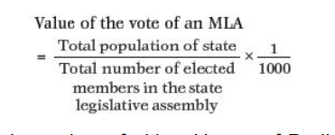
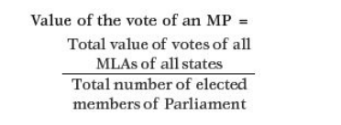
54. Election of President.—
The President shall be elected by the members of an electoral college consisting of—
(a) the elected members of both Houses of Parliament; and
(b) the elected members of the Legislative Assemblies of the States.
© the elected members of the legislative assemblies of the Union Territories of Delhi and Puducherry
There are a total of 776 voters in both the Houses of Parliament. The Electoral College also consisted of 4120 MLAs in the states.
Each MP had a vote value of 708 in the Presidential Election 2012.

Slide 32
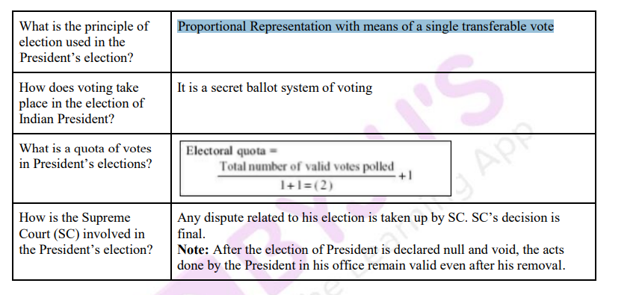

Slide 33
55. Manner of election of President. —
(1) As far as practicable, there shall be uniformity in the scale of representation of the different States at the election of the President.
(2) For the purpose of securing such uniformity among the States the number of votes which each elected member of Parliament and of the Legislative Assembly of each State is entitled to cast at such election shall be determined in the following manner:—
(a) every elected member of the Legislative Assembly of a State shall have as many votes as there are multiples of one thousand in the quotient obtained by dividing the population of the State by the total number of the elected members of the Assembly;
(b) if, after taking the said multiples of one thousand, the remainder is not less than five hundred, then the vote of each member referred to in sub-clause
(a) shall be further increased by one;

Slide 34
(c) each elected member of either House of Parliament shall have such number of votes as may be obtained by dividing the total number of votes assigned to the members of the Legislative Assemblies of the States under sub-clauses (a) and (b) by the total number of the elected members of both Houses of Parliament, fractions exceeding one-half being counted as one and other fractions being disregarded.
(3) The election of the President shall be held in accordance with the system of proportional representation by means of the single transferable vote and the voting at such election shall be by secret ballot.

Slide 35
.
56. Term of office of President.—
(1) The President shall hold office for a term of five years from the date on which he enters upon his office:
Provided that—
(a) the President may, by writing under his hand addressed to the Vice-President, resign his office;
(b) the President may, for violation of the Constitution, be removed from office by impeachment in the manner provided in article 61;
(c) the President shall, notwithstanding the expiration of his term, continue to hold office until his successor enters upon his office.
(2) Any resignation addressed to the Vice-President under clause (a) of the provision to clause (b) shall forthwith be communicated by him to the Speaker of the House of the People.

Slide 36
57. Eligibility for re-election.—
A person who holds, or who has held, office as President shall, subject to the other provisions of this Constitution, be eligible for re-election to that office.

Slide 37
58. Qualifications for election as President.—
Qualifications for Election as President
A person to be eligible for election as President should fulfil the following qualifications:
He should be a citizen of India.
He should have completed 35 years of age.
He should be qualified for election as a member of the Lok Sabha.
He should not hold any office of profit under the Union government or any state government or any local authority or any other public authority. A sitting President or VicePresident of the Union, the Governor of any state and a minister of the Union or any state is not deemed to hold any office of profit and hence qualified as a presidential candidate. Further, the nomination of a candidate

Slide 38
59. Conditions of President's office.—
(1) The President shall not be a member of either House of Parliament or of a House of the Legislature of any State, and if a member of either House of Parliament or of a House of the Legislature of any State be elected President, he shall be deemed to have vacated his seat in that House on the date on which he enters upon his office as President.
(2) The President shall not hold any other office of profit.
(3) The President shall be entitled without payment of rent to the use of his official residences and shall be also entitled to such emoluments, allowances and privileges as may be determined by Parliament by law and, until provision in that behalf is so made, such emoluments, allowances and privileges as are specified in the Second Schedule.
(4) The emoluments and allowances of the President shall not be diminished during his term of office.

Slide 39
60. Oath or affirmation by the President.—
Every President and every person acting as President or discharging the functions of the President shall, before entering upon his office, make and subscribe in the presence of the Chief Justice of India or, in his absence, the senior-most Judge of the Supreme Court available
“I, A.B., do swear in the name of God / solemnly affirm that I will faithfully execute the office of President (or discharge the function of the President) of India and will to the best of my ability preserve, protect and defend the Constitution and the law and that I will devote myself to the service and well-being of the people of India.”

Slide 40
61. Procedure for impeachment of the President.—
(1) When a President is to be impeached for violation of the Constitution, the charge shall be preferred by either House of Parliament.
(2) No such charge shall be preferred unless—
(a) the proposal to prefer such charge is contained in a resolution which has been moved after at least fourteen days' notice in writing signed by not less than one-fourth of the total number of members of the House has been given of their intention to move the resolution, and
(b) such resolution has been passed by a majority of not less than two-thirds of the total membership of the House.

Slide 41
(3) When a charge has been so preferred by either House of Parliament, the other House shall investigate the charge or cause the charge to be investigated and the President shall have the right to appear and to be represented at such investigation.
(4) If as a result of the investigation a resolution is passed by a majority of not less than two-thirds of the total membership of the House by which the charge was investigated or caused to be investigated, declaring that the charge preferred against the President has been sustained, such resolution shall have the effect of removing the President from his office as from the date on which the resolution is so passed.

Slide 42
62.Time of holding election to fill vacancy in the office of President and the term of office of person elected to fill casual vacancy. —
An election to fill a vacancy caused by the expiration of the term of office of President shall be completed before the expiration of the term.
An election to fill a vacancy in the office of President occurring by reason of his death, resignation or removal, or otherwise shall be held as soon as possible after, and in no case later than six months from, the date of occurrence of the vacancy

Slide 43
POWERS AND FUNCTIONS OF THE PRESIDENT
The powers enjoyed and the functions performed by the President can be studied under the following heads.
1. Executive powers
2. Legislative powers
3. Financial powers
4. Judicial powers
5. Diplomatic powers
6. Military powers
7. Emergency powers

Slide 44
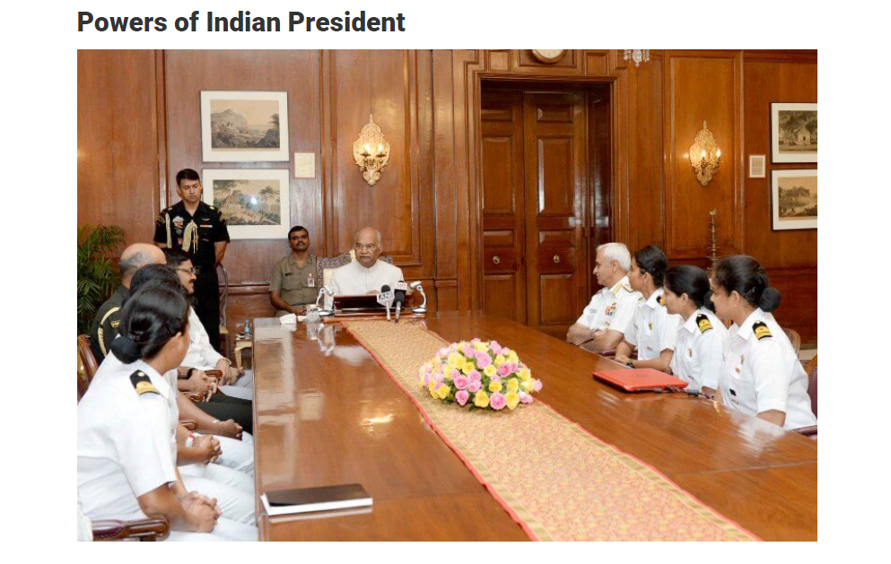

Slide 45
1.Executive Powers of President
For every executive action that the Indian government takes, is to be taken in his name
He may/may not make rules to simplify the transaction of business of the central government
He appoints the attorney general of India and determines his remuneration
He appoints the following people:
Comptroller and Auditor General of India (CAG)
Chief Election Commissioner and other Election Commissioners
Chairman and members of the Union Public Service Commission
State Governors
Finance Commission of India chairman and members
He seeks administrative information from the Union government
He requires PM to submit, for consideration of the council of ministers, any matter on which a decision has been taken by a minister but, which has not been considered by the council
7.He appoints National Commissions of:
Scheduled Castes
Scheduled Tribes
Other Backward Classes
8.He appoints inter-state council
9.He appoints administrators of union territories
10.He can declare any area as a scheduled area and has powers with respect to the administration of scheduled areas and tribal areas

Slide 46
2.Legislative Powers of President
He summons or prorogues Parliament and dissolve the Lok Sabha
He summons a joint sitting of Lok Sabha and Rajya Sabha in case of deadlock
He addresses the Indian Parliament at the commencement of the first session after every general election
He appoints speaker, deputy speaker of Lok Sabha, and chairman/deputy chairman of Rajya Sabha when the seats fall vacant
He nominates 12 members of the Rajya Sabha
He can nominate two members to the Lok Sabha from the Anglo-Indian Community
He consults the Election Commission of India on questions of disqualifications of MPs.
He recommends/ permits the introduction of certain types of bills
He promulgates ordinances
He lays the following reports before the Parliament:
Comptroller and Auditor General
Union Public Service Commission
Finance Commission, etc.

Slide 47
3.Financial Powers of President
To introduce the money bill, his prior recommendation is a must
He causes Union Budget to be laid before the Parliament
To make a demand for grants, his recommendation is a pre-requisite
Contingency Fund of India is under his control
He constitutes the Finance Commission every five year
4. Judicial Powers of President
Appointment of Chief Justice and Supreme Court/High Court Judges are on him
He takes advises from Supreme Court however, those advises are not binding on him
He has pardoning power.

Slide 48
5.Diplomatic Powers of President
International Treaties and agreements that are approved by the Parliament are negotiated and concluded in his name
He is the representative of India in international forums and affairs
6.Military Powers of President
He is the commander of defence forces of India.
He appoints: 1. chief of the Army 2. chief of the Navy, and 3. chief of the Air Force
7.Emergency Powers of President
He deals with three types of emergencies given in the Indian Constitution:
National Emergency (Article 352)
President’s Rule (Article 356 & 365);
Financial Emergency (Article 360)

Slide 50
The veto power enjoyed by the executive in modern states can be classified into the following four types:
Absolute veto
Qualified veto :which can be overridden by the legislature with a higher majority.
3. Suspensive veto
4. Pocket veto
Note : There is no qualified veto in case of Indian President .Only 3 Veto powers can be used.

Slide 55
ORDINANCE-MAKING POWER OF THE PRESIDENT
Article 123 of the Constitution empowers the President to promulgate ordinances during the recess of Parliament.
These ordinances have the same force and effect as an act of Parliament, but are in the nature of temporary laws.
The ordinance-making power is the most important legislative power of the President.
But, the exercises of this power is subject to the following four limitations:
He can promulgate an ordinance only when both the Houses of Parliament are not in session or when either of the two Houses of Parliament is not in session.
He can make an ordinance only when he is satisfied that the circumstances exist that render it necessary for him to take immediate action.
His ordinance-making power is coextensive as regards all matters except duration, with the law-making powers of the Parliament. This has two implications:
An ordinance can be issued only on those subjects on which the Parliament can make laws.
An ordinance is subject to the same constitutional limitation as an act of Parliament.
4. Every ordinance issued by the President during the recess of Parliament must be laid before both the Houses of Parliament when it reassembles.

Slide 56
PARDONING POWER OF THE PRESIDENT
Article 72 of the Constitution empowers the President to grant pardons to persons who have been tried and convicted of any offence

Slide 57
RELATIONSHIP WITH THE PRESIDENT
The following provisions of the Constitution deal with the relationship between the President and the Prime Minister:
Article 74
There shall be a council of ministers with the Prime Minister at the head to aid and advise the President who shall, in the exercise of his functions, act in accordance with such advice. However, the President may require the council of ministers to reconsider such advice and the President shall act in accordance with the advice tendered after such reconsideration.
2. Article 75
(a) The Prime Minister shall be appointed by the President and the other ministers shall be appointed by the president on the advice of the Prime Minister;
(b) The ministers shall hold office during the pleasure of the president; and
(c) The council of ministers shall be collectively responsible to the House of the People.
3. Article 78
It shall be the duty of the Prime Minister:
to communicate to the President all decisions of the council of ministers relating to the administration of the affairs of the Union and proposals for legislation;
to furnish such information relating to the administration of the affairs of the Union and proposals for legislation as the President may call for; and
if the President so requires, to submit for the consideration of the council of ministers any matter on which a decision has been taken by a minister but which has not been considered by the council.

Slide 58
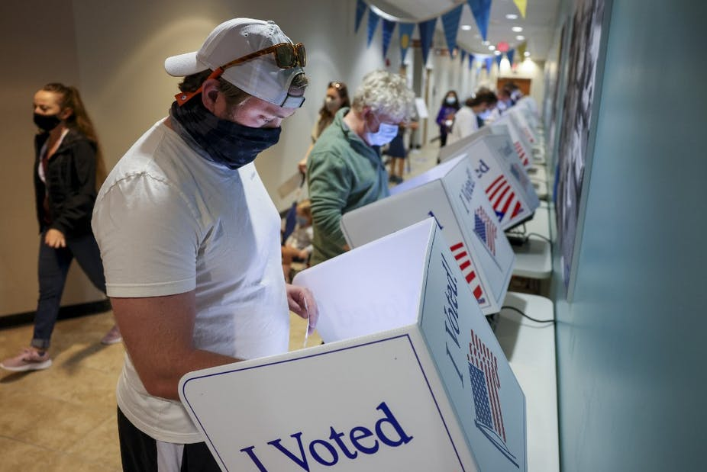
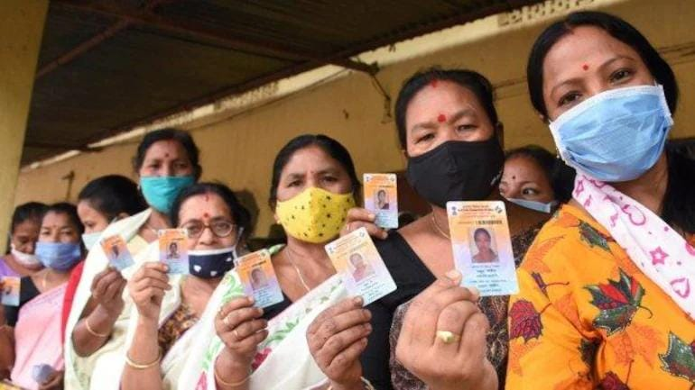

Slide 59
PRIME MINISTER
In the scheme of parliamentary system of government provided by the constitution, the President is the nominal executive authority and Prime Minister is the real executive authority.
In other words, President is the head of the State while Prime Minister is the head of the government.
APPOINTMENT OF THE PRIME MINISTER
The Constitution does not contain any specific procedure for the selection and appointment of the Prime Minister.
Article 75 says that the Prime Minister shall be appointed by the president.
The President has to appoint the leader of the majority party in the Lok Sabha as the Prime Minister

Slide 60
OATH, TERM AND SALARY (Rs 3,80,000)
Before the Prime Minister enters upon his office, the president administers to him the oaths of office and secrecy.
1. to bear true faith and allegiance to the Constitution of India, 2. to uphold the sovereignty and integrity of India,
3. to faithfully and conscientiously discharge the duties of his office, and
4. to do right to all manner of people in accordance with the Constitution and the law, without fear or favour, affection or ill will.

Slide 61
POWERS AND FUNCTIONS OF THE PRIME MINISTER
The powers and functions of Prime Minister can be studied under the following heads:
In Relation to Council of Ministers
The Prime Minister enjoys the following powers as head of the Union council of ministers:
He recommends persons who can be appointed as ministers by the president. The President can appoint only those persons as ministers who are recommended by the Prime Minister.
He allocates and reshuffles various portfolios among the ministers.
He can ask a minister to resign or advise the President to dismiss him in case of difference of opinion.
He presides over the meeting of council of ministers and influences its decisions.
He guides, directs, controls, and coordinates the activities of all the ministers.
He can bring about the collapse of the council of ministers by resigning from office.

Slide 62
In Relation to the President
The Prime Minister enjoys the following powers in relation to the President:
1. He is the principal channel of communication between the President and the council of ministers.
It is the duty of the prime minister:
to communicate to the President all decisions of the council of ministers relating to the administration of the affairs of the Union and proposals for legislation;
to furnish such information relating to the administration of the affairs of the Union and proposals for legislation as the President may call for; and
if the President so requires, to submit for the consideration of the council of ministers any matter on which a decision has been taken by a minister but which has not been considered by the council.
2. He advises the president with regard to the appointment of important officials like attorney general of India, Comptroller and Auditor General of India, chairman and members of the UPSC, election commissioners, chairman and members of the finance commission and so on.

Slide 63
In Relation to Parliament
The Prime Minister is the leader of the Lower House. In this capacity, he enjoys the following powers:
He advises the President with regard to summoning and proroguing of the sessions of the Parliament.
He can recommend dissolution of the Lok Sabha to President at any time.
He announces government policies on the floor of the House.
Other powers of the Prime Minister:
1. He plays an important role in shaping the foreign policy of the nation.
2. He is the chief spokesman of the Central Government.
3. He is the leader of the ruling party.
4. He is ex-officio Chairman of the Planning Commission (now NITI Aayog), National Development Council, National Integration Council, Inter-State Council and National Water Resources Council.

Slide 64
Council of Ministers
Constitution of India provides for a parliamentary system of government modelled on the British pattern, the council of ministers headed by the prime minister is the real executive authority is our politico-administrative system. The principles of parliamentary system of government are

Slide 65
CONSTITUTIONAL PROVISIONS
Article 74—Council of Ministers to aid and advise President
Article 75–Other Provisions as to Ministers
The Prime Minister shall be appointed by the President and the other Ministers shall be appointed by the President on the advice of the Prime Minister.
The total number of ministers, including the Prime Minister, in the Council of Ministers shall not exceed 15% of the total strength of the Lok Sabha. This provision was added by the 91st Amendment Act of 2003.
A member of either house of Parliament belonging to any political party who is disqualified on the ground of defection shall also be disqualified to be appointed as a minister. This provision was also added by the 91st Amendment Act of 2003.
The ministers shall hold office during the pleasure of the President.
The council of ministers shall be collectively responsible to the Lok Sabha.
The President shall administer the oaths of office and secrecy to a minister.
A minister who is not a member of the Parliament (either house) for any period of six consecutive months shall cease
The salaries and allowances of ministers shall be determined by the Parliament.

Slide 66
Article 77–Conduct of Business of the Government of India
All executive action of the Government of India shall be expressed to be taken in the name of the President
Article 78–Duties of Prime Minister
Article 88–Rights of Ministers as Respects the Houses
Every minister shall have the right to speak and take part in the proceedings of either House, any joint sitting of the Houses and any Committee of Parliament
APPOINTMENT OF MINISTERS
The Prime Minister is appointed by the President and can appoint only those persons as ministers who are recommended by the Prime minister.
Usually, the members of Parliament, either Lok Sabha or Rajya Sabha, are appointed as ministers.
A person who is not a member of either House of Parliament can also be appointed as a minister. But, within six months, he must become a member (either by election or by nomination) of either House of Parliament, otherwise, he ceases to be a minister.

Slide 67
COMPOSITION OF THE COUNCIL OF MINISTERS

Slide 68
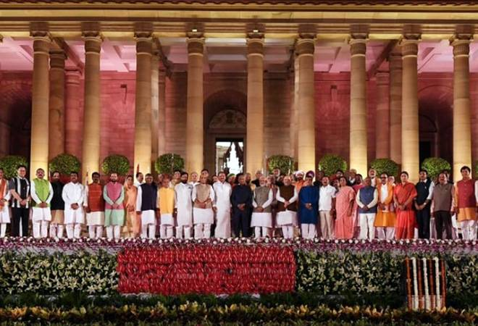
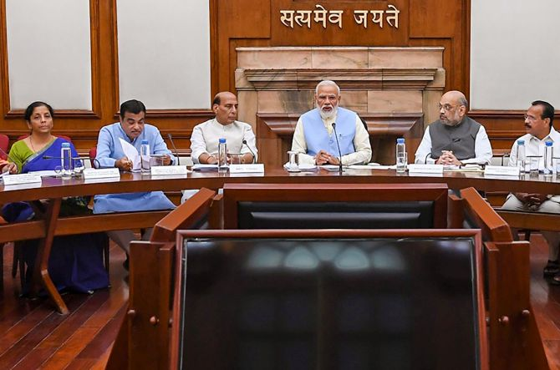

Slide 69
COMPOSITION OF THE COUNCIL OF MINISTERS
At the top of all these ministers stands the Prime Minister–the supreme governing authority of the country.
The council of ministers consists of three categories of ministers, namely,
CABINET MINISTERS : Head the important ministries of the Central government like home, defence, finance, external affairs and so forth. They are members of the cabinet, attend its meetings and play an important role in deciding policies.
MINISTERS OF STATE : The ministers of state can either be given independent charge of ministries/ departments or can be attached to cabinet ministers.
DEPUTY MINISTERS : They are not given independent charge of ministries/departments. They are attached to the cabinet ministers or ministers of state and assist them in their administrative, political, and parliamentary duties. They are not members of the cabinet and do not attend cabinet meetings.
PARLIAMENTARY SECRETARIES.:They are the members of the last category of the council of ministers (which is also known as the ‘ministry’). They have no department under their control. They are attached to the senior ministers and assist them in the discharge of their parliamentary duties.

Slide 70
CABINET:
It is the highest decision-making authority in our politico administrative system.
It is the chief policy formulating body of the Central government.
It is the supreme executive authority of the Central government.
It is chief coordinator of Central administration.
It is an advisory body to the president and its advice is binding on him.
It is the chief crisis manager and thus deals with all emergency situations.
It deals with all major legislative and financial matters.
It exercises control over higher appointments like constitutional authorities and senior secretariat administrators.
It deals with all foreign policies and foreign affairs.

Slide 71
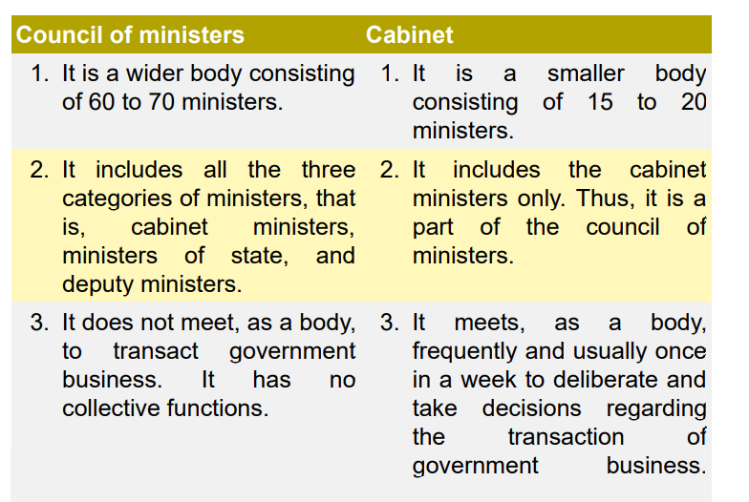
DISTINCTION BETWEEN COUNCIL OF MINISTERS AND CABINET

Slide 72
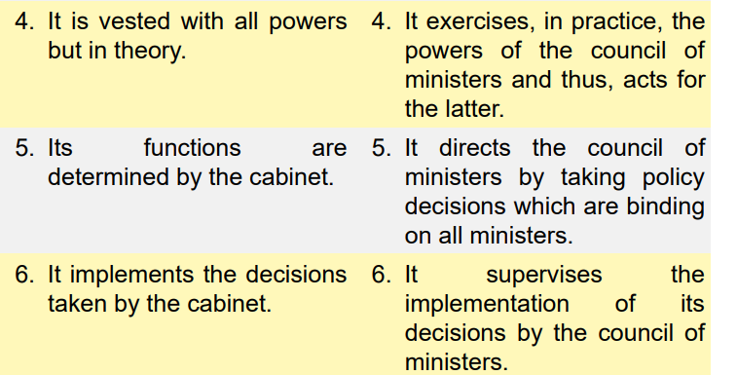

Slide 73
CENTRAL SECRETARIAT
Introduction: The Central Secretariat stands for the complex of departments or ministries
whose administrative heads are designated as Secretaries and whose political heads are ministers
Meaning: The Central Secretariat occupies a key position in Indian administration. The Secretariat refers to the conglomeration of various ministries/departments of the central government. The Secretariat works as a single unit with collective responsibility as in the case of the Council of Ministers
Role:
1.The Secretariat assists the ministers in the formulation of governmental policies. The Secretarial makes adequate data, precedents and other relevant information available to the minister, thus, enabling him to formulate policies.
2. The Secretariat assists the ministers in their legislative work too.
The Secretariat prepares legislative drafts to be introduced in the legislature.
3.It engages in the collection of relevant information for answering parliamentary questions. And, also, for various parliamentary committees.
4. It carries out detailed scrutiny of a problem bringing an overall comprehensive viewpoint on it

Slide 74
Functions as the main channel of communication between the government and other concerned agencies like the Planning Commission, Finance Commission, etc.
FUNCTIONS OF CENTRAL SECRETARIAT:
The Central Secretariat system in India is based on two principles:
The task of policy formulation needs to be separated from policy implementation.
Maintaining Cadre of Officers operating on the tenure system is a prerequisite to the working of the Secretariat system. The Central Secretariat is a policy-making body of the government and is not, to undertake work of execution unless necessitated by the lack of official agencies to perform certain tasks.
The Central Secretariat normally performs the following functions:
Assisting the minister in the discharge of his policymaking and parliamentary functions.
Framing legislation, rules, and principles of procedure.
Sectoral planning and program formulation.
a) Budgeting and control of expenditure in respect of activities of the ministry department.
b) Securing administrative and financial approval for the operational program and their subsequent modifications.
c) Supervision and control over the execution of policies and programs by the executive departments or semi-autonomous field once.
Assisting in increasing coordination at the Central level.

Slide 75
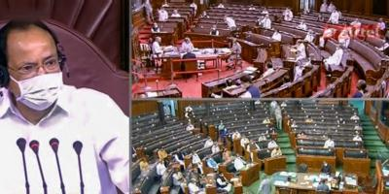
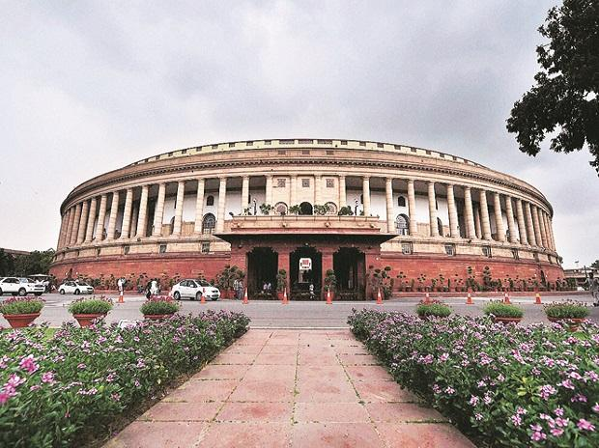
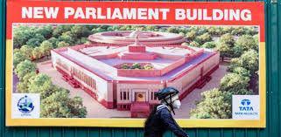

Slide 76
PARLIAMENT
ORGANISATION OF PARLIAMENT
Under the Constitution, the Parliament of India consists of three parts viz, the President, the Council of States and the House of the People. In 1954, the Hindi names ‘Rajya Sabha’ and ‘Lok Sabha’ were adopted by the Council of States and the House of People respectively.
The Rajya Sabha is the Upper House (Second Chamber or House of Elders)------------ the states and union territories of the Indian Union
Lok Sabha is the Lower House (First Chamber or Popular House)………………………. the people of India as a whole
A bill passed by both the Houses of Parliament cannot become law without the President’s assent.
Lok Sabha
Composition of Lok Sabha The maximum strength of the Lok Sabha is fixed at 552. Out of this, 530 members are to be the representatives of the states, 20 members are to be the representatives of the union territories and 2 members are to be nominated by the president from the AngloIndian community . At present, the Lok Sabha has 545 members. Of these, 530 members represent the states, 13 members represent the union territories and 2 Anglo-Indian members are nominated by the President .

Slide 77
Each Lok Sabha is formed for a five-year term, after which it is automatically dissolved, unless extended by a Proclamation of Emergency which may extend the term in one-year increments. The 17th Lok Sabha was formed in April 2019.
An exercise to redraw Lok Sabha constituencies' boundaries has been carried out by the Delimitation Commission based on the Indian census of 2001. This exercise, which was supposed to be carried out after every census, was suspended in 1976 following a constitutional amendment to avoid adverse effects of the family planning program which was being implemented

Slide 78
Membership qualifications
Membership of the Lok Sabha requires that the person must be a citizen of India, aged 25 or over, mentally sound, should not be bankrupt and has no criminal procedures against him/her. For reserved seats one should be member of the scheduled castes and/or tribes. Sessions and working hours
On normal business days, the Lok Sabha assembles from 11 a.m. to 1 p.m., and again from 2 p.m. to 6 p.m. The first hour of every sitting is called the Question Hour, during which questions posed by members may be assigned to specific government ministries, to be answered at a fixed date in the future.

Slide 79
The Lok Sabha shares legislative power with the Rajya Sabha, except in the area of Money Bills, in which case the Lok Sabha has the ultimate authority. In the case of money bill it is only sent to the rajya sabha for recommendations and in the case of other related issues it is sent with a period of 14 working days. If it is not returned in that span of time it is considered as passed. If conflicting legislation is enacted by the two Houses, a joint sitting is held to resolve the differences. In such a session, the members of the Lok Sabha would generally prevail, since the Lok Sabha includes more than twice as many members as the Rajya Sabha.
Three sessions of Lok Sabha take place in a year:
1. Budget session: February to May.
2. Monsoon session: July to September.
3. Winter session: November to December.
The sitting of a House may be terminated by (a) dissolution, (b) prorogation, or (c) adjournment

Slide 80
Rajya Sabha
The Rajya Sabha is the upper house of the Parliament of India. Membership is limited to 250 members, 12 of whom are chosen by the President of India for their expertise in specific fields of art, literature, science, and social services. These members are known as nominated members. The remainder of the body is elected by state and territorial legislatures. Terms of office are for six years, with one third of the members retiring every two years.

Slide 81
The Rajya Sabha meets in continuous session and, unlike the lower house of parliament, the Lok Sabha, is not subject to dissolution. The Rajya Sabha shares legislative powers with the Lok Sabha, except in the area of supply, where the Lok Sabha has overriding powers. In the case of conflicting legislation, a joint sitting of the two houses is held. However, since the Lok Sabha has more than twice as many members than the Rajya Sabha, it holds de facto veto power in such joint sessions. Only three joint session have been held. The last one was for the passage of the anti-terror law POTA.
.

Slide 82
The Vice-President of India is the ex-officio Chairman of the Rajya Sabha. The Deputy Chairman of the Rajya Sabha, who is elected from amongst its members, takes care of the day-to-day matters of the house in the absence of the Chairman.
The Rajya Sabha held its first sitting on 13 May 1952.
There are 238 indirectly-elected members, who represent the 28 states and 2 Union Territories (Delhi and Puducherry), including the National Capital territory, New Delhi. Seats are allotted in proportion to population

Slide 83
Nominated Members
Under article 80 of the Constitution, out of the 250 members of the Council of States (Rajya Sabha), 12 are nominated by the President of India from amongst persons who have special knowledge or practical experience in the fields such as literature, science, art or social service.
Since its inception in 1952, 105 members have been nominated so far, for a term of 6-year each, and with an added provision that one-third of the members shall retire every two years

Slide 84
Officers of Parliament
89. The Chairman and Deputy Chairman of the Council of States.—
(1) The Vice- President of India shall be ex officio Chairman of the Council of States
(2) The Council of States shall, as soon as may be, choose a member of the Council to be Deputy Chairman thereof and, so often as the office of Deputy Chairman becomes vacant, the Council shall choose another member to be Deputy Chairman thereof.

Slide 85
90. Vacation and resignation of, and removal from, the office of Deputy Chairman.—
A member holding office as Deputy Chairman of the Council of States—
(a) shall vacate his office if he ceases to be a member of the Council;
(b) may at any time, by writing under his hand addressed to the Chairman, resign his office; and
(c) may be removed from his office by a resolution of the Council passed by a majority of all the then members of the Council:
Provided that no resolution for the purpose of clause (c) shall be moved unless at least fourteen days‘ notice has been given of the intention to move the resolution.

Slide 86
91. Power of the Deputy Chairman or other person to perform the duties of the office of, or to act as, Chairman.—
(1)While the office of Chairman is vacant, or during any period when the Vice-President is acting as, or discharging the functions of, President, the duties of the office shall be performed by the Deputy Chairman, or, if the office of Deputy Chairman is also vacant, by such member of the Council of States as the President may appoint for the purpose.
(2) During the absence of the Chairman from any sitting of the Council of States the Deputy Chairman, or, if he is also absent, such person as may be determined by the rules of procedure of the Council, or, if no such person is present, such other person as may be determined by the Council, shall act as Chairman.

Slide 87
92. The Chairman or the Deputy Chairman not to preside while a resolution for his removal from office is under consideration.—
(1) At any sitting of the Council of States, while any resolution for the removal of the Vice-President from his office is under consideration, the Chairman, or while any resolution for the removal of the Deputy Chairman from his office is under consideration, the Deputy Chairman, shall not, though he is present, preside, and the provisions of clause (2) of article 91 shall apply in relation to every such sitting as they apply in relation to a sitting from which the Chairman, or, as the case may be, the Deputy Chairman, is absent.
(2) The Chairman shall have the right to speak in, and otherwise to take part in the proceedings of, the Council of States while any resolution for the removal of the Vice -President from his office is under consideration in the Council, but, notwithstanding anything in article 100, shall not be entitled to vote at all on such resolution or on any other matter during such proceedings.

Slide 88
93. The Speaker and Deputy Speaker of the House of the People.—
The House of the People shall, as soon as may be, choose two members of the House to be respectively Speaker and Deputy Speaker thereof and, so often as the office of Speaker or Deputy Speaker becomes vacant, the House shall choose another member to be Speaker or Deputy Speaker, as the case may be.

Slide 89
94. Vacation and resignation of, and removal from, the offices of Speaker and Deputy Speaker.—
A member holding office as Speaker or Deputy Speaker of the House of the People—
(a) shall vacate his office if he ceases to be a member of the House of the People;
(b) may at any time, by writing under his hand addressed, if such member is the Speaker, to the Deputy Speaker, and if such member is the Deputy Speaker, to the Speaker, resign his office; and
(c) may be removed from his office by a resolution of the House of the People passed by a majority of all the then members of the House:

Slide 90
Provided that no resolution for the purpose of clause (c) shall be moved unless at least fourteen days‘ notice has been given of the intention to move the resolution:
Provided further that, whenever the House of the People is dissolved, the Speaker shall not vacate his office until immediately before the first meeting of the House of the People after the dissolution.

Slide 91
95. Power of the Deputy Speaker or other person to perform the duties of the office of, or to act as, Speaker.—
(1) While the office of Speaker is vacant, the duties of the office shall be performed by the Deputy Speaker or, if the office of Deputy Speaker is also vacant, by such member of the House of the People as the President may appoint for the purpose.
(2) During the absence of the Speaker from any sitting of the House of the People the Deputy Speaker or, if he is also absent, such person as may be determined by the rules of procedure of the House, or, if no such person is present, such other person as may be determined by the House, shall act as Speaker.

Slide 92
96. The Speaker or the Deputy Speaker not to preside while a resolution for his removal from office is under consideration.—
(1) At any sitting of the House of the People, while any resolution for the removal of the Speaker from his office is under consideration, the Speaker, or while any resolution for the removal of the Deputy Speaker from his office is under consideration, the Deputy Speaker, shall not, though he is present, preside, and the provisions of clause (2) of article 95 shall apply in relation to every such sitting as they apply in relation to a sitting from which the Speaker, or, as the case may be, the Deputy Speaker, is absent.

Slide 93
(2) The Speaker shall have the right to speak in, and otherwise to take part in the proceedings of, the House of the People while any resolution for his removal from office is under consideration in the House and shall, notwithstanding anything in article 100, be entitled to vote only in the first instance on such resolution or on any other matter during such proceedings but not in the case of an equality of votes.

Slide 94
97. Salaries and allowances of the Chairman and Deputy Chairman and the Speaker and Deputy Speaker.—
There shall be paid to the Chairman and the Deputy Chairman of the Council of States, and to the Speaker and the Deputy Speaker of the House of the People, such salaries and allowances as may be respectively fixed by Parliament by law and, until provision in that behalf is so made, such salaries and allowances as are specified in the Second Schedule.

Slide 95
98. Secretariat of Parliament.—
(1) Each House of Parliament shall have a separate secretarial staff:
Provided that nothing in this clause shall be construed as preventing the creation of posts common to both Houses of Parliament.
(2) Parliament may by law regulate the recruitment, and the conditions of service of persons appointed, to the secretarial staff of either House of Parliament.
(3) Until provision is made by Parliament under clause (2), the President may, after consultation with the Speaker of the House of the People or the Chairman of the Council of States, as the case may be, make rules regulating the recruitment, and the conditions of service of persons appointed, to the secretarial staff of the House of the People or the Council of States, and any rules so made shall have effect subject to the provisions of any law made under the said clause.

